Slide 1



Classroom Strategies
for Students
with FASD
What is Fetal Alcohol Spectrum Disorder?
Learn More
Notes:
Revised: September, 2022

Slide 2
Land
Acknowledgements
2
Notes:
Please find and include the appropriate land acknowledgement for the land you will be giving your presentation from (which may change between presentations depending on your location).
If you are unsure, https://native-land.ca/ is a resource that can tell you what territory you are on.

Slide 3
Presenter Introduction
Your Name
& Pronouns
Space to include a fun fact
Your Network
Email@emailaddress.com

Slide 4
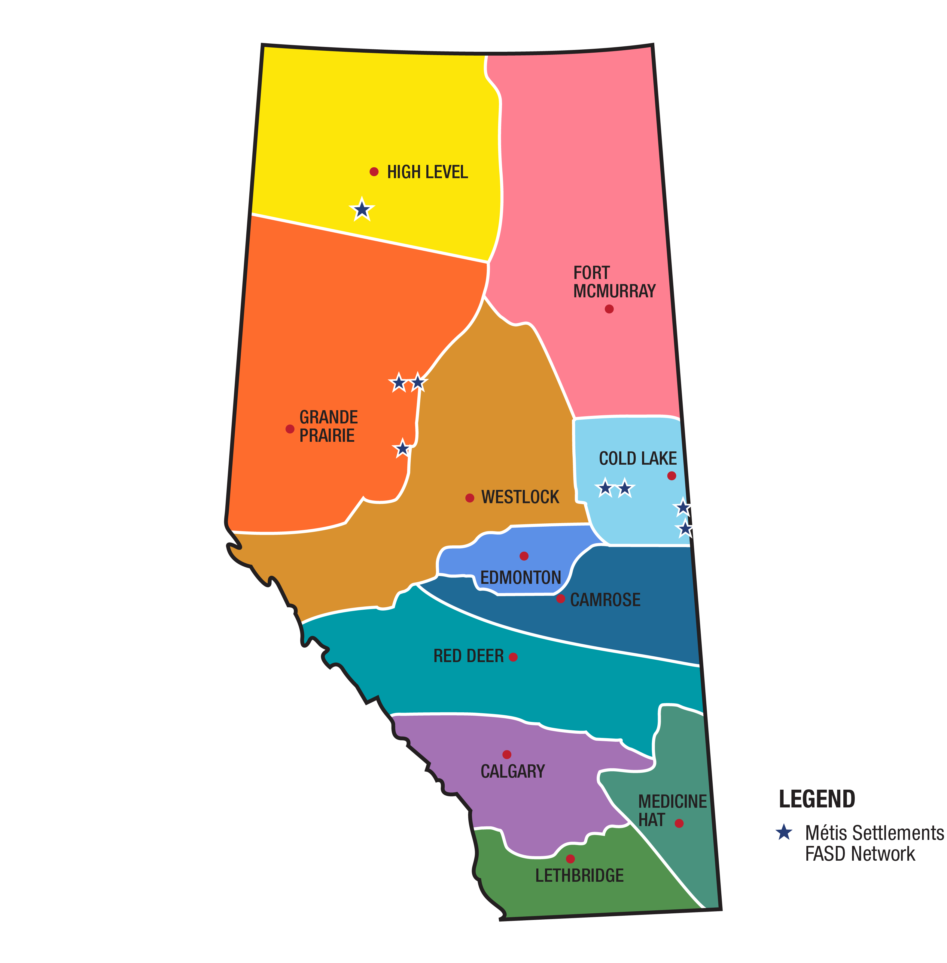
FASD Networks
In Alberta
www.FASDAlberta.ca
Notes:
A key innovation of Alberta’s response to FASD was the development and continued funding of 12 regionally based civil society FASD Service Networks, which have become the cornerstone for the delivery of FASD awareness, prevention, assessment and diagnosis, and supports for individuals with FASD, their families, and caregivers across the province.
In alignment with the strategic direction provided by the Government of Alberta, the FASD Service Networks build capacity in communities by enhancing existing services and by fostering the development of new ones.
The community-led FASD Service Networks have each designed a model of service delivery to meet the unique needs in their region.
The WRaP 2.0 project is implemented by the FASD Networks.

Slide 5
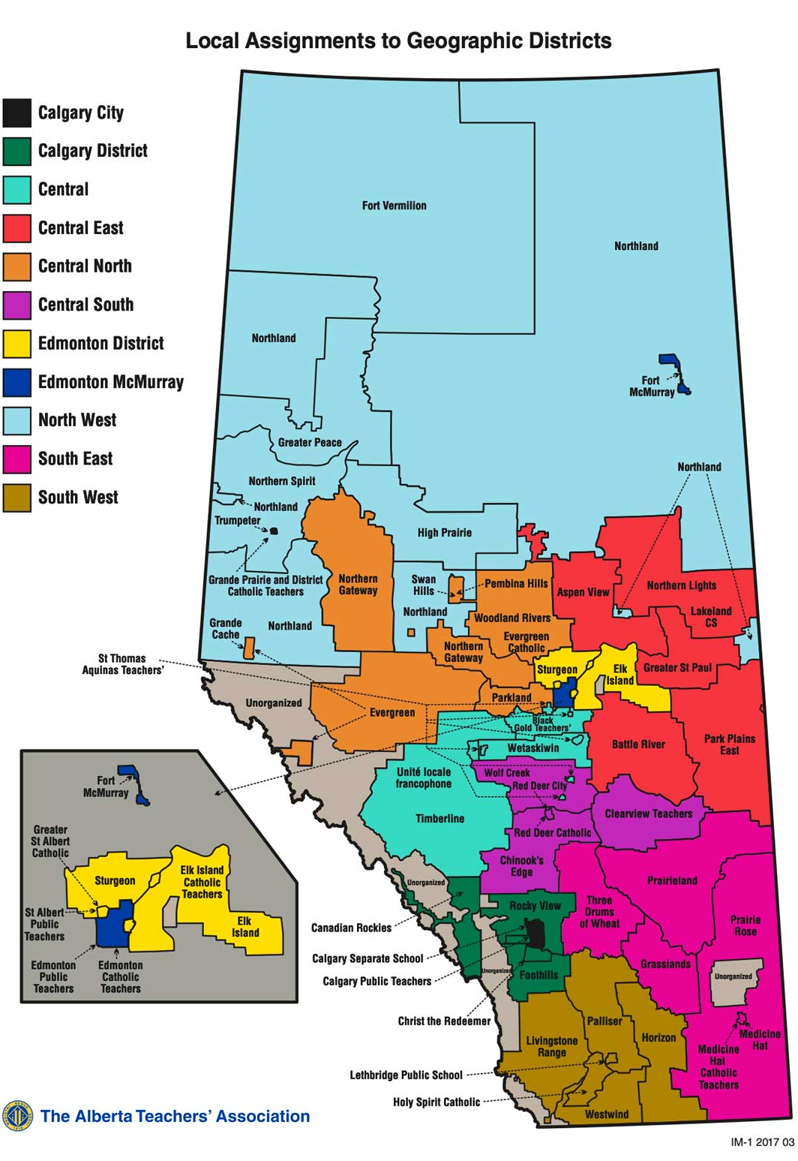
ATA Locals Map
View interactive map Local Assignments to Geographic Districts
Notes:
https://www.teachers.ab.ca/SiteCollectionDocuments/ATA/For%20Members/ATA%20Locals/IM-1%202017%2003%2011x17%20Colour.pdf
The WRaP 2.0 project is a five-year project, from development to implementation to exit strategy and it began February 1, 2021 and will run until everything is finalized by January 31, 2026.
It is province-wide and focuses on building the knowledge and capacity of educators to better support students with FASD.
The objectives of the project include:
•Increase the capacity of teachers and schools to meet the educational needs of children and youth (ECS :Early Childhood Services: education programs that are offered by a school authority to Grade 12) with FASD
•Teachers and school leaders will increase their knowledge and skills regarding how to support students with FASD by engaging in current best practices as shared by the FASD Networks through FASD instructional coaches.
•Schools will enhance their capacity by incorporating FASD-informed approaches into their classroom communities, as part of a continuum of supports and services.

Slide 6
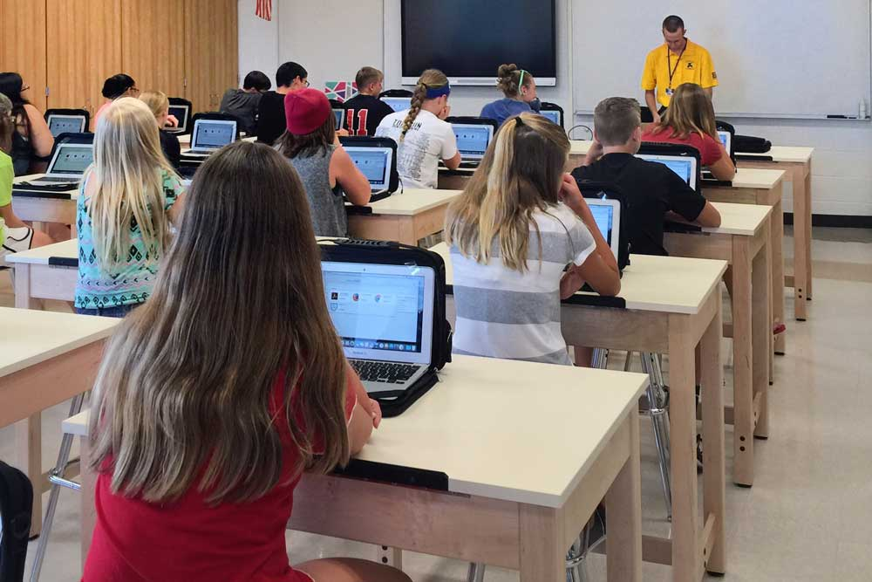
Introduction
This presentation will cover strategies you can use to support students with FASD to succeed in the school environment.
6

Slide 7
01
Overview of FASD
02
Building Inclusive Schools
03
Implementing Interventions
04
Understanding FASD and Self-Regulation
Content
05
Managing Sensory Processing Needs
06
Accommodations
07
Targeted vs. Universal Approaches
08
Strategies Outside the Classroom
09
FASD Programs in Schools
10
Educator Self-Care
11
Review
Notes:
Overview of FASD
Building Inclusive Schools
Implementing Interventions
Understanding FASD and Self-Regulation
Managing Sensory Processing Needs
Accommodations
Targeted vs. Universal Approaches
Strategies Outside the Classroom
Examples of FASD Programs in Schools
Educator Self-Care

Slide 8

SECTION 1
Overview
of FASD
TOPICS:
Prevalence
Definition
Language Matter
FASD and the Brain
Signs and Symptoms
Protective Factors
8
Notes:
This presentation assumes you already went through a detailed overview of FASD with this audience using Presentation 1 - Foundations in FASD. This section just provides a refresher on the key elements covered in Presentation 1. You can supplement this section with additional slides and materials from Presentation 1 as needed.

Slide 9

Prevalence
1.5 million
people in Canada
174,000
4%
people in Alberta
of people
in Canada
1 in 25
people in Canada
Notes:
FASD stands for Fetal Alcohol Spectrum Disorder
It is one of the most common neurodevelopmental disabilities in Canada, impacting 4% of the population or 1.5 million people.
More people have FASD in Canada than autism, cerebral palsy, or Down syndrome all combined.
Researchers estimate that at least 4% of people in Canada have FASD.
That translates to:
1.5 million people in Canada
174,000 people in Alberta
1 in 25 people
This means about one student in every classroom may have FASD.

Slide 10

Definition
“
Fetal Alcohol Spectrum Disorder (FASD) is a diagnostic term used to describe impacts on the brain and body of individuals prenatally exposed to alcohol.
FASD is a lifelong disability. Individuals with FASD will experience some degree of challenges in their daily living, and need support with motor skills, physical health, learning, memory, attention, communication, emotional regulation, and social skills to reach their full potential.
Each individual with FASD is unique and has areas of both strengths and challenges.
”
Notes:
This is the standard definition of FASD, developed by the Canada Fetal Alcohol Spectrum Disorder Research Network, or CanFASD. CanFASD strongly recommends that professionals adopt this definition in their practice because it can:
Reduce stigma
Increase everyone’s understanding of FASD
Reduce confusion about the disability
Improve consistency in how we talk about this disorder
Help us to focus on a more strengths-based approach
For conversations about FASD in more informal settings, a community definition was also developed:
“FASD is a lifelong disability that affects the brain and body of people who were exposed to alcohol in the womb. Each person with FASD has both strengths and challenges and will need special supports to help them succeed with many different parts of their daily lives.”

Slide 11
Possible Diagnoses
01
02
At-risk for neurodevelopmental disorder and FASD associated with PAE
FASD with sentinel facial features
FASD without sentinel facial features
Diagnosis
Designation
Notes:
Prior to 2015, individuals could be diagnosed with Fetal Alcohol Syndrome (FAS), partial FAS (pFAS), or Alcohol-Related Neurodevelopmental Disorder (ARND).
The process for FASD assessment and diagnosis in Canada was most recently updated in 2015. There are 2 possible categories of FASD diagnosis:
FASD with sentinel facial features
FASD without sentinel facial features
FASD with or without sentinel facial features replaced FAS, pFAS, and ARND, which are no longer used as diagnostic terms.
An individual may also be given the designation of “At risk for neurodevelopmental disorder and FASD, associated with PAE” which is not a diagnosis, but means that the person is experiencing significant challenges that may eventually lead to a diagnosis.
In Canada, we use FASD as the general term to cover anyone who meets criteria for diagnosis. The third “At-Risk” term is non-diagnostic, which means that the individual does not currently meet diagnostic criteria for FASD at the time of assessment but will require future follow-up and support.

Slide 12


Prenatally Exposed to Alcohol
Level 1
Raising public awareness
Levels of
FASD Prevention
Level 2
Opportunity for safe discussions
Level 3
Provision of supportive services
Level 4
Supporting new mothers
Notes:
FASD can occur when someone is “prenatally exposed to alcohol”. But just because someone drinks during pregnancy does not mean their child will have FASD. The science isn't clear about timing and amount of exposure, so experts recommend that no alcohol is safest during pregnancy, and if you're trying to get pregnant or are breastfeeding.
FASD is technically preventable, but FASD prevention is really complex. There are four levels of prevention that all must be considered in order to support healthy pregnancies.
This is background knowledge on FASD. You should consult resources on FASD prevention if you plan to present or develop teachings on sexual or reproductive health or substance use.

Slide 13

FASD is a Lifelong Disability
Notes:
“FASD is lifelong” so supports must be provided across the lifespan. An individual’s needs and strengths may change throughout their lives. Strategies will need to be constantly reviewed and revised as the individual grows and changes and throughout transition periods.

Slide 14







Common challenges might include:
Following or Participating in Conversations
Reading or Writing for Meaning
Learning and Memory
Being Impulsive, overwhelmed
Making Friends
Some Degree of Challenges
Understanding Abstract Concepts
Being Sensitive to Stimuli
Notes:
“Individuals with FASD will experience some degree of challenges in their daily living, and need support”. Possible areas that may be affected include: motor skills, physical health, learning, memory, attention, communication, emotional regulation, and social skills.
Some common challenges may include difficulty with:
Learning and memory (long term processing pace)
Following or participating in conversations
Reading or writing for meaning
Using and understanding expressive/receptive language
Understanding abstract concepts like time and money
Being impulsive, distracted, overwhelmed
Making friends
Being sensitive to sounds, visual stimuli, textures and smells
Educational strategies that rely on an assumption of “normal” functioning of these cognitive processes are likely to be less effective for students with FASD

Slide 15
















Each Individual with FASD is Unique
Notes:
“Each individual is unique and has areas of both strengths and challenges”.
When supporting students, you need to take into account their unique needs and strengths, as well as their unique environments and supports, in order to be effective in helping them succeed.
An educational approach that only takes into consideration their challenges won’t be effective because it doesn’t give the student the opportunity to identify and grow their strengths.

Slide 16
Language Matters
Instead of…
Use…
Suffering with, Damaged by, Living with
Person or Individual with FASD
Mentally Disabled
Cognitive or Neurodevelopmental Disability
FASD Student
Student with FASD
Alcoholics, Addicts, Women who choose to drink
Women Who Use Alcohol or Drugs
Admitted to Alcohol Use or Denied Alcohol Use
Reported Drinking Alcohol or Confirmed Alcohol Use
Notes:
FASD is a highly stigmatized and stereotyped disability. We want to make sure the language we’re using doesn’t perpetuate stigma for individuals with FASD, their families, and women who are pregnant and/or using substances.
The language we’re using should be:
strengths-based
person-first (unless their preference is otherwise identified)
evidence-based; and
dignity-promoting
For example:
Use person or individual with FASD instead of suffering with, damaged by, living with FASD
Use cognitive or neurodevelopmental disability instead of mentally disabled
Use student with FASD instead of FASD students
Use women who use alcohol or drugs instead of alcoholics, addicts, women who choose to drink
Use reported drinking alcohol or confirmed alcohol use instead of admitted to alcohol use or denied alcohol use

Slide 17
Signs and Symptoms
vv
A
L
A
R
M
S
Reasoning
Adaptation
Sensory Processing Disorders
Attention
Language
Memory
Notes:
FASD often goes undiagnosed or misdiagnosed. Signs and symptoms are hard to recognize in babies and young children, so individuals with FASD often aren’t diagnosed until they are in school or teenagers. Many receive diagnosis in adulthood.
ALARMS is a tool that may help you identify a student with FASD in your classroom. ALARMS stands for Adaptation, Language, Attention, Reasoning, Memory, Sensory Processing Disorders:
Adaptation – students struggle getting started or stopping activities. At school this may look like trouble managing all the transitions happening throughout the day (i.e. moving from Math to art). Unsupervised time can also be really challenging for students with FASD because there is less structure and fewer rules to depend on.
Language – students with FASD are often gifted with expressive language but are challenged in the receptive language domain. This may make the child seem older than they are, but at the same point the child may have trouble understanding instructions or completing a task.
Attention – People with FASD often have a comorbid ADHD/ADD diagnosis. Paying attention to one task can be challenging.
Reasoning – Abstract concepts are challenging for people with FASD to understand. They often have trouble with math, science, and reading comprehension, and struggle to understand concepts like time and money.
Memory – People with FASD often have memory challenges and will experience gaps or holes in memory. They will often make the same mistakes again, or come back to school on Monday and can’t remember what they learned on Friday
Sensory Processing Disorders – people with FASD often struggle managing sensory input, organization, and output. They may be over or under stimulated in their environments. For some, they may experience sensory overloads, others may stay “tuned-out”
Remember: With this information, your role can be to identify students with possible PAE and follow school process to move towards diagnosis.

Slide 18






Several factors can protect individuals with FASD and result in more positive outcomes:
Stable and nurturing home environment
Basic needs met
Early and effective supports and services
No experience with violence or trauma
Protective Factors
Developmental disabilities services
Diagnosed and flagged before the age of 6
Notes:
There are several protective factors that can result in positive outcomes and enable potential success for individuals with FASD. These include:
Nurturing and stable home
Consistent home environment
Basic needs met
No experience with violence or trauma
Received developmental disability services
Diagnosed or flagged before the age of 6 years
Early and effective supports where needed
Ref: AFKA Understanding FASD half day PPT

Slide 19

SECTION 2
Building Inclusive Schools
TOPICS:
Principles of Inclusion
FASD-Informed Schools
Building Towards Inclusivity
Teams of Support
19

Slide 20

Education Act
Shared responsibility and requires collaboration, engagement and empowerment of all partners in the education system to ensure that all students achieve their potential.
Students are entitled to welcoming, caring, respectful and safe learning environments that respect diversity and nurture a sense of belonging and a positive sense of self.
An inclusive education system provides each student with the relevant learning opportunities and supports necessary to achieve success.
Notes:
Education is a shared responsibility and requires collaboration, engagement and empowerment of all partners in the education system to ensure that all students achieve their potential. Students are entitled to welcoming, caring, respectful and safe learning environments that respect diversity and nurture a sense of belonging and a positive sense of self. An inclusive education system provides each student with the relevant learning opportunities and supports necessary to achieve success.

Slide 21


Principles of Inclusion
Anticipate, value and support diversity and learner differences
High expectations for all learners
Understand learners’ strengths and needs
Remove barriers within learning environments
Build capacity
Collaborate for success
Notes:
There are six key principles guiding Alberta’s vision for an inclusive education system. These principles need to be built into policy, practices, and actions at every level.
Anticipate, value and support diversity and learner differences: Welcoming, caring, respectful and safe learning environments create a sense of belonging for all learners and their families.
High expectations for all learners: Creating a culture of high expectations begins with an accessible curriculum and meaningful and relevant learning experiences. Educators and families act on the idea that, with the right instructional supports, every learner can be successful. However, it is important to remember that these expectations should be based on the learner’s challenges, strengths, needs, and goals.
Understand learners’ strengths and needs: Meaningful data is gathered and shared at all levels of the system—by teachers, families, schools, school authorities and the Ministry—to understand and respond to the strengths and needs of individual learners.
Remove barriers within learning environments: All education partners work together to remove barriers within the learning environment so that all learners are successful and can participate in the school community.
Build capacity: Government, school and system leaders, teachers, education professionals, families and community partners have ongoing opportunities, relationships and resources that develop, strengthen and renew their understanding, skills and abilities to create flexible and responsive learning environments. Capacity building takes place at the personal, school and system levels.
Collaborate for success: All education stakeholders, including school and system staff, families, community partners, post-secondary institutions, teacher preparation programs and government are committed to collaboration to support the success of all learners.

Slide 22
System and structural
change for inclusion
Policy
Successful inclusion of learners with FASD
Curriculum design, decision making, and delivery
Knowledge
of FASD
Practice
Actions
Collaboration and communication
No blame,
no shame
Adapted from Achieving Inclusion for Students with FASD in Australian Schools
Notes:
A framework was developed in Australia to support inclusion at the policy, practice, and action levels. Key elements of the framework include:
Knowledge of FASD
Collaboration and communication
No blame, no shame

Slide 23

Case for a
Different Approach
Flexible, individual-based responses prove to be most effective approaches
Students with FASD and positive school experiences are less likely to develop adverse outcomes
Teachers often report that they lack the knowledge and training in FASD
Research has found that traditional approaches in classroom management can be unsuccessful in supporting the needs of students with FASD
Typical behavioural responses are not always interpreted appropriately by the individual with FASD
23
Notes:
FASD affects each person uniquely, so flexible, individualized approaches are needed for working with students with FASD;
Students with FASD and positive school experiences are less likely to develop adverse outcomes
Teachers often report that they lack the knowledge and training in FASD but are eager to provide improved support to their students
Traditional approaches in classroom management may not be effective in supporting the needs of students with FASD

Slide 24






Caregivers
FASD Informed Schools
Teachers & school boards
Knowledge of FASD among all education professionals and caregivers
Communities
Notes:
Inclusivity begins with a knowledge of FASD among all educational professionals. In a study of school Superintendents researchers found most lacked more than a cursory knowledge of FASD yet over 50% had to deliver on a disciplinary meeting (suspension, expulsion) of a student with FASD.
In an FASD intervention project in North-Western Ontario, researchers found a number of positive impacts when school boards, communities, and caregivers were trained on how to support children with FASD:
Caregivers realized they weren’t alone;
Teachers reported that being aware of FASD, having tracking mechanisms, and connecting with knowledgeable support people was very helpful; and
Teachers reported better mental health and well-being.

Slide 25

Three Areas of Focus
Understanding the whole student
Responding with dynamic environments
Optimizing student-centered programming
Notes:
Teachers have identified three important components of understanding FASD, and strategies for building this understanding:
Understanding the whole student
Take time to build and cultivate a relationship with the student
Focus on and emphasize the accomplishments over the challenging behaviours
Integrate choice with expectations
Responding within dynamic environments
Foster an inclusive atmosphere with student peers
Build the home-school relationships
Access individualized funding
Optimizing student-centered programming
Match supports with needs
Build on strengths
Address service gaps

Slide 26

Building Towards Inclusivity for FASD
Classroom inclusion becomes more challenging over time
Building inclusivity in schools requires us to adapt to the needs of the learner
Flexible and responsive learning environments that can adapt to the changing needs of learners
Notes:
Classroom inclusion may become more challenging over time. As children diagnosed with FASD transition to higher grades, their areas of need and challenges may become more obvious. All students experience challenges but students with FASD may experience challenges that isolate and differentiate them from their peers.
Building inclusivity for FASD in schools requires us to adapt to the needs of the learner. Every learner has unique needs. Some learners have profound and ongoing needs and others have short-term or situation-based needs. This calls for flexible and responsive learning environments that can adapt to the changing needs of learners.

Slide 27

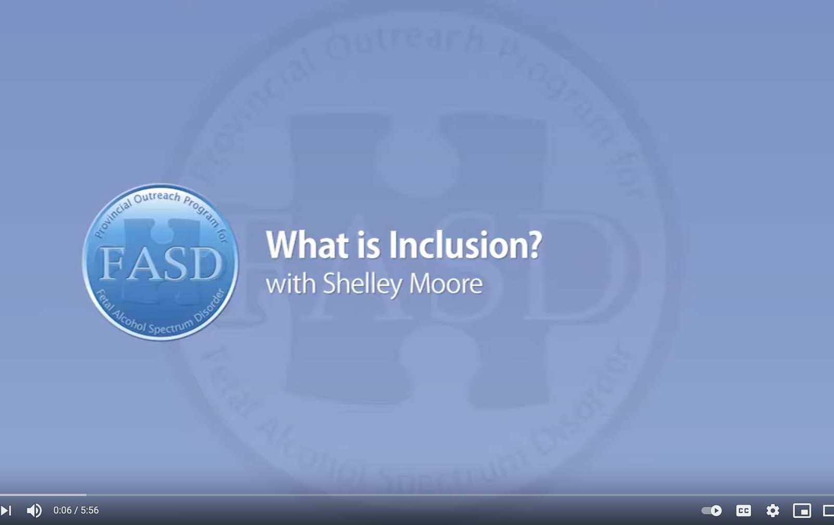
What is Inclusion?
with Shelley Moore
https://www.youtube.com/watch?v=D1fbTKYkU4k
Notes:
Consider this teacher’s experience trying to promote inclusion for her students in a space that wasn’t ideally structured for them: https://www.youtube.com/watch?v=D1fbTKYkU4k (5:56)

Slide 28

Belonging
6 elements to improve belonging:
Effective Listening
Supports
Positive Relationships
Early Programs
Common Interests
Extracurriculars
Notes:
A key element of inclusion is a sense of belonging. Students with FASD need a supportive school community that welcomes them, makes them feel safe, and makes them feel like a contributing member of the school.
In a study on student belonging in Quebec, researchers made six recommendations to improve feelings of belonging for students:
Training educators on effective listening strategies
Providing personal and academic supports for students
Encouraging positive social relationships
Ensuring early implementation of social competence programs
Providing education activities where students can develop common interests with peers
Encouraging extracurricular participation related to their various interests

Slide 29
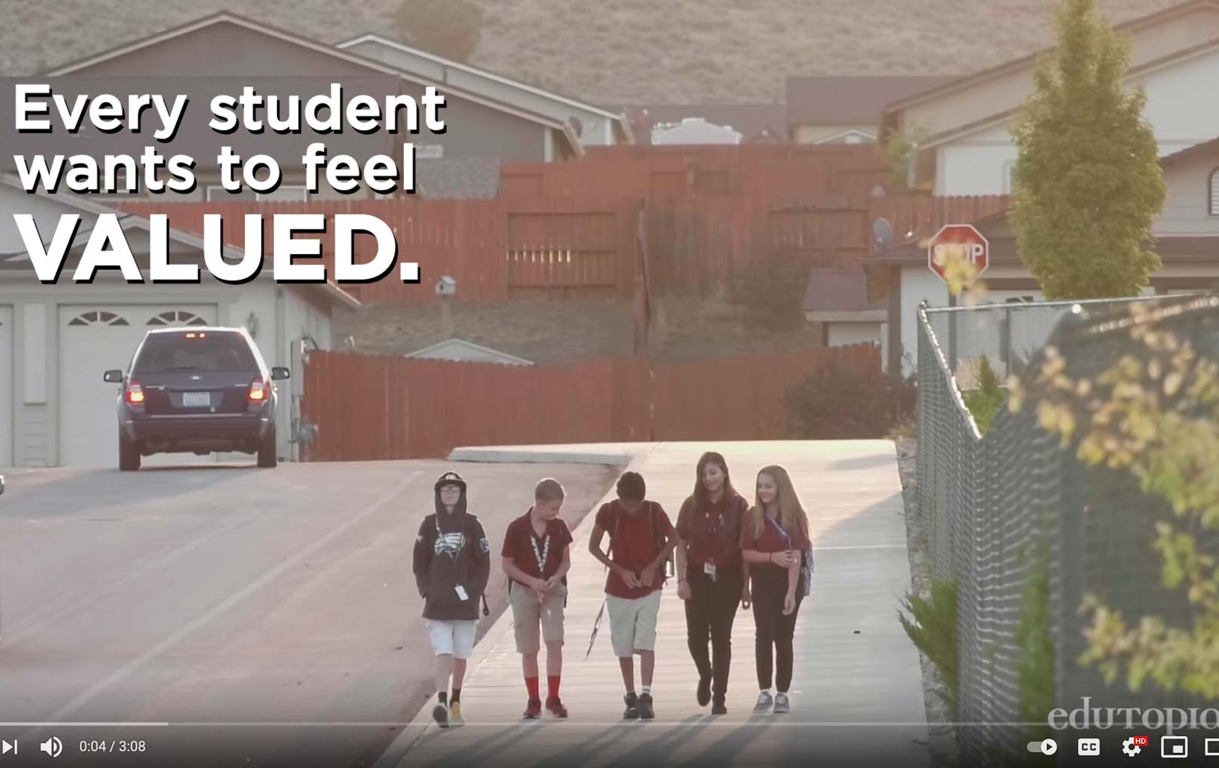
Making Sure Each Child is Known
by Edutopia
https://www.youtube.com/watch?v=xjZx0VdmgkE
Notes:
Consider this strategy implemented in a middle school in Nevada to ensure each student feels like they belong in their school: https://www.youtube.com/watch?v=xjZx0VdmgkE (3:08)

Slide 30

Teams of Support
Educational
Assistant
School Administrators
Teacher
Communication & Collaboration
Consistent Strategies
Outside Agencies
Continuing Education
Caregivers
Notes:
Building capacity and collaboration are key elements to achieving success. The student and educator both need a strong and supportive network. Key stakeholders and their roles in supportive school communities include:
School Administrators
Identify gaps and seeks resources
Promote reflective practice
Commit to inclusivity
Provide leadership with vision
Communicate actively with caregivers
Teachers
Communicate with team
Commit to reflective practice
Incorporate classroom strategies
Compassionately engage with child
Communicate actively with caregivers
Educational Assistants
Provide one-on-one support when needed
Guided or directed by the teacher
Help develop/evaluate strategies
Compassionately engage with child
Maintain a safe environment
Outside Agencies
FASD Assessment and Diagnostic Clinics
Help provide a greater understanding of the student’s needs
FASD Support Providers
Provide resources for training as well as services for students
Caregivers
The core and most consistent member of the student’s support network
Provide a vast diversity of information regarding the student’s strengths, needs, and desires
Serve as the foundation of a strong and supportive network
Other stakeholders may include: school-based counsellors, sports coaches, wellness coaches, inclusive education coordinators, and counselling support professionals. Schools may have centralized supports and services, so it is important to bring in staff that are knowledgeable about those types of programs in order to best support individuals.
Together, the whole team of support needs to have a shared understanding of FASD, shared understanding of each unique individual, and shared goals to support the student. Strategies for the support team include:
Using consistent strategies to support the student’s success.
Communicating and collaborating to decide on one strategy at a time to address a specific goal.
Developing a communications plan which outlines how the team can share information in a timely manner.

Slide 31

If Sarah didn’t eat her breakfast in the morning, Sarah’s caregivers need a way to communicate that with her teacher. That way, her teacher knows that Sarah’s routine was disrupted, and she may be dysregulated, which may lead to challenges in the classroom.
As a team, Sarah’s caregiver and teacher can decide on a strategy to mitigate concerns, like providing Sarah with a granola bar during her first lesson. It can be as simple as an email or a phone call, but communication is huge in helping achieve success for these students.
31
Tracy Masterangelo, Adapted from the Supporting Self-Regulation with Individuals with FASD Presentation
Notes:
Tracy Masterangelo, Adapted from the Supporting Self-Regulation with Individuals with FASD Presentation

Slide 32
Working with Caregivers
Possible Stages
Seeking Diagnosis
Seeking Support
Educator, Advocate
1
2
3
4
5
Coming to Terms
New Understanding
Notes:
Caregivers of individuals with FASD often juggle multiple roles. They are their child’s primary provider, but often also take the role of advocate to raise awareness of FASD and secure supports for their children. Unlike most other support workers, a caregiver is a 24/7 occupation.
Caregivers of individuals with FASD report high levels of stress, even in comparison with caregivers of individuals with other developmental disabilities.
Caregivers may move through several stages in the process of receiving a diagnosis:
Seeking and possibly receiving a diagnosis
Processing emotions and coming to terms with the child’s difficulties
Seeking support and belonging within a knowledgeable community
Developing a new understanding of the child’s behaviour
Becoming an educator, advocate, and expert on the child and FASD

Slide 33

Caregiver Needs and Educator Responses
Caregiver needs:
  Being Heard by Educators
  Openness from Educators
  FASD-Informed Educators
  Involvement in Child’s Education
  Resources and Accommodations
  Supportive Knowledge Base
  Support and Understanding at Home
Notes:
Caregiver needs might include:
Being Heard by Educators
Openness from educators when communicating
FASD-Informed Educators
Educators who understand and are willing to meet the complex needs of students with FASD
Involvement in their Child’s Education
Active involvement in their child’s education to ensure proper fit
Resources and Accommodations
Practical resources that address their child’s complex needs
Supportive Knowledge Base
Gaining knowledge about FASD and to develop effective supports
Support and Understanding at Home
Develop successful parenting techniques for their child
Possible educator responses
Encourage parents to have a structured, consistent, predictable home environment
Share strategies and tips that have worked for other parents
Discuss the role of rules and expectations in the classroom
Explain how they create routines that increase compliance and self-management, both at home and school
Consider the concerns identified by caregivers and if this is something that the school can address. Offer caregivers online and video resources that address concerns
Facilitate ongoing, open communication between home and school. This can be accomplished through weekly phone calls or using a communication book between home and school
Encourage parents to get accurate information about FASD from libraries, hotlines, community agencies or other sources
Encourage parents to talk to other families in the community who have children with special needs
Provide parents with information regarding network organizations with support groups in the community
Acknowledge and understand the difficult role of parents of children with special needs and support parents in this role
Assist parents in helping children develop appropriate social networks

Slide 34

Intentional practices require
Constant Education
Shared learning within the student’s entire support system will enhance education outcomes.
Notes:
Intervention research is relatively new in the FASD field, but cognitive (self-regulation, memory, attention), academic (math, language, literacy), behavioural, social skills, and caregiver programs and supports have been promising
By implementing interventions and/or supports we create opportunities for targeted skill growth and development, while also shifting environmental supports and expectations in order to optimize opportunity. The goal is to promote well-being and generate opportunities for meaningful success.
Remember: meaningful outcomes come from meaningful understandings. We have to understand both the needs and strengths of an individual in order to create helpful interventions.

Slide 35

SECTION 3
Implementing Interventions
TOPICS:
Principles of Practice
Understanding Behaviour
35

Slide 36
Interventions
Researchers have shown that interventions can improve cognitive (self-regulation, memory, attention), academic (math, language, literacy), behavioural, and social skills in individuals with FASD. Caregiver programs and supports also show promise.
Opportunities for skill growth
Meaningful success
Promote
well-being
Optimize opportunity
Implement Interventions
Notes:
Intervention research is relatively new in the FASD field, but cognitive (self-regulation, memory, attention), academic (math, language, literacy), behavioural, social skills, and caregiver programs and supports have been promising
By implementing interventions and/or supports we create opportunities for targeted skill growth and development, while also shifting environmental supports and expectations in order to optimize opportunity. The goal is to promote well-being and generate opportunities for meaningful success.
Remember: meaningful outcomes come from meaningful understandings. We have to understand both the needs and strengths of an individual in order to create helpful interventions.

Slide 37
Consistency
within a school
01
Principles
of Practice
Collaboration
Between schools and school staff
02
Responsiveness
Between school staff and an individual and their family
03
Proactivity
By school staff
04
Notes:
Four overarching principles of practice can be used as a helpful way to frame intervention approaches
1. Consistency – within a school requires:
Establishing a common understanding of FASD shared by all staff
Using common messages and approaches to providing services
Minimizing staff turnover and building relationships
Maintaining system structure and stability
2. Collaboration – between schools and school staff requires:
Integrated response systems at all organizational levels
Organizational support for complex case management
Intentional planning between types of services and levels of service delivery
3. Responsiveness – between school staff and an individual and their family requires:
Balance between dependence and independence
Expectations that are unique to individual strength, needs, and culture
Supportive and adaptive environments to facilitate skill development
4. Proactivity – by school staff requires:
Early intervention to develop positive behaviours
Consideration of individual control and success-focused trajectory
Planning for transition periods

Slide 38
Framework of Practice
Reconceptualizing practice as evolutionary
Developing alternative strategies
Intentional Actions
Learning about dynamic influences
Assimilate Ideas
Reflective Thinking
Notes:
These principles of practice underlie a framework of practice that drive classroom strategies for students with FASD.
Intentional Actions – Using actions based on the student’s needs, their environments, and necessary supports to achieve desired learning and developmental goals.
As a team, we really need to ensure the intervention is geared towards the individual student and make a whole team effort to implement that intervention to achieve a specific goal. ​
Reflective Thinking – Using evaluation, assessment, and explanations in reflection.
This means that after we implement an intervention, we come back and reflect on whether the intervention worked. If it didn't work, we scrap that intervention and move on. Failure is OK. Fail means our First Attempt In Learning. ​
Assimilation of Ideas – Using reflection to influence future decisions.
Reflecting on what's working can help us in choosing future goals and future interventions.
Resources:
Yang, L. & Tan, H. [yticornell]. (2018 May 22). We the People: Shifting Social Perception about Disability [Video]. YouTube. https://youtu.be/80ZReQd9EDk
https://www.researchgate.net/publication/280170816_Toward_Intentional_Reflective_and_Assimilative_Classroom_Practices_with_Students_with_FASD

Slide 39


Brain
Understanding
Behaviour
NOT
As educators, we know, particularly for our students with complex needs, behavior can become their primary means of communication. It is important to remember all behaviour serves a purpose.
Blame
Notes:
In order to implement interventions effectively, we need to shift our mindset around behaviour. As educators, we know, particularly for our students with complex needs, behavior can become their primary means of communication. It is important to remember all behaviour serves a purpose.
All behaviour is goal-oriented, meaning that is functional and serves a purpose.
It may be difficult to determine the “reasons” behind the challenging behaviour
Instead of focusing on the resistive behaviour, explore what the goal is, the obstructions and how to use their strengths to achieve the goal
When trying to understand the behaviours, consider alternative explanations
We need to shift our thinking towards a brain not blame mindset.

Slide 40

It may seem like they just can’t sit still but in reality they are overstimulated and overwhelmed
Provide opportunities to develop skills to better regulate emotions.
It may seem like a student is stealing when in reality they may have a lack of understanding of boundaries or ownership Provide opportunities to have ownership
Brain not Blame
It may seem like a student is deliberately lying, but they may be using storytelling to cover up memory problems.
Stay calm and ask more concrete questions to get to the “truth”
Notes:
It may seem like a student is stealing when in reality they may have a lack of understanding of boundaries or ownership. We can provide opportunities to have ownership.
It may seem like a student is deliberately lying, but they may be using storytelling to cover up memory problems. We can stay calm and ask more concrete questions to parse out the “truth”
It may seem like they just can’t sit still but in reality they are overstimulated and overwhelmed. We can provide opportunities to develop skills to better regulate emotions.

Slide 41

The Shift
From seeing child as:
To understanding child as:
Bad
Lazy
Lies
Doesn’t Try
Mean
Doesn’t Care, Shut Down
Refuses to Sit Still
Fussy, Demanding
Resisting
Trying to Make Me Mad
Trying to Get Attention
Acting Younger
Thief
Inappropriate
Not Trying to Get to the Obvious
Frustrated, Defended, Challenged
Tries Hard
Confabulates/Fills In
Exhausted or Can’t Start; Tired of Always Failing
Defensive, Hurt, Abused
Can’t Show Feelings
Overstimulated
Oversensitive
Doesn’t Get It
Can’t Remember
Needing Contact, Support
Being Younger
Doesn’t Understand Owners
May Not Understand Properties
Needing More Reteaching
Notes:
We need to shift how we see students with FASD from willful to identifying the behaviour you are seeing.

Slide 42

Personal and Professional Shift
Personal shift from:
To feelings of:
Hopelessness
Fear
Chaos, Confusion
Anger
Power Struggles
Frustration
Exhaustion
No Good Outcomes
Isolation
Hope
Understanding
Organization, Meaningfulness
Reframing Perceptions, Defusing
Working with, Rather than at
Trying Differently, Not Harder
Re-energized, New Options to Try
Seeing, Supporting Strengths
Networking, Collaboration
Notes:
Then we may also see a personal shift from feelings of:
Hopelessness to feelings of hope
Feelings of fear to feelings of understanding
Exhaustion to feelings energized and having new options to try
Using tools like:
Reframing perceptions, defusing anger
Working with rather than working at the student
Trying differently not trying harder
Seeing and supporting strengths
Networking and collaboration
And we will see a professional shift from traditional approaches with traditional interventions and consequences aimed at changing people to ourselves being able to recognize brain differences, prevent problems, develop effective strategies, and focus on changing environments.

Slide 43

Leveraging Strengths
Supporting Students
Unique Needs and Strengths
Unique Environment
Notes:
As we mentioned above, each individual with FASD is unique and will have their own strengths and challenges. Students with FASD are consistently underestimated because they often struggle in areas where ability is traditionally measured, like reading, spelling, and math. Being in an environment where strengths are celebrated can transform the learning experience.
Educators should recognize and celebrate these strengths of students with FASD and provide opportunities for learners to use and build on their strengths.

Slide 44






Personal Strengths
Caring with a strong sense of justice
Friendly and outgoing
Energetic
Helpful and keen to please
Non-judgemental
Good with younger children, the elderly, and/or animals
Notes:
For individuals with FASD, personal strengths may include:
Being helpful and keen to please​
Give them roles within the class which allow them to do this successfully​
Phrase tasks as a request, use suggestions or weighted choices, rather than phrasing it as a demand but ensure they have a clear understanding of their role and the task itself
Sometimes individuals with FASD can appear objectionable if they’re told to do something but will comply if asked for their cooperation instead​
Explain why the task is important rather than responding with “because I said so”
Being caring with a strong sense of justice​
They often want to help people who are upset or sad, especially if someone seems vulnerable​. Support them by:
Discussing socially appropriate ways to show care in different situations
Being non-judgemental​
They tend not to judge, reject, or bully those who do not fit the social norm​ and often choose friends who have complex needs of their own:
Support them in recognizing healthy friendships, strengthening them, and keeping them
Friendly and Outgoing​
They may be well known across the school community for their ability to speak to anyone and everyone​
Teach appropriate social skills, what information to share about ourselves, and what information to not​
Patient with and Interacts Well with Younger Children, the Elderly, and/or Animals​
Look for opportunities to work with younger children such as working with a school club or coaching a sports team​
Energetic​
They may be hands-on, concrete, active learners​. Support them by:
Provide movement-based learning tasks​
Ensure the task is simple, clearly explained, and finite

Slide 45





Learning Strengths
Hands on, concrete learner
Lateral thinkers with points of insight in certain areas
Athletic, sporty, creative, or musical
Persistent, determined, and hardworking
Excellent long term visual memories
Notes:
For individuals with FASD, learning strengths may include:
Hands-On, Concrete Learners​
They learn best when they can interact with actual object or items to help their learning​
Learners may need support to transfer learning from one context to another​
Lateral Thinkers with Points of Insight in Certain Areas​
Often have creative solutions or unusual insights​. Support them by:
Encouraging them to think about and explain their thinking (metacognitive strategies)​
Praise their insights​
Athletic, Sporty, Creative, or Musical​
Build opportunities for the learner to share their skills and possibly teach others​
Encourage social skills, body movements, creative skills and organisational skills
Persistent, Determined, and Hard-Working​
Their determination to keep trying can be a positive attribute if channelled correctly. Support them by:
Ensuring that the task is of the right level and length to be completed​
Giving clear visual indications of time remaining​
Strong Long Term Visual Memories​
People with FASD are often visual learners​. Support them by:
Breaking tasks into visual steps​
Allowing learners to record information in a way that suits their visual learning styles

Slide 46



Individualized Program Plans (IPPs)
Actively involve caregivers in the process
Actively involve students
(with FASD) in the process
46
Notes:
Individualized Program Plans (IPPs) are written commitments of intent by education teams to ensure appropriate planning for students with FASD or other special needs. An IPP is also known as Individualized Education Plans (IEP), Instructional Support Plan (ISP), or Positive Behaviour Support Plan (BSP/PBSP). They are working documents and records of student progress. IPPs are really important because they provide the opportunity to assess students’ unique needs and their skill levels and will establish realistic goals for the student that can promote academic and behavioral functioning. They begin with comprehensive assessment of the child in a variety of classroom settings.
School staff must use a collaborative, individualized, strength-based approach to develop an IPP. It is important to regularly review the plan to confirm it matches the assessment recommendations and changing needs of the student.
Actively involve caregivers in the IPP process.
Seek parent/caregiver input prior to IPP conferences, e.g., send home a form seeking information about their goals, their children’s preferences, etc.
Give parent/caregiver the opportunity to specify how they would like to be involved in their children’s education programs and keep them informed.
Assist parents/caregivers in preparing for IPP meetings.
Discuss a draft IPP and invite meaningful input from the parents/caregivers. Make changes and additions with their input. (Putting a signature on a finalized IPP with no opportunity for input may be discouraging to some parents/caregivers.)
Provide parents/caregivers with a copy of IPPs so they can support the goals at home.
Actively involve students in the IPP process, increasing participation as they mature.
Involve students in setting goals and evaluating progress to increase ownership and motivation, as appropriate.
Involve students in IPP conferences, as appropriate .
Support students in developing the skills and language to describe needs and seek support they need.
Help students develop self-advocacy skills.

Slide 47

SECTION 4
Understanding FASD and Self Regulation
TOPICS:
FASD and the Brain
Self-Regulation
47

Slide 48
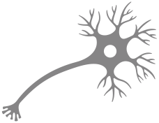

FASD and the Brain
Neuron
The brain begins as a tube (the brain stem)
Brain cells (neurons) grow from the brain stem in an upward and outward direction to build the brain
If alcohol is consumed during pregnancy, it may disrupt the growth and distribution of the neurons in a variety of ways, and may even kill some neurons
Brain Stem
Notes:
Alcohol is a teratogen, which is a substance that disturbs the development of an embryo or fetus
The brain begins as a tube (the brain stem). Brain cells (neurons) grow from the brain stem in an upward and outward direction to build the brain. Exposure to alcohol during pregnancy may disrupt the growth and distribution of the neurons in a variety of ways and may even kill some neurons. Alcohol impacts each developing brain different based on the timing and amount of alcohol consumed.
A developing fetus receives all nutrients and oxygen from what its mother eats and drinks. These nutrients travel through the placenta via the umbilical cord. A fetus’ system breaks down alcohol very slowly compared to adults. Exposure to alcohol can impact fetal brain and body development.
Understanding the function of different areas of the brain:
Amygdala – decision making; fight or flight or freeze response; area of the brain for perceived fear
Basal Ganglia – cognitive functioning; motor control; executive functioning
Caudate Nucleus – planning the execution of movement, but also learning, memory, reward, motivation, emotion
Cerebellum – motor control; motor learning
Corpus Collosum – connecting and processing between two sides of the brain; speed of processing
Frontal Lobe – high level executive functions; impulse control; planning; voluntary movement
Hippocampus – learning and memory and emotional regulation
Nucleus Accumbens – reward, pleasure, laughter, addiction, aggression, fear, and the placebo effect
Parietal Lobe – integrating sensory information; spatial awareness; mathematical ability; dypraxia

Slide 49

Brain Domains
Motor Skills
Brain Structure and Functioning
Cognitive
Language
Academic Achievement
Memory
Attention
Executive Functioning
Affect Regulation
Adaptive Behaviour, Social Skills
Notes:
When an individual is diagnosed with FASD a multidisciplinary team of experts will assess their function in 10 different brain domains:
Motor Skills​
Neuroanatomy/Neurophysiology (Brain Structure and Functioning)​
Cognition (Thinking and Reasoning)​
Language (Expressive and Receptive)​
Academic Achievement​
Memory​
Attention​
Executive Function, including impulse control​
Affect Regulation (Control Emotions)​
Adaptive Behaviour, Social Skills, or Social Communication​

Slide 50
Self-Regulation
Ability to
self-monitor
Control over thoughts, behaviours, emotions
Ability to manage or make sense of our environment
Manage impulses
Notes:
The brain-based differences of individuals with FASD can manifest in many different ways. One of the ways that it shows up in daily life is in difficulties with self-regulation. Self-regulation is our ability to regulate our thoughts, feelings, and behaviour in response to environmental demands. Self-regulation is an umbrella term and can relate to:
Our ability to self-monitor
Our control over our thoughts, behaviours, and our emotions
How we manage our impulses
How our sensory systems interact with our ability to manage or make sense of our environment
Individuals are dysregulated when they are unable to regulate their thoughts, feelings, and behaviour.

Slide 51




Self-Regulation and FASD
Challenges may include:
vv
Getting through tasks
Being flexible
Planning
Blocking out competing stimuli
Notes:
Individuals with FASD often struggle with self-regulation. These may include difficulties with:
Getting through a task
Being flexible
Planning through things
Blocking out environmental stimuli
(i.e. listening to the teacher at the front of the room as opposed to the buzzing of the overhead lights or the whispering kids behind me)
Developing self-regulations skills can help students identify their current state, talk about their thoughts and feelings, and find ways to better express, cope with, or mitigate their emotions or problematic behaviours when they start to feel frustrated or overwhelmed.

Slide 52

Strategies
to Support
Self-Regulation
Provide structure
Consider physical environments
Support social and environmental functioning
Provide guidance and support
Adjust teaching strategies
Notes:
There are many ways that an FASD-informed approach can be translated in the classroom. The strategies presented here are intended as broad suggestions to build on the more specific examples provided in Presentation 2. These are some strategies that can help address brain-based needs, including self-regulation, of students with FASD.
Provide Structure
Establishing clear and consistent routines
Be as consistent and immediate as possible in imposing consequences.
Remind students what the consequences are for, keeping in mind that they may not retain this information
Provide strategies for organization in the classroom.
For example, detailed daily schedules (visual or written depending on the ability of the student), help in organizing school supplies, desk, locker, breaking down a task or set of instructions into smaller, more easily attainable steps in written or pictorial form to ensure understanding and success
Consider Physical Environments
Opportunities to move for students who need extra stimulation (e.g., reading in a rocking chair)
Offer sensory stimulation options such as taping sandpaper to the underside of the desk or attaching a squeezing (and strength-increasing) ball to the desk
Arrange a quiet area to use when distractions are too great
Support Social and Environmental Functioning
Avoid physical contact, or ask before making contact
Explain social rules in concrete terms (e.g., “keep people at arm’s length”)
Identify a “signal” that the person can give when they’re feeling overwhelmed or frustrated
Try to learn about the individual’s “triggers” and be proactive in recognizing signs of escalation
Provide healthy outlets for expression (e.g., writing, art, listening to music, physical activity)
Allow a cooling down period in a safe, calming space in the classroom or at home, prior to debriefing with them.
Use a calm tone of voice and keep language simple and direct
Using fewer words and more visual cues or demonstration may be helpful; too much talking may be difficult for the student to process
Provide Guidance and Support
Ask students for feedback about helpful learning behaviour and not-so-helpful learning behaviours. For example, “what can we do to make this work?” and “if this was not helpful, why not?”
Teach students to use self-talk to help stay focused (e.g., “the first thing I have to do is…”) and curb impulsive behaviour (e.g. stop and think). Model this behaviour for students.
Employ metacognitive strategies (i.e. encouraging students to “think about their thinking”)
Help students to problem solve: “Where did the problem start?” “What did I do?” ”Who did I affect” “What else could I have done?” and “What else could I do next time?”
Write down what is said so that they can follow the conversation.
Social stories or cartoon captions work well
Anticipate and prevent problems through close supervision or partnering with peers (i.e. buddy system, peer tutor)
Adjust Teaching Strategies
Teach similar concepts across different contexts
Assess for comprehension and generalization of learning by having the student both tell and show what they understand
Promote learning by trying to make the material personally relevant to the student (make it interesting, important, or meaningful) and by implementing strategies for active learning (e.g. rather than simply reading over course material, having them teach it to someone else, or generate questions based on his reading, etc.)

Slide 53






Emotion Chart
Notes:
Another strategy that may help to build self-regulation is using an emotion chart to encourage students to identify their emotions. An emotion chart might be used by students to point to the emotion their starting to feel.
Be creative when developing your resources to make sure they work for your student. An emotion chart can be as simple as a 10 point “thermometer” check in where a 1 is regulated and a 10 is extremely dysregulated. Once a student can identify their emotions, you can begin to map them and start to recognize patterns and supports that help bring a student from a 7 to a 4, or from an angry face to a happy face.

Slide 54

SECTION 5
Managing Sensory Processing Needs
TOPICS:
Sensory Processing and FASD
Strategies
54

Slide 55







Sensory Processing and FASD
vv
Notes:
A student’s ability to self-regulate can be supported or aggravated by their sensory environment. Every moment of every day we are taking in information through our senses. Our brain processes sensory information and tells us to respond or to ignore it. Individuals with FASD who have sensory processing difficulties are often confused or overwhelmed by everyday sensory information. They may be under or over-responsiveness to input in any of the sensory systems (i.e. some may feel bombarded by sensory information while others might seek out intense sensory experiences).
Children with FASD often have difficulty thinking, planning, and making decisions when they are in emotionally aroused states. Sensory challenges can make it hard for students with FASD to regulate their behaviour and emotions. School classrooms are often overwhelming places for students with FASD. This can make learning more difficult because when students become overwhelmed by the environment, they may tune out, shut down, or act up.
If there are particular activities or parts of the school day that are difficult for a learner, consider whether this could be linked to sensory processing differences and how the environment could be adapted accordingly. For example, regular movement breaks, both planned and spontaneous, are an excellent strategy to promote regulation

Slide 56






Challenges of Sensory Processing
vv
Taste/Oral
Visual/Sight
Auditory/Hearing
Smell/Olfactory
Tactile/Touch
Sense of Body Position/Movement
Notes:
Some students with FASD may be oversensitive to sensory input, while some may be undersensitive. Some may be able to manage sensory input one day but may become distressed the next day.
Challenges with sensory processing can be highly variable from student to student, but some of the behaviours that might indicate sensory problems include:
You can choose some of these to present:
Taste/Oral
Fussy eater
Chews on clothing
Puts non-food items in their mouth
Overstuffs mouth with food
Smell/Olfactory
Strongly dislikes smells that are often undetectable by others
Tells other they smell bad
Refuses certain food because they “smell bad”
Visual/Sight
Easily upset in a busy place, such as a school hallway
Frequently can’t find their belongings
Frequently distracted, have trouble paying attention
Tactile/Touch
Over- or under-sensitive to touch
Bothered by tags on clothing
React strongly when touched, especially if it is unexpected
May not feel hot or cold
Constantly exploring their environment
Auditory/Hearing
Trouble screening out background environmental noise
Easily upset by noise from appliances
Covers their ears, react with anger, or bolt when they hear loud noises
Creates noise to drown out other upsetting noises
Misinterprets a regular speaking voice as yelling
Sense of body position/movement
Poor body awareness
May unintentionally enter other people’s personal space,
Becomes motion sick easily
Struggles with co-ordination, may be seen as clumsy
Has poor danger awareness
Has trouble with pressure and movement, may play rough, play destructively or break toys or other objects
It may be helpful to work with caregivers to make a sensory profile for your student with FASD. This profile could be used to advise school personnel about activities or resources that may help to meet the student’s sensory needs. The following slides are suggestions on how to support sensory processing skills in students with FASD.

Slide 57

“
Children with FASD may be under or over sensitive to their surroundings. They may not be able to communicate their responses to the environment clearly and directly, not having a language to say what’s different for them.
They will more likely communicate their response to their environment through their behaviours.... Behaviours often change as environments are modified....
- Diane V. Malbin
”
57
Notes:
What Educators Need to Know – Manitoba

Slide 58


“Grab your green science book in
5 minutes, when
the timer is done”
Reduced visual stimulation and clutter
Visual schedules for daily routine
Highly organized shelves and colour coded binders
Visual timers
Math
Visual
Strategies
Music
English
Science
Notes:
Children with FASD are often visual learners and possess visual processing strengths​. Teachers can use visual strategies to enhance comprehension and retention of learning​, and to support self-regulation. These strategies include:
Reduce visual stimulation and clutter​
Adjust the light coming into the classroom with removable sheets attached with Velcro or curtain rods​
Create visual schedules for daily routine
Have highly organized shelves and colour coded binders​
Use visual timers to help students prepare for transitions
We all use visual supports in our daily lives, are there some that you use that you can name?
Planners
Calendars
Phones
Stop signs
Exit Signs
Etc.

Slide 59












Visual Schedule (Elementary)
vv
Morning Routine
Playground
O’Canada
English
Recess
Snack
Music
Afternoon Routine
Lunch
Gym
Recess
Snack
Science
Home
Notes:
https://www.nhsaaa.net/media/8391/fasd_whateducatorsneedtoknow.pdf
Use the age group appropriate for the teachers you are presenting to

Slide 60










Visual Schedule (Highschool)
vv
Morning Routine
School Bus
Locker
Homeroom/English
Announcements
Math
Afternoon Routine
Lunch
Science
Gym
School Bus
Home
Notes:
https://www.nhsaaa.net/media/8391/fasd_whateducatorsneedtoknow.pdf
Use the age group appropriate for the teachers you are presenting to

Slide 61
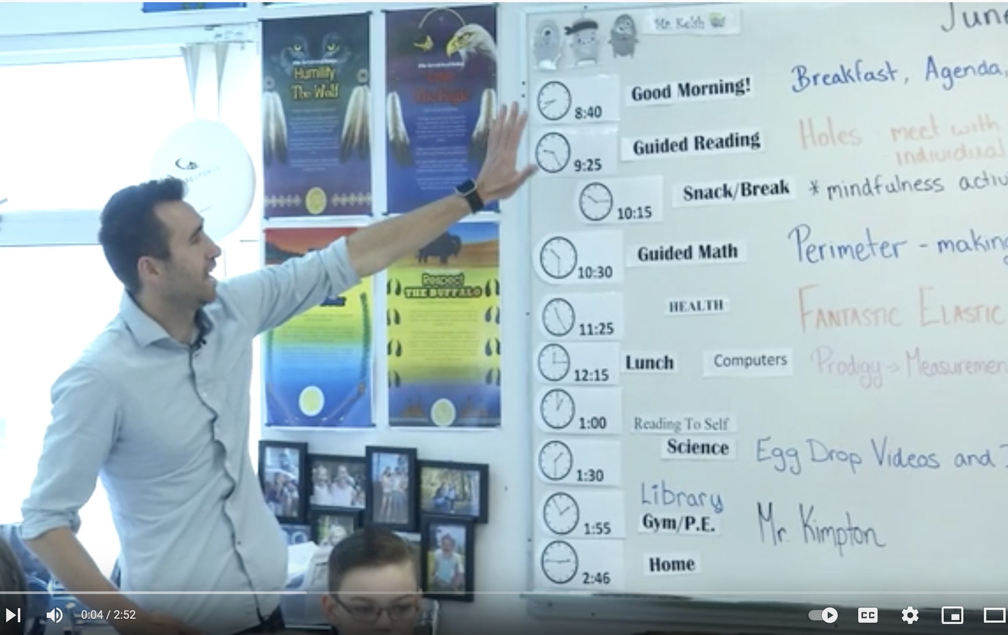
Teachable - Starting the Day: Agenda
by POPFASD
https://youtu.be/JDw8u46xDLA
Notes:
This video provides an example of how to clearly and effectively communicate the "shape" of a school day.
https://youtu.be/JDw8u46xDLA (2:52)

Slide 62

Colours in the Classroom
Bright colours can be distracting
Primary colours should be limited as visual/behaviour cues
Red = Stop
  Increases brain wave activity and stimulates release
  of adrenaline
Yellow = Slow
  Processed differently by children with a brain disorder
  and may trigger aggression and agitation
Green = Go
  Tends to reduce nervous system activity and muscular tension
  Should be used only if muted
Blue
  A cool colour that has a calming effect
Orange
  High appetite appeal
Notes:
Colours can be used in moderation in a classroom to help set your students up for success. Bright colours can be very distracting for students with FASD:
When decorating, avoid highly contrasting colours and brightness (primary colours – red, yellow, blue)
Use colours as visual/behaviour cues
Red = stop
Physiological effects on central nervous system
Increases brain wave activity and stimulates release of adrenaline
Yellow = Slow
Used in small quantities as a visual message for safety
Processed differently by children with a brain disorder and may trigger aggression and agitation
Green = Go
Cool colour that has the opposite effect of red
Tends to reduce nervous system activity and muscular tension
Should be used only if muted
Blue
A cool colour that has a calming effect
Good for spaces where a peaceful environment is desired
Orange
High appetite appeal
Good for eating areas in small amounts

Slide 63




Prepare for fire drills
Use soft, relaxing music
Limit intercom announcements
Use a sound field system
Auditory
Strategies
Use ear protectors or headphones
Notes:
As mentioned above, students with FASD may have trouble processing auditory information, which may make them unfocused, overloaded, or anxious. Strategies that address this may include:
Preparing ahead of time for fire drills
Use soft, relaxing music either for the whole class or provide the individual with earphones
Limiting intercom announcements to certain times of the day when possible
Use a sound field system to override background classroom sounds
Use ear protectors or headphones to filter out background noise, which may help the student concentrate
Use noise-reducing materials like carpets throughout the classroom where possible

Slide 64






Soft, Manipulative Handheld Objects
Stress Balls
Candy
Chewing Gum
Sucking on a Straw
Tactile
Strategies
Sandpaper
Notes:
As we mentioned above, students with FASD may be oversensitive or undersenstive to touch. Our mouth also plays a big part in our touch system, so strategies that focus on stimulating the mouth, like providing students with chewing gum, can help calm and organize the nervous system. Strategies include:
Stress balls
Soft, stretchy keychains
Other soft, manipulative handheld objects or fidget toys
Chewing gum
Sucking on a candy
Sucking on a straw or water bottle
Sandpaper on bottom of desk

Slide 65

Visual boundaries in hallway and locker area
Visual line using tape on the floor
Deep pressure touch
(i.e. back rubs)
Check with student and caregiver first
Sense of Body Position and Movement/Balance
Strategies
Incorporate movement breaks
into schedule
Notes:
Children with FASD often have difficulties with body awareness and body boundaries. They may also have difficulty adjusting their muscle movements appropriate to the task. Strategies include:
Visual boundaries in locker areas and hallways
Visual lines using tape on the floor
Incorporate movement breaks into schedule
Walks outside of the classroom, running errands for the teacher, recess, yoga, stretching, rocking, bouncing on therapy balls, swings, etc.
Slow repetitive movement can be calming

Slide 66

“
Instead of time out I use physical activities such as hopping on one spot or punching the punching bag. This is because kids with FASD cannot sit still for very long.
-Teacher
”
66
Notes:
What Educators Need to Know – Manitoba

Slide 67

SECTION 6
Accommodations
TOPICS:
Instructional
Assessment
Environmental
Transition
67
Notes:
You can implement instructional, assessment, environmental and transition accommodations to support students with FASD to succeed in school. When considering accommodations, you can refer to the UDL guidelines to provide multiple opportunities for engagement, representations, and action and expression.

Slide 68

Instructional Accommodations
Assessment Accommodations
Environmental Accommodations
Possible Classroom Accommodations
Transition Accommodations
Notes:
In addition to the individually directed strategies for supporting students with FASD, there are also accommodations that can be made in the classroom to help support regulation and learning. Classroom accommodations can be broken down into instructional, assessment, environmental, and transition accommodations.

Slide 69

Instructional Accommodations
Notes:
Instructional accommodations might include:
Ensuring visuals are clear and simple
Providing opportunities for multi-sensory learning
Maintaining a consistent routine
Providing extra time to finish tasks
Giving plenty of support and praise
Give a personal responsibility to the student
Encourage peer support particularly in unstructured environments.
Can you think of any other instructional accommodations that you could provide?

Slide 70

Assessment Accommodations
Notes:
Assessment accommodations might include:
Ensuring quiet environments
Alternative methods of assessment
Allowing students to use concrete and tactile manipulatives
Allowing regulation strategies and tools to be used during assessment time

Slide 71


Environmental Accommodations
Calming Spaces
Notes:
Environmental accommodations might look like developing calming spaces, a quiet, safe space for the student to self-regulate. Calming spaces should be non-threatening and non-punitive (i.e. it’s not a time-out) but should provide students with a personal space. It could be a study carrel or a different corner of the classroom. This may incorporate visuals or other reminders to show the student what the space is for, how it can be used, and how students should return to learning when they are ready to do so.

Slide 72





Environmental Accommodations
Body Position/Movement
Strategic Seating
Tactile
Auditory
Visual
Notes:
Other environmental accommodations might target specific areas of sensory processing, as discussed above:
Body position/Movement
Frequent, short exercise programs during the day
Personal space may need to be defined for all students
Use a pass key and signals for restroom, water, and body breaks
Tactile:
Use moderate temperatures in the classroom
Use strategic seating and minimize change.
Seating students with FASD at the front or back of the room may minimize distractions or anxiety
Horseshoe pattern may also be effective
Auditory
Use chair and desk mufflers on the legs to eliminate scratching and squeaking noises
Provide noise muffling headphones to help students focus
Visual
Reduce brightness in the room and on assistive technology
Use calm colours on walls and bulletin boards
Provide visual cues (i.e. list of jobs, schedule, classroom rules, timer as a visual reminder)
A calm learning environment, free from clutter and distractions as much as possible (i.e. cover up charts when not in use)

Slide 73





Transition Accommodations
01
Forewarn (or frontload)
02
Anticipate
03
State
04
Act
Notes:
Transitions are any events that result in changes to relationships, routines, expectations, or roles. Transitions occur naturally throughout our lifespan and can be small (like transitioning from one class to another) or big (like transitioning from high school into adulthood).
Transitions happen frequently at school. They may look like transitioning between activities, from classroom to classroom, or between subjects. Transition times are periods of change. Students with FASD often thrive on routine, so transitions may create opportunities for dysregulation to arise. Helping students build self-regulation strategies and providing them with sensory tools that they can turn to during these periods is important.
Transitions become more frequent, and potentially more difficult, as a student progresses through higher grades. Four tips to prepare students for these transitions on a daily basis:
Forewarn (or Frontload) - alert students a few minutes before an activity is over
Anticipate - restate the change, expect and plan for resistance, wait a few minutes
State - tell student exactly what action is required next. Use visual cues if possible.
Act - state the immediate action that is required.

Slide 74




Different Strategies for Different Ages
Strategies you use might look different depending on what stage of life they’re in
Elementary - Use alarm clocks to help recognize important times
vv
Junior High – a desktop computer with access to a calendar program
High School – try to schedule activities at the same time each week
Notes:
The strategies you use might look different depending on what stage of life the student is in:
For example, maintain structure and routine in a classroom could look like:
Elementary - Use alarm clocks to help recognize important times​
Junior high – Desktop computer with access to a calendar program​
High school - Try to schedule activities at the same time each week

Slide 75

SECTION 7
Targeted vs. Universal Approaches
TOPICS:
Universal Approaches
Targeted Approaches
Making Every Child Known (video)
75
Notes:
Strategies to address non-academic barriers and improve educational outcomes for people with FASD can often be broken down into two camps: universal approaches and targeted approaches.

Slide 76

Universal
Approaches
•Build relationships
•Tone of voice and language
•Check Ins with students
•Model responsiveness
•Repairing relationships
•Be predictable (routines)
Notes:
Universal approaches refer to the strategies that you can implement to support all students that will also be beneficial for students with FASD. These strategies include:
Building Relationships - Get to know each student better on a personal level, because connections can build to better learning.​
Ex. Conversations in hallways, thumbs up Thursday or feel good Friday where students get to share how they feel.
Greeting students by name entering the school
Ask about favourite foods or favorite sports teams & have conversations to help build connections
Implement the two-by-ten method to get to know students better and learn their interests
Spend 2 minutes a day for 10 days simply talking with a student about whatever they want to talk about. This helps build the relationship and develop trust.
Classroom circles
Be aware of your tone of voice (calming) and language (simple and concrete)
Implement check-ins with students to monitor their mood
Thermometer check-in
Help
student to self-identify dysregulation, and use a signal with their support team to communicate that they’re dysregulated
Model responsiveness
Repairing Relationships
If you have had a negative reaction with a student, focus on repairing the relationship and building back their trust before trying to resume teaching
Be Predictable
Create routines and structure for students

Slide 77
Making Sure Each Child is Known
by Edutopia
https://www.youtube.com/watch?v=xjZx0VdmgkE
Notes:
Consider this strategy implemented in a middle school in Nevada to ensure each student feels like they belong in their school: https://www.youtube.com/watch?v=xjZx0VdmgkE (3:08)

Slide 78

Targeted Approaches
For students where you’ve put in all universal approaches but you’re still seeing challenges
Notes:
Targeted approaches to break down non-academic barriers refer to the individual interventions you can implement when you have already applied the universal approaches, but you are still seeing challenges. Targeted interventions should be implemented in such a way that you make sure base needs are met first:
(Physical) Food, sleep, movement, mindfulness activities
(Sensory) change of lighting, change of location, opportunities for different smells, gum, fidgets, computer games

Slide 79

SECTION 8
Strategies Outside the Classroom
TOPICS:
Recess
Lunchroom
School Bus
Different School Stages and Needs
79

Slide 80



Strategies Outside the Classroom
vv
01
Recess
02
Lunchroom
03
School Bus
Notes:
Students with FASD may have difficulty adjusting to non-classroom school settings, such as the playground, school bus, or lunchroom. Success in these settings may require extra planning and supports. To work successfully with students with FASD, support personnel, such as bus drivers and lunchroom supervisors, may require extra training and coaching on FASD-informed practice.
What are some environments outside of the classroom where students may face challenges?

Slide 81

Recess
Review expectations and routines shortly before
Consider alternatives to recess
Special student buddy
Provide a clear but limited number of choices
Teacher aides to supervise a select group
Allow students with FASD to help supervise younger students during recess
Plan for emergency situations on the playground
Alternate recess time
Structure recess activities
Notes:
Review expectations and routines for recess shortly before recess.
Consider alternatives to recess, such as use of computer room, games room or the gym, but only with student buy-in (i.e., not as a form of punishment or isolation).
Find a student to act as a special buddy to the student with FASD during recess.
Have teacher aides supervise a select group of students on the playground, if necessary.
Allow students with FASD to help supervise younger students during recess.
Develop a plan for handling emergency situations that occur on the playground.
Consider an alternate recess time
Some students benefit from a recess with a small group rather than the entire school population.
Structure recess activities to avoid potential problems.
Arrange specific activities, teach games, assign equipment, designate areas for individuals to play.
Provide a clear but limited number of choices for activities

Slide 82

Lunchroom
Provide expectations and routines for lunchroom
Post lunchroom rules
Provide training to lunchroom supervisors
Assign seating with appropriate peers
Arrange activities to fill the lunch break
Consider an alternate lunch setting
Plan for emergency situations
Notes:
Provide information and training about lunchroom expectations and routines.
Teach a lunch-hour routine.
Post lunchroom rules in print and visual formats.
Provide training to lunchroom supervisors.
Assign seating with appropriate peers in the lunchroom.
Arrange activities to fill the lunch break such as videos, supervised gym activities or art projects.
Consider an alternate lunch setting for a small number of students.
Develop a plan with the school administration team for handling emergency situations.

Slide 83

School Bus
Provide the bus driver with strategies
Provide classroom and on-bus training to students
Use a bus seating plan
Post bus rules with visual prompts
Teach and reteach routines and expectations
Use social stories to prepare students for the bus ride
Provide the bus driver with a way to communicate concerns.
Provide extra supervision on the bus for students with severe difficulties, if necessary.
Notes:
Provide the bus driver with strategies for working with students who have FASD.
Provide classroom and on-bus training to students.
Teach and reteach routines and expectations.
Use a bus seating plan and place students who have FASD with appropriate peers.
Post bus rules with visual prompts.
Use social stories to prepare students for the bus ride.
Provide the bus driver with a way to communicate concerns.
Provide extra supervision on the bus for students with severe difficulties, if necessary.

Slide 84
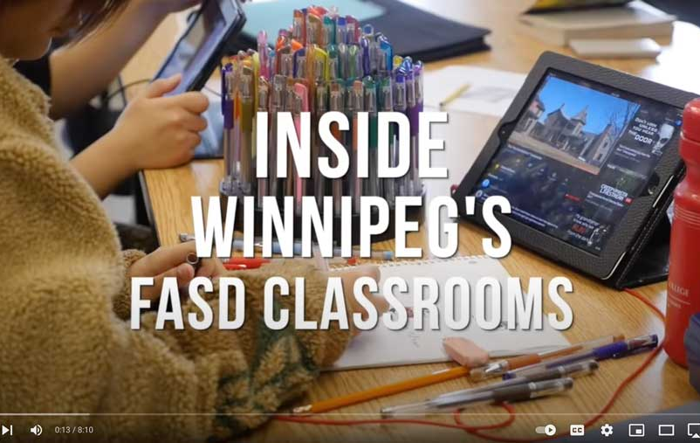
SECTION 9
Winnipeg
FASD
Schools
https://www.youtube.com/watch?v=HzgVZ1mcSio
Notes:
https://www.youtube.com/watch?v=HzgVZ1mcSio
Here are some examples of strategies and accommodations that schools in Winnipeg developed to support students with FASD:
Elementary​
Schools have developed a brain-based curriculum, similar to the Mind Up curriculum, focusing on the areas of the brain that may function differently, and they start teaching with this brain-based “model” as early as Grade 1. ​
Ex. Occupational therapist goes through large muscle skills (i.e. balancing, jumping, hand eye coordination) and then we teach the kids about that part of their brain (ex. where its located, what it’s called, what it does). And then they teach them calming strategies. The goal is they have strategies they can use in any environment​.
To the students, EAs and teachers are a full team​
Consistent routines throughout the day so the kids know what to expect​
Schedules up on the wall with pictures of activities for the day to prepare students for changes throughout the day. The pictures get flipped over after the activity is finished. ​
This school has created rooms in the school dedicated to different strategies:
Heart and Soul Room – intended for exercise. Students go there once a day, generally before lunch​
Calming room – essentially a room with cushions where kids can go when they’re upset and don’t need to ask permission​
They also integrate sensory tools throughout the school to support students through self-regulation.
Calming tools – classrooms have a basket full of calming tools that can pull from when they start to feel dysregulated (i.e. stuffed animals, glitter tubes, fidget toys, headphones)
Moving chairs – rockers or chairs with exercise balls to let them move throughout the day but still focus​
Headphones – each student in the classroom gets a headphone set for assemblies because clapping and noise can be overwhelming ​
High School ​
Low enrolment classrooms (10-12 students) ​
The students follow all the academic curriculums laid out for the province, the difference is pace and timing for students with FASD. ​If someone needs a full year to complete an English credit as opposed to 4 months, the school will make an accommodation.
Grade 9 students are coming into the school for the first time so they spend the first semester just getting to know the classroom. In the second semester they add in art or physical education classes. ​
Grade 10 students might be ready to be added or integrated into a math or science class.
Their strategy is heavily focused on building relationships between teachers and students. These relationships take time to build​ but are extremely beneficial.
There is also a major emphasis on communication, especially between home and school, which helps teachers not only build relationships with students but also with their families.
Finally, they prioritize helping students transition through school and then out of school and into adulthood

Slide 85

SECTION 10
Educator Self Care and Wellness
TOPICS:
Self-Care and Wellness
Compassion Fatigue
85

Slide 86

Self-Care
and Wellness
Key areas of consideration:
Meaning and Caring Burnout
Compassion Fatigue
Vicarious Trauma
Ambiguous Endings
Professional Uncertainty
You cannot take care of others until you take care of yourself
Notes:
Working with students with FASD can be challenging but very rewarding. Teachers with a strong understanding of FASD report less burnout and compassion fatigue.
However, it is important to recognize the signs of burnout.
Five areas for consideration:
Meaning and caring burnout
Compassion fatigue
Vicarious trauma
Ambiguous endings
Professional uncertainty
Remember: you cannot take care of others until you take care of yourself. Develop the self-care skills and strategies you need to maintain personal, familial, emotional, and spiritual needs.
Seek support from a professional if needed.

Slide 87

Compassion Fatigue
May look like:
Losing confidence that you can make a difference
Changes to your feelings of being safe
Personal relationships are affected
Your world view changes, you question your decision to be a teacher
Feelings of dependency
Isolating yourself and feeling overwhelmed
Notes:
Know the signs of compassion fatigue:
You begin to lose confidence that you can make a difference
You experience changes to your feelings of being safe
Your intimate personal relationships are affected
Your world view changes, you question your decision to be a teacher, and your ability to make a difference
Your experience changes to a feeling of dependency
You begin isolating yourself and feel overwhelmed

Slide 88

SECTION 11
Review
TOPICS:
FASD
Strategies
88

Slide 89

Foundations Review
FASD is a lifelong and complex disability
Each person is unique and has different strengths and challenges
Protective factors can reduce the risk of adverse outcomes
Inclusivity requires knowledge of FASD, communication and collaboration, and a ‘no blame, no shame’ approach
School staff should be
FASD-informed
Intentional action, reflective thinking, and assimilation of ideas
Notes:
Let’s review some of the key foundational pieces we learned in this presentation:
FASD is a lifelong and complex disability
Each person with FASD is unique and will have different strengths and challenges
Protective factors that can reduce the risk of adverse outcomes include having a stable and nurturing home, their basic needs met, no experience with trauma, early and effective supports, services for developmental disabilities, and early diagnosis
School staff should be FASD-informed, which requires a knowledge of FASD among all school staff and caregivers.
A framework for inclusion for students with FASD requires knowledge of FASD amongst all parties, communication and collaboration, and a no blame, no shame approach
In order to implement successful interventions, teams need intentional actions, reflective thinking, and assimilation of ideas
Understanding behaviour in the context of brain no blame and leveraging the students’ strengths is an important step in achieving success

Slide 90

Classroom Strategies Review
Instructional, assessment, environmental, and transition accommodations
Universal approaches are applied to all students and targeted approaches are applied to individuals
Self-regulation is how we regulate thoughts, feelings, and emotions
Strategies to support self-regulation
Visual, auditory, tactile, and body positioning strategies to address sensory processing
Understanding FASD can prevent burnout and compassion fatigue
Strategies can be applied outside the classroom
Notes:
Let’s review some of the key classroom strategies we learned in this presentation.
Students with FASD may struggle with self-regulation, which impacts their ability to regulate thoughts, feelings, and emotions in response to environmental stimuli.
Strategies to support self-regulation include providing structure, consider physical environments, support social and environmental functioning, provide guidance and support, and adjust teaching strategies.
School staff can use visual, auditory, tactile, and body positioning challenges to address sensory processing challenges that students with FASD may have
School staff can implement instructional, assessment, environmental, and transitional accommodations to support students with FASD in schools
Universal approaches are strategies that support all students and are also beneficial to students with FASD. Targeted approaches are strategies that you can implement for individuals when you’ve already applied universal approaches but you’re still seeing challenges.
These strategies can also be applied outside of the classroom at recess, in lunchrooms, and on the school bus
Understanding FASD can help prevent burnout and compassion fatigue but teachers should still pay attention to warning signs.

Slide 91

WRaP Blog
wrap2fasd.org
FASD Networks in Alberta
fasdalberta.ca
CanFASD
canfasd.ca

Slide 92

Break
Slide
Take a short break

