Slide 1



Foundations in FASD
Education Presentation
What is Fetal Alcohol Spectrum Disorder?
Learn More
Notes:
Edited: Fall/Winter 2025

Slide 2
Land
Acknowledgement
2
Notes:
Please find and include the appropriate land acknowledgement for the land you will be giving your presentation from (which may change between presentations depending on your location).
If you are unsure, https://native-land.ca/ is a resource that can tell you what territory you are on.

Slide 3
Presenter Introduction
Your Name
& Pronouns
Space to include a fun fact
Your Network
Email@emailaddress.com

Slide 4
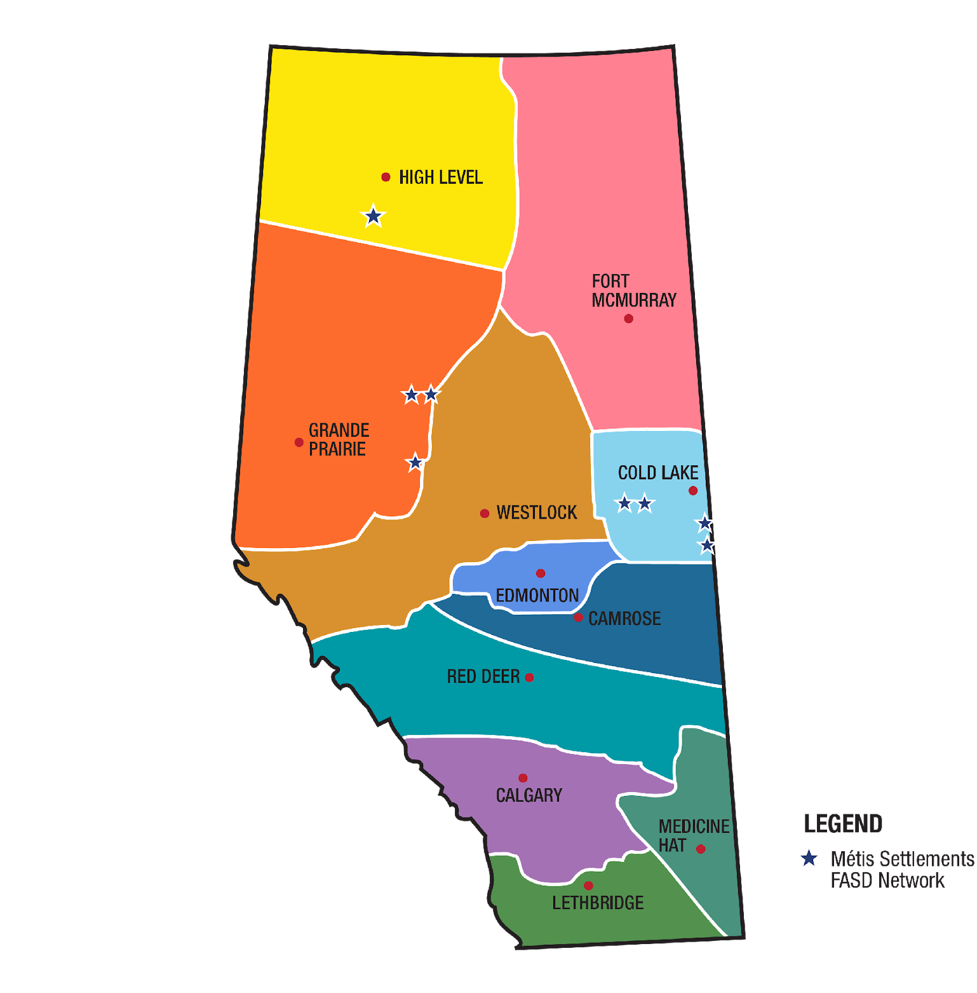
FASD Networks
In Alberta
http://www.fasdalberta.ca/
Notes:
A key innovation of Alberta’s response to FASD was the development and continued funding of 12 regionally based civil society FASD Service Networks, which have become the cornerstone for the delivery of FASD awareness, prevention, assessment and diagnosis, and supports for individuals with FASD, their families, and caregivers across the province.
In alignment with the strategic direction provided by the Government of Alberta, the FASD Service Networks build capacity in communities by enhancing existing services and by fostering the development of new ones.
The community-led FASD Service Networks have each designed a model of service delivery to meet the unique needs in their region.
The WRaP 2.0 project is implemented by the FASD Networks.

Slide 5
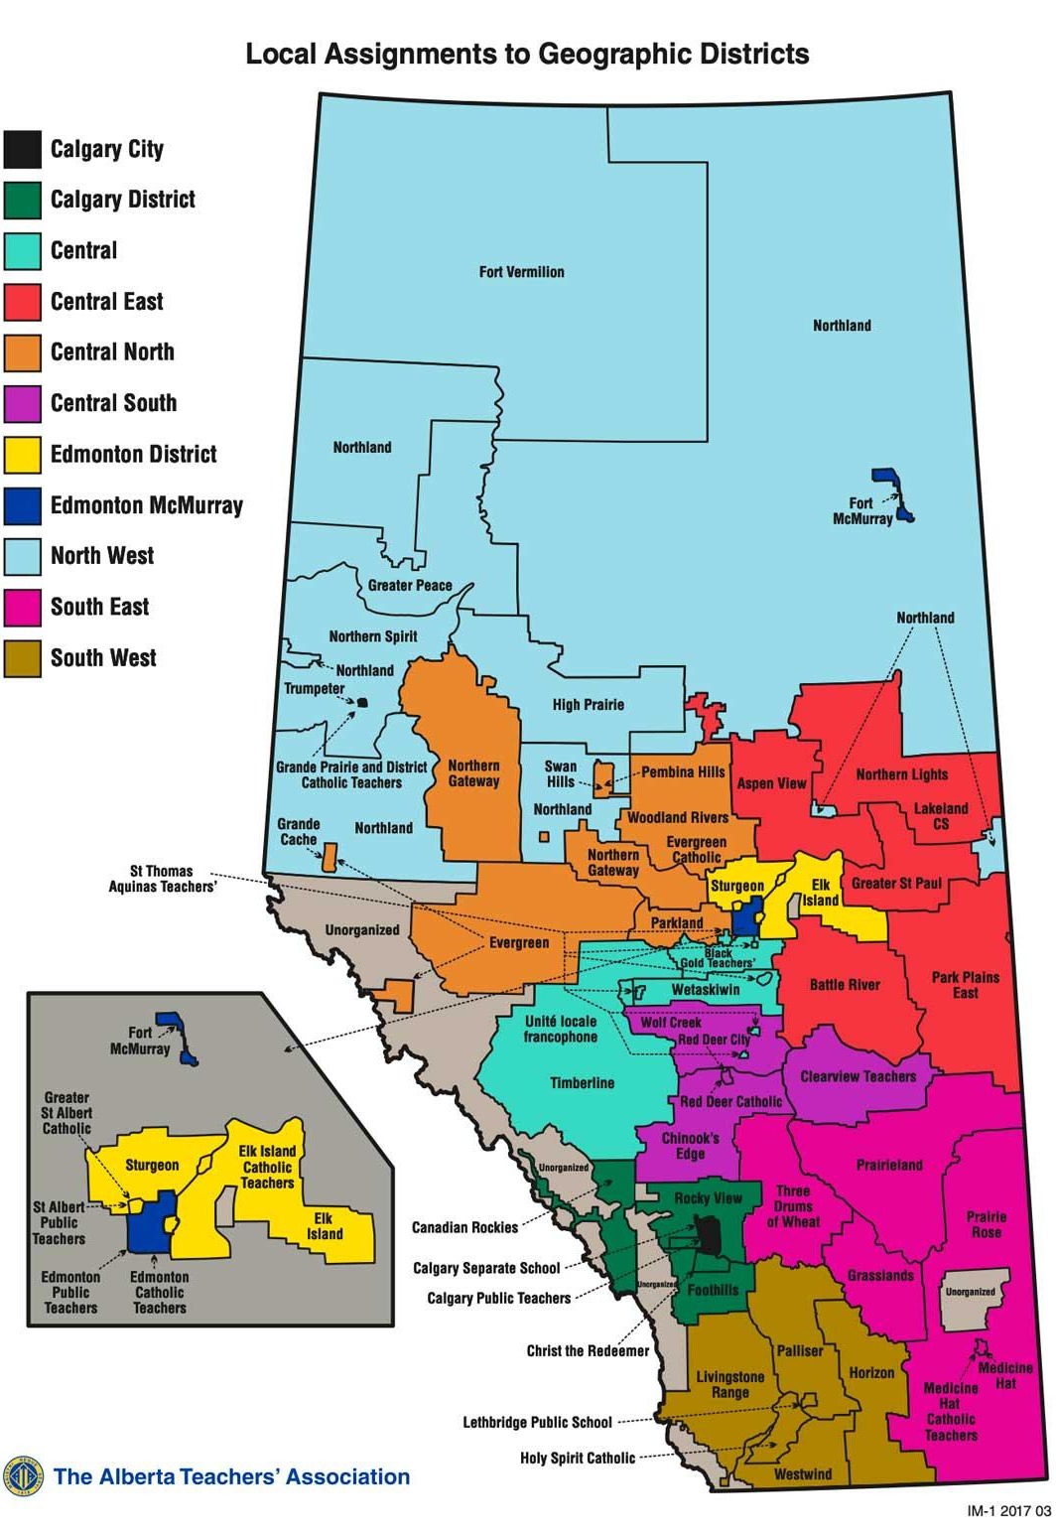
ATA Locals Map
View interactive map Local Assignments to Geographic Districts
Notes:
https://www.teachers.ab.ca/SiteCollectionDocuments/ATA/For%20Members/ATA%20Locals/IM1%202017%2003%2011x17%20Colour.pdf
The WRaP 2.0 project is a five-year project, from development to implementation to exit strategy, and it began February 1, 2021 and will run until everything is finalized by January 31, 2026.
It is province-wide and focuses on building the knowledge and capacity of educators to better support students with FASD.
The objectives of the project include:
Increase the capacity of teachers and schools to meet the educational needs of children and youth (ECS: Early Childhood Services: education programs that are offered by a school authority to Grade 12) with FASD
Teachers and school leaders will increase their knowledge and skills regarding how to support students with FASD by engaging in current best practices as shared by the FASD Networks through FASD instructional coaches.
Schools will enhance their capacity by incorporating FASD-informed approaches into their classroom communities, as part of a continuum of supports and services.

Slide 6

Introduction
This presentation will provide an overview of Fetal Alcohol Spectrum Disorder (FASD) and highlight the strengths, support needs, and considerations that can help individuals with FASD thrive across the lifespan.
6

Slide 7
01
What is FASD?
02
Alcohol & Fetal Development
Outline
03
Signs & Symptoms
04
FASD Diagnosis
05
FASD Interventions
06
FASD Prevention
07
Building Inclusive Schools
08
Review
Notes:
This presentation is broken into 8 modules or sections. Today we will cover:
What is FASD? ​
Alcohol and Fetal Development ​
Signs and Symptoms​
FASD Diagnosis​
FASD Interventions​
FASD Prevention​
Building Inclusive Schools
Review
As the presenter, you can choose which modules and information to cover based on your allotted time.

Slide 8

SECTION 1
What is
FASD?
TOPICS:
Definition
Alcohol Consumption in Canada
Prevalence
Cost

Slide 9



FASD is…
vv
COMPLEX
COMMON
LIFELONG
Notes:
FASD is a complex neurodevelopmental disorder that is caused by prenatal alcohol exposure.
FASD is one of the leading known causes of developmental disability in the western world.
Researchers estimate that at least 4% of individuals in Canada have FASD.
This is more than 2 times more common than Autism spectrum disorder.
FASD is a life-long, whole body disorder and there is good evidence that early and appropriate supports can improve outcomes for people with FASD.
Reference: https://canfasd.ca/wp-content/uploads/publications/Prevalence-1-Issue-Paper-Update-FINAL.pdf

Slide 10

Definition
“
Fetal Alcohol Spectrum Disorder (FASD) is a diagnostic term used to describe impacts on the brain and body of individuals prenatally exposed to alcohol.
FASD is a lifelong disability. Individuals with FASD will experience some degree of challenges in their daily living, and need support with motor skills, physical health, learning, memory, attention, communication, emotional regulation, and social skills to reach their full potential.
Each individual with FASD is unique and has areas of both strengths and challenges.
”
Notes:
This is the standard definition of FASD, developed by the Canada Fetal Alcohol Spectrum Disorder Research Network, or CanFASD (Harding et al., 2019). CanFASD strongly recommends that professionals adopt this definition in their practice because it can:
Reduce stigma
Increase everyone’s understanding of FASD
Reduce confusion about the disability
Improve consistency in how we talk about this disorder
Help us to focus on a more strengths-based approach
For conversations about FASD in more informal settings, a community definition was also developed:
“FASD is a lifelong disability that affects the brain and body of people who were exposed to alcohol in the womb. Each person with FASD has both strengths and challenges and will need special supports to help them succeed with many different parts of their daily lives.”
Reference:
Harding, K., Flannigan, K., & McFarlane, A. (2019, July). Policy action paper: Toward a standard definition of fetal alcohol spectrum disorder in Canada. Canada FASD Research Network. https://canfasd.ca/wp-content/uploads/2019/08/Toward-a-Standard-Definition-of-FASD-Final.pdf

Slide 11


Alcohol Consumption
IN CANADA
10 to 15%
42-65%
of pregnant women in Canada consume alcohol during pregnancy.
of pregnancies are unplanned.
30.5%
of reproductive age women in Canada report weekly alcohol use.
Notes:
There is no known safe amount of alcohol to consume during pregnancy. However, in Canada, it is estimated that 10-15% of pregnancies are alcohol exposed.
In Canada, it is estimated that 10-15% of pregnancies are alcohol exposed. Although some provincial registry data reports much lower numbers (e.g., under 2%), these are likely underestimates due to stigma and underreporting.
A pregnant person might drink during pregnancy for many different reasons, including:
Not having full information or awareness of the risks
Receiving conflicting or incorrect messages from health providers, friends, or media
Using alcohol to cope with stress, trauma, or substance use challenges
Feeling social pressure to drink, or having a partner who drinks
Not knowing yet that they are pregnant
Choosing not to share that they are pregnant
Seeing others drink during pregnancy and believing it was safe
Experiencing stigma, shame, or fear of judgment, which can prevent open conversations about alcohol use
There may be other social and economic factors at play including:
Poverty and food insecurity
Limited support networks or social isolation
Experiences of gender-based violence or other trauma
Lack of safe and respectful healthcare interactions
Autonomy and complex personal circumstances
It is important to use non-judgemental, supportive language and to recognize that there are many influences on alcohol use in pregnancy.
Conversations should focus on reducing risk and promoting safe, healthy outcomes for both parent and baby.

Slide 12

Prevalence
1.6 million
people in Canada
44 - 176, 000
4%
people in Alberta
of people
in Canada
1 in 25
people in Canada
Notes:
Researchers currently estimate that at least 4% of individuals in Canada have FASD.
This estimate translates to more than 1.6 million people in Canada or at least 1 in 25.
In Alberta, estimates are between 44,000 to 176,000, or 1-4% in the general population.
This means about one student in every classroom may have FASD.
References:
Flannigan, K., Cauduro, E., Unsworth, K., Harding, K., & McFarlane, A. (2024). The prevalence of fetal alcohol spectrum disorder: Issue paper update. Canada FASD Research Network. https://canfasd.ca/wp-content/uploads/publications/Prevalence-1-Issue-Paper-Update-FINAL.pdf
Popova, S., Lange, S., Shield, K., Burd, L., & Rehm, J. (2019). Prevalence of fetal alcohol spectrum disorder among special subpopulations: a systematic review and meta‐analysis. Addiction, 114(7), 1150-1172. DOI: https://doi.org/10.1111/add.14598
Popova, S., Lange, S., Poznyak, V., Chudley, A. E., Shield, K. D., Reynolds, J. N., ... & Rehm, J. (2019). Population-based prevalence of fetal alcohol spectrum disorder in Canada. BMC public health, 19(1), 845. https://link.springer.com/article/10.1186/s12889-019-7213-3

Slide 13
2 times more common than
Autism Spectrum Disorder (ASD)
(2%)
FASD is…
Notes:
FASD is recognized as one of the most common neurodevelopmental disabilities in the western world.
Compared to other disabilities, at an estimated prevalence of at least 4% in Canada, FASD
FASD is more than:
2 times more common than ASD
17 times more common than cerebral palsy
29 times more common than Down syndrome
40 times more common than Tourette’s syndrome.
This means that FASD is more common than autism, cerebral palsy, Down Syndrome, and Tourette’s Syndrome all combined.

Slide 14
2 times more common than
Autism Spectrum Disorder (ASD)
(2%)
FASD is…
17 times
more common than
Cerebral Palsy
(0.23%)
Notes:
FASD is recognized as one of the most common neurodevelopmental disabilities in the western world.
Compared to other disabilities, at an estimated prevalence of at least 4% in Canada, FASD
FASD is more than:
2 times more common than ASD
17 times more common than cerebral palsy
29 times more common than Down syndrome
40 times more common than Tourette’s syndrome.
This means that FASD is more common than autism, cerebral palsy, Down Syndrome, and Tourette’s Syndrome all combined.

Slide 15
2 times more common than
Autism Spectrum Disorder (ASD)
(2%)
FASD is…
17 times
more common than
Cerebral Palsy
(0.23%)
29 times
more common than
Down Syndrome
(0.14%)
Notes:
FASD is recognized as one of the most common neurodevelopmental disabilities in the western world.
Compared to other disabilities, at an estimated prevalence of at least 4% in Canada, FASD
FASD is more than:
2 times more common than ASD
17 times more common than cerebral palsy
29 times more common than Down syndrome
40 times more common than Tourette’s syndrome.
This means that FASD is more common than autism, cerebral palsy, Down Syndrome, and Tourette’s Syndrome all combined.

Slide 16
2 times more common than
Autism Spectrum Disorder (ASD)
(2%)
FASD is…
17 times
more common than
Cerebral Palsy
(0.23%)
29 times
more common than
Down Syndrome
(0.14%)
40 times
more common than
Tourette’s Syndrome
(0.10%)
Notes:
FASD is recognized as one of the most common neurodevelopmental disabilities in the western world.
Compared to other disabilities, at an estimated prevalence of at least 4% in Canada, FASD
FASD is more than:
2 times more common than ASD
17 times more common than cerebral palsy
29 times more common than Down syndrome
40 times more common than Tourette’s syndrome.
This means that FASD is more common than autism, cerebral palsy, Down Syndrome, and Tourette’s Syndrome all combined.

Slide 17

Prevalence Rates are Estimates
Rates may be higher than estimated because of:
Prenatal alcohol use is often underreported.
FASD looks different for each person.
Access to diagnosis varies.
Facial features are not reliable indicators.
Awareness and understanding are still growing.
Notes:
The true rates of FASD are thought to be higher than the “best guess” estimates of 4-5% because diagnosis is challenging and prenatal alcohol exposure may not always be recognized.
There are several reasons why the numbers may not reflect the full picture:
Prenatal alcohol exposure is often underreported due to stigma, shame, or fear of judgment.
FASD can look different for everyone. Strengths and needs may not be obvious in early years and may only become clear as expectations increase.
Diagnostic practices differ across regions, and access to comprehensive assessment varies.
Facial features are not a reliable indicator; they are present in only a small proportion (~10%) of individuals and often become less noticeable over time.
Awareness and understanding continue to grow, and as more people are accurately identified and supported, we are gaining a clearer understanding of how common FASD truly is.
Although prevalence studies give us valuable insight, they only tell part of the story. Every individual with FASD has unique strengths, abilities, and support needs, and increasing recognition helps ensure that people receive understanding and services that help them thrive.

Slide 18
Investment in FASD
vv
Total Investment
$9.7 billion/year
Canadian dollars
Notes:
Supporting individuals with FASD represents a significant social and economic investment in Canada.
Each year, about $9.7 billion is invested nationally across health care, education, and social services, research, and justice.
Approximately 17% of this investment occurs in education, underscoring the importance of FASD-informed schools and inclusive supports.
In Alberta, annual investments are estimated at $130-400 million for new diagnoses, and $48-143 million for ongoing supports.
These figures highlight the need for coordinated, well-resourced services that promote prevention, early identification, and lifelong supports.
Finally, the personal and social impacts, including resilience, advocacy, and contributions of individuals with FASD and their families (those with living experience?), extend far beyond what can be measured financially.

Slide 19

SECTION 2
Alcohol Use During Pregnancy: What do we know?

Slide 20

Alcohol Use and Pregnancy
Alcohol is a teratogen that can affect fetal development.
Nutrients and oxygen pass from the pregnant person to the fetus through the bloodstream.
Alcohol crosses the placenta and enters the fetal system.
Notes:
Alcohol is a teratogen, which is a substance that disturbs the development of an embryo or fetus.
When alcohol is consumed during pregnancy, it crosses the placenta and enters the fetus’ bloodstream.
Because the fetus processes alcohol much slower than an adult, even small amounts can remain longer and affect brain and body development.
A developing fetus receives all nutrients and oxygen from what its mother eats and drinks. These nutrients travel through the placenta via the umbilical cord. A fetus’ system breaks down alcohol very slowly compared to adults.
Exposure to alcohol can impact fetal brain and body development. It can change the embryo’s DNA, which can impact the development of its brain and result in life-long learning difficulties, challenges with emotional and sensory regulation, social challenges, and physical and mental health concerns.

Slide 21
Understanding Fetal Development
Embryo Stage = First 8 weeks
Head and tail distinguishable
Brain begins to form
Distinct human appearance
3rd Week
(Day 17)
6th Week
(42 days)
1st Week
Day 22-32
8th Week
Head and tail curve towards each other
Notes:
A fetus’ brain and central nervous system are developing throughout the entire 40 weeks of pregnancy.
The first 8 weeks of pregnancy are known as the embryo stage. Remarkable and rapid changes occur during this period. Alcohol consumption during the embryo stage can result in major congenital anomalies.
In the first week of pregnancy, a single cell rapidly divides to make an embryo that by the end of the first week has two distinct cell layers.
Early in the third week (day 17), the head and tail ends of the disc of cells can be distinguished, and the brain begins to form. From day 22 to 32, the embryo elongates as the head and tail end curve toward each other
By six weeks (42 days), the embryo has a distinctly human appearance.
A lot of the development in the embryo occurs before a pregnancy is typically recognized (4 to 6 weeks).
After 8 weeks, the embryo is termed a fetus. The fetal stage occurs from week nine to birth. Alcohol consumption in the fetal stage can result in minor congenital anomalies and significant functional deficits.

Slide 22




Zero Alcohol is Safest
Factors impacting how alcohol affects development:
Genetic
Makeup
Timing
Amount
Nutrition
Notes:
The effects of alcohol on a developing fetus depend on many interacting factors, such as timing, amount, genetics, and nutrition.
No one can predict exactly how alcohol will affect a developing baby, but the timing and amount of alcohol consumed, genetic makeup, and maternal nutrition are factors that influence the impact on the developing fetus.
Timing – different body parts and systems develop in the baby at different times during pregnancy. Drinking alcohol at any time during pregnancy can have an impact, but the impacts may vary.
Amount – heavy binge drinking is clearly shown to increase risks.
Genetic makeup – genes influence the mother’s ability to metabolize alcohol and the impact on a fetus. Research has shown that non-identical twins may be impacted differently.
Nutrition – alcohol consumption and poor nutrition are sometimes linked and can place the fetus at increased risk of brain impacts during development.
The bottom line is: There is no safe time, type, or amount of alcohol to drink during a pregnancy.

Slide 23

Our Language Matters
Instead of…
Try…
Suffering with, Damaged by, Living with
Person or Individual with FASD
Mentally Disabled
Cognitive or Neurodevelopmental Disability
FASD Student
Student with FASD
Alcoholics, Addicts, and Alcoholic mother
Birth mother, or parent who use(d) substances during pregnancy
Admitted to Alcohol Use or Denied Alcohol Use
Reported Drinking Alcohol or Confirmed Alcohol Use
Notes:
Creating FASD-informed schools also means shifting our language around how we talk and think about FASD. How we talk about people with FASD matters.
Individuals with FASD are often stigmatized because of their diagnosis, their behaviours, and other possible traits that may be seen as different from others. A great deal of stigma also surrounds mothers and women who use substances during pregnancy and family members of people with FASD.
Language is an important tool is addressing stigma and stereotypes. We want to make sure the language we’re using is:
strengths-based
person-first (unless their preference is otherwise specified)
evidence-based; and
dignity-promoting
For example:
Use person or individual with FASD instead of suffering with, damaged by, living with FASD
Use cognitive or neurodevelopmental disability instead of mentally disabled
Use student with FASD instead of FASD students
Replace stigmatizing terms such as “alcoholic mother” with person-first terms such as “birth mother, or parent who use(d) substances during pregnancy.
Use reported drinking alcohol or confirmed alcohol use instead of admitted to alcohol use or denied alcohol use
Creating FASD-informed schools also means shifting our language around how we talk and think about FASD.
Additional information can be found within the Common Messages Guide: https://canfasd.ca/wp-content/uploads/publications/Common-Messages.pdf

Slide 24
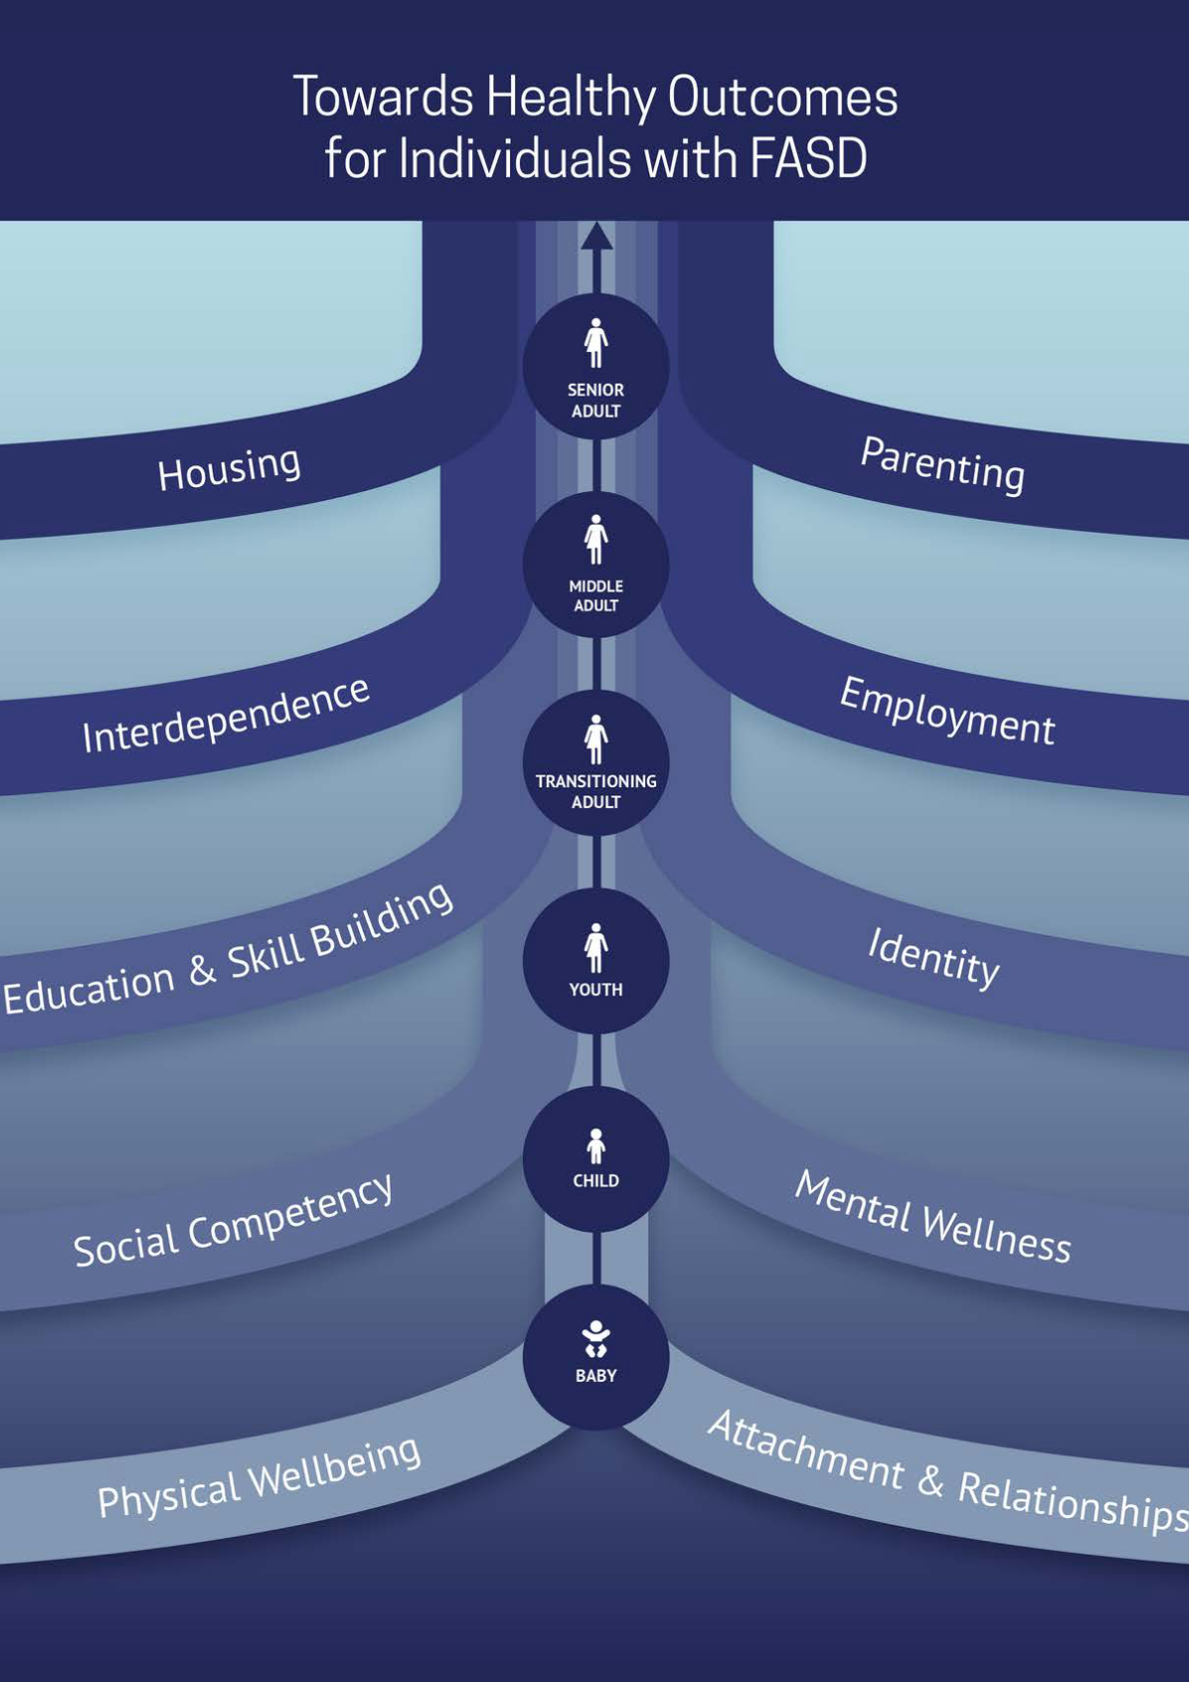
Towards Healthy Outcomes: A Framework for Integrated Community Intervention
Notes:
Individuals with FASD often experience multifaceted and complex challenges throughout the lifespan.
Interventions are intentional strategies or approaches geared towards promoting growth in the individual.
Ideally, interventions are built on existing strengths of the individual being supported to help address areas of challenge and support achievement of healthy outcomes at all ages.
The THO framework reminds us that FASD is more than a diagnosis. It involves relationships, environments, and opportunities for growth. When schools, families, and communities work together, students are better able to use their strengths and develop new skills.

Slide 25




Shared Understandings
Why an Intervention Framework?
Increases Consistency & Intentionality
Creates Opportunity for Integration
Notes:
THO fosters a shared understanding of intervention approach and goals. Notice we are using the word shared.
Using a framework like THO allows for greater consistency among services and intervention and greater intentionality behind intervention supports for all supportive others.
THO can also act as a mechanism that can streamline the link between research evidence and community wisdom
THO framework also creates opportunities for greater integration of research within intervention practices and communication among supports.

Slide 26
THO Emphasizes…
Vestibulum congue
Developmental Lifespan Perspective
All Behaviour is Functional
Strengths-
Based & Empowered
Interactive Systems
Vestibulum congue
Vestibulum congue
Notes:
THO emphasizes quality of life!
We are looking beyond worries and fears for the future and instead focusing on our goals.
By setting educational goals focused on healthy outcomes, we must consider strengths and new ways of understanding needs.
That’s not to say we don’t consider needs and challenges, but they are not our focus. That’s why THO highlights the importance of appropriate expectations and goal setting.
We must consider strengths alongside areas of need to understand the person with FASD we are supporting and help them move towards success.
There are three tenets that guide the design and implementation of the THO framework including the developmental lifespan perspective, interactive systems and strengths-based and empowered.
At the heart of these philosophies is the understanding that we have already developed that all behaviour is functional.
When we apply this to education, we consider:
What supports exist within the system (school, home, peers)?
How can we promote belonging and dignity alongside skill growth?
How can we recognize and celebrate strengths (creativity, empathy, visual learning, persistence)?
In the following three slides, we will review and explain these underlying philosophies.

Slide 27
Developmental Lifespan Perspective
A person’s past and future impact their functioning.
Intervention is a lifelong process.
Intervention goals are based on an individual’s strengths & challenges.
Ages
Developmental Trajectory
Notes:
As represented by the figures in the middle of the framework, we move through developmental stages as we grow. This means we are influenced by the past while also looking towards the future. Our past and our future influence the way we are acting today.
Like all of us, students with FASD continue to grow and develop throughout their lives. The 10 THO domains are also represented in an order across the lifespan, showing a developmental trajectory of intervention needs.
This highlights that intervention is lifelong; it does not begin or end at any specific point.
Recognizing this ongoing development, we must also base our goals on the unique strengths and needs that each person we are working with possesses. I wouldn’t set the same goals for myself as another person in this room, so why would we treat students with FASD any differently?

Slide 28
Interactive Systems
The influence of systems across the lifespan is interactive and additive.
Areas of support must interact fluidly and flexibly.
Meaningful collaboration and responsivity is necessary.
Layers of Colours
Notes:
People with FASD often depend on multiple, complex systems over their lives. As they age, these systems can actually become more complex. The influence of these systems (especially education) is crucial to consider, along with the understanding that each system is connected to both the individual as well as to other systems.
These connections are often interactive and impact each other – a student who struggles with learning demands within the educational system, may interact with mental health and medical systems as well.
Given the number and complexity of these systems, educators need to try their best to work alongside those systems fluidly and flexibly.
Collaboration and responsivity is required by all supporters working alongside students with FASD.

Slide 29
Strengths-Based & Empowered
Mitigate challenges while ALSO promoting strengths.
Combination of individual strengths and engagement with support systems creates conditions for success.
Co-create success alongside individuals with FASD.
Individual is at the Centre
Notes:
The strengths-based philosophy considers areas of need and strengths too.
Remember, everyone has access to different resources, abilities, and strengths, and these strengths can be used to support areas of need and difficulty.
The strengths and empowered approach used by THO helps us recognize that all people want to achieve success, however we define that for ourselves.
It also helps the client feel their voice is heard throughout the decision-making and intervention process.

Slide 30

All Behaviour is Functional
Intent of Behaviour
Observed Behaviour
“What do I know?”
before
“What do I do?”
Utility of Behaviour
Notes:
Even beyond our shifting our language, shifting the way we interpret behaviour is a helpful step in supporting people with FASD. All behaviour has a purpose. Behaviour communicates needs. Students act in ways that meet a need, even if the behaviour looks challenging.
For example, a student who runs out of a classroom, may be seeking regulation or space. A student who blurts out answers may be trying to stay engaged. A student who shuts down, may be feeling overwhelmed. When we interpret behaviour as communication, we move from reacting to understanding. This approach supports learning and emotional safety for everyone in the classroom.
Third, the goal-oriented approach recognizes that all behaviour serves a purpose and that any person’s goals are likely to change overtime. Through identifying the underlying purpose of behaviours, professionals are then able to work with people with FASD to adjust their behaviour and help them navigate achieving their evolving goals in an adaptive way.

Slide 31
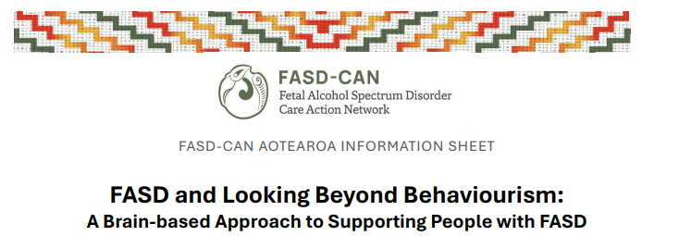
Looking Beyond Behaviourism: Resource
Notes:
FASD-CAN has produced a resource that explain that behaviour in individuals with FASD reflects underlying brain-based differences rather than intentional misbehaviour.
Traditional reward and consequence approaches are often ineffective because they do not address the root causes of behaviour.
A brain-first approach focuses on understanding why a behaviour occurs and adjusting environments and supports accordingly.
Shifting from behaviour control to behaviour understanding supports learning, regulation, and long-term success.
This resource can be found here: https://assets.nationbuilder.com/fasdcan/pages/6241/attachments/original/1763682912/FASD_and_Looking_Beyond_Behaviourism_-_Information_Sheet.pdf?1763682912

Slide 32

SECTION 3
Overview of Needs:
TOPICS:
Challenges
Effects
Strengths
Notes:
FASD is a spectrum disorder, so there is a wide range of impacts that can occur from prenatal alcohol exposure. These impacts are lifelong but can be mitigated with appropriate supports. The type and need for supports that an individual with FASD experiences will vary across the life span.
FASD is often considered a “hidden” disability because there are rarely visible indicators of disability. Less than 10% of individuals with FASD have the facial characteristics that are associated with prenatal alcohol exposure (i.e., called sentinel facial features).
It is important to note that the use of terms such as “invisible” or “hidden” have the potential to invalidate and stigmatize people with FASD and their families. However, many individuals with living experience choose to refer to FASD as an “invisible” disability. Respect should be given to how people with living experience choose to describe their own lives and disability.

Slide 33






Common challenges might include:
Learning and Remembering
Speech and Language
Attention and Behaviour
Social Skills
Areas in Need of Support
Sensory
Difficulties
Physical Challenges
Notes:
Each person with FASD is an individual and has unique strengths and challenges. No two people with FASD are alike, but challenges may include:
Learning and memory (long term processing pace)
Speech and language problems (receptive and expressive)
Short attention span, impulsive behaviour, easily overwhelmed
Social difficulties (poor grasp of social rules and expectations)
Sensory difficulties (hearing, vision, touch, smell)
Physical problems (coordination and motor difficulties, organ defects, skeletal abnormalities)
Following or participating in conversations
Reading or writing for meaning
Using and understanding expressive/receptive language
Understanding abstract concepts like time and money
Being impulsive, distracted, overwhelmed
Making friends
Being sensitive to sounds, visual stimuli, textures, and smells
People with FASD also have many strengths and skills. They are often reported to be:
Caring
Friendly, outgoing, affectionate, and likeable
Hard-working, determined, and persistent
Chatty and good storytellers
Helpful and generous
Creative and artistic
Patient, interacts well with, and relates well to children, elderly people, and animals
Non-judgemental
References
Cook, J. L., Green, C. R., Lilley, C. M., Anderson, S. M., Baldwin, M. E., Chudley, A. E., Conry, J. L., LeBlanc, N., Loock, C. A., Lutke, J., Mallon, B. F., McFarlane, A. A., Temple, V. K., & Rosales, T. (2016). Fetal alcohol spectrum disorder: A guideline for diagnosis across the lifespan. Canadian Medical Association Journal, 188(3), 191–197. https://www.cmaj.ca/content/188/3/191
Flannigan, K., Harding, K., Reid, D., & The Family Advisory Committee. (2018). Strength Among Individuals with FASD. Canada FASD Research Network. https://canfasd.ca/wp-content/uploads/2018/10/Strengths-Among-Individuals-with-FASD.pdf
Pei, J., Tremblay, M., McNeil, A., Poole, N., & McFarlane, A. (2017). Neuropsychological aspects of prevention and intervention for FASD in Canada. Journal of Pediatric Neuropsychology, 3(1), 25-37. DOI: 10.1007/s40817-016-0020-1

Slide 34

Common areas of need:
Motor Skills
Brain Structure and Functioning
Cognitive
Language
Academic Achievement
Memory
Attention
Executive Functioning
Affect Regulation
Adaptive Behaviour
Social Skills
Notes:
Primary disabilities are difficulties that are directly associated with the impacts of PAE on the brain and body. These impacts are typically categorized in the following brain domains:
Motor Skills
Specific actions that can be carried out by coordinating large muscle groups (gross motor; such as walking, balancing, and jumping), or smaller muscle groups (fine motor; more precise movements, such as writing, and using zippers and buttons)
Neuroanatomy/Neurophysiology (Brain Structure and Functioning)
This might include structural abnormalities. Some people with FASD may have seizures
Cognition (Thinking and Reasoning)
refers to our ability to think and process information. Assessment in this domain typically focuses on verbal comprehension (an individual’s ability to use and understand language and vocabulary), fluid or perceptual reasoning (an individual’s ability to solve novel visual or nonverbal problems), processing speed (the speed with which an individual can take in and respond to information), and working memory (an individual’s ability to hold and manipulate information ‘online’ in their mind).
Language (Expressive and Receptive)
broadly refers to an individual’s ability to communicate effectively, both in terms of understanding and producing language. It also includes higher-level language skills such as narrative (e.g., story-telling) and complex/abstract comprehension abilities (e.g., understanding sarcasm)
Academic Achievement
Academic skills refer to an individual’s ability to learn and carry out work relating to reading, writing, and math
Memory
refers to an individual’s ability to acquire, store, retain, and retrieve verbal and visual information from their mind, either intentionally (e.g., remembering information for a test) or unintentionally (e.g., ‘remembering’ how to ride a bike)
Attention
refers to the process of selectively focusing on something specific in our environment, which involves resisting distractions and irrelevant information. Attention is a critical component of learning and memory. It can refer to inattention (difficulty maintaining focus); selective attention (difficulty ignoring visual or auditory stimuli in the environment) or sustained attention (difficulty paying attention for long periods of time)
Executive Function, including impulse control
involves the higher-level thinking skills used to organize and control one’s own thoughts and behaviours in order to meet a long-term goal. The exact components of executive functioning are sometimes debated, but in an FASD assessment they include working memory, inhibition and impulse control (hyperactivity), planning and problem-solving, and cognitive flexibility. Other related and overlapping skills include self-monitoring, organizing and prioritizing, and shifting focus from one area or task to another.
Affect Regulation (Controlling Emotions)
refers to an individual’s ability to change or maintain their feelings or emotional state through effortful control in order to meet the demands of their environment. In an FASD assessment, affect regulation is specific to depressive and anxiety disorders as defined in the Diagnostic Statistical Manual of Mental Disorders – 5th Edition (DSM-5).
Adaptive Behaviour, Social Skills, or Social Communication
are the daily living skills and abilities that are necessary to function socially and practically in the home and community in an age-appropriate manner, such as communication, interpersonal skills, self-care, domestic skills, functional academics (e.g., money math), etc.
Reference: Cook, J. L., Green, C. R., Lilley, C. M., Anderson, S. M., Baldwin, M. E., Chudley, A. E., Conry, J. L., LeBlanc, N., Loock, C. A., Lutke, J., Mallon, B. F., McFarlane, A. A., Temple, V. K., & Rosales, T. (2016). Fetal alcohol spectrum disorder: A guideline for diagnosis across the lifespan. Canadian Medical Association Journal, 188(3), 191–197. https://www.cmaj.ca/content/188/3/191

Slide 35

Appears clumsy, careless, or physically aggressive due to low body awareness.
Appears to be constantly “on the move”.
Leans against things to maintain an upright posture due to low postural stability.
Has difficulty writing or awkwardly grasps pens or other objects.
Is uncomfortable sitting or standing for long periods of time due to differences in muscle tone.
Motor Skills
Notes:
Appears clumsy, careless, or physically aggressive due to low body awareness
Appears to be constantly “on the move”
Leans against things to maintain an upright posture due to low postural stability
Has difficulty writing or awkwardly grasps pens or other objects
Is uncomfortable sitting or standing for long periods of time due to differences in muscle tone

Slide 36

“Shuts down”: Becomes frustrated or stops engaging when conversations or questions move quickly.
Provides one word answers or seems to “not care”
Seems mentally fatigued by easy tasks.
Takes longer than expected to answer questions.
Mistakes words when interpreting what others are trying to say.
Difficulty applying or generalizing new information.
Cognitive
Notes:
“Shuts down” due to difficulty keeping up with class pace
Becomes frustrated or shuts down when conversations or questions move quickly or the topic changes rapidly
Provides one word answers or seems to “not care” when information is complex or presented too quickly
Seems mentally fatigued by easy tasks
Takes longer than expected to answer questions
Mistakes words when interpreting what others are trying to say
Has difficulty applying or generalizing new information

Slide 37

“Shuts down” when language is too high-level to understand.
Unable to articulate something they know.
Uses “big words” incorrectly.
Can’t tell stories in a coherent or sequential way.
Speaks well, but has difficulty understanding the meaning of what other people are saying.
Takes speech literally
Language
Notes:
“Shuts down” when language is too high-level to understand
Unable to articulate something they know
Uses “big words” inappropriately
Can’t provide a coherent or sequential story
Speaks well but has difficulty understanding the meaning of what other people are saying
Takes speech literally; has difficulty understanding sarcasm or abstract topics or language (e.g., metaphors, idioms, analogies)
Nods and appears to understand what is said to them, but does not follow directions, answer the question asked, or otherwise respond appropriately
Is unable to repeat back information but may not actually understand enough to follow through
Can physically write, but written work is hard to follow or makes sense of

Slide 38

Nods and appears to understand what is said to them, but does not follow directions, answer the question, or otherwise respond appropriately.
Is unable to repeat back information but may not actually understand enough to follow through.
Can physically write, but written work is hard to follow or understand.
Language
Notes:
“Shuts down” when language is too high-level to understand
Unable to articulate something they know
Uses “big words” inappropriately
Can’t provide a coherent or sequential story
Speaks well but has difficulty understanding the meaning of what other people are saying
Takes speech literally; has difficulty understanding sarcasm or abstract topics or language (e.g., metaphors, idioms, analogies)
Nods and appears to understand what is said to them, but does not follow directions, answer the question asked, or otherwise respond appropriately
Is unable to repeat back information but may not actually understand enough to follow through
Can physically write, but written work is hard to follow or makes sense of

Slide 39

Difficulty completing tests.
Trouble reading and understanding large blocks of text.
Struggles with literacy, reading, writing, and/or math.
Appears to ignore written signs or warnings.
Has difficulty with concepts involving money.
Has difficulty with the concept of time.
Academics
Notes:
Has difficulty completing tests
Has trouble reading and understanding large blocks of text
Struggles in the areas of literacy, reading, writing, and math
Appears to ignore written signs or warnings
Has difficulty with concepts involving money
Has difficulty with the concept of time (e.g., thinks that 30 days is longer than 3 months because 30 is larger than 3)

Slide 40

Has trouble remembering basic facts and may need things repeated daily.
Fails to remember important facts about an event.
Is unable to tell a story from beginning to end in the right sequence of events.
Confabulates: Recalls details or events that did not happen; appears to lie but is actually ‘filling in’ gaps in memory.
Memory
Notes:
Has trouble remembering basic facts and may need things repeated each day
Fails to remember important facts about an event, or details they shared with you previously
Is unable to tell a story from beginning to end in the right sequence of events
Recalls details or events that did not happen; appears to lie but is actually ‘filling in’ gaps in memory (confabulation)
Doesn’t seem to remember what they have been told, even when they have received the information or explanation multiple times
Yields to leading questions or agrees simply because they do not remember (acquiescence)
Is late or fails to show up to class
Forgets classroom or school rules or routines
Seems defiant because they repeatedly make the same mistakes or land in the same negative situations

Slide 41

Doesn’t seem to remember what they have been told.
Yields to leading questions.
Acquiescence: agrees simply because they do not remember or understand
Is late or fails to show up to class.
Forgets classroom rules or school routines.
Seems defiant because they repeatedly make the same mistakes.
Memory
Notes:
Has trouble remembering basic facts and may need things repeated each day
Fails to remember important facts about an event, or details they shared with you previously
Is unable to tell a story from beginning to end in the right sequence of events
Recalls details or events that did not happen; appears to lie but is actually ‘filling in’ gaps in memory (confabulation)
Doesn’t seem to remember what they have been told, even when they have received the information or explanation multiple times
Yields to leading questions or agrees simply because they do not remember (acquiescence)
Is late or fails to show up to class
Forgets classroom or school rules or routines
Seems defiant because they repeatedly make the same mistakes or land in the same negative situations

Slide 42

Appears restless, distracted, or bored in class.
Is highly focused on one aspect of class, such as the appearance of the teacher, but does not follow what is being said.
Wanders out of the classroom.
Easily distracted: for example, waves or acknowledges people they know walking by the classroom.
Frequently requests repetitions or asks, “what?”
Attention
Notes:
Appears restless, distracted, or bored in class
Is highly focused on one aspect of class, such as the appearance of the teacher, but does not follow what is being said
Wanders out of the classroom during a break
Waves or acknowledges people they know who is walking by the classroom rather than focusing on what is being said
Frequently requests repetitions or asks, “what?”
Struggles to focus when being spoken to, especially in long classes
Seems to mentally fatigue after long periods where sustained attention was required
Has difficulty staying on topic OR becomes highly focused on one aspect of a conversation or a lesson
Becomes distracted in class and momentarily forget why they are there

Slide 43

Struggles to focus when being spoken to, especially in long classes.
Seems to mentally fatigue after long periods of sustained attention.
Has difficulty staying on topic OR becomes highly focused on one aspect of a conversation or a lesson.
Becomes distracted in class and momentarily forgets why they are there.
Attention
Notes:
Appears restless, distracted, or bored in class
Is highly focused on one aspect of class, such as the appearance of the teacher, but does not follow what is being said
Wanders out of the classroom during a break
Waves or acknowledges people they know who is walking by the classroom rather than focusing on what is being said
Frequently requests repetitions or asks, “what?”
Struggles to focus when being spoken to, especially in long classes
Seems to mentally fatigue after long periods where sustained attention was required
Has difficulty staying on topic OR becomes highly focused on one aspect of a conversation or a lesson
Becomes distracted in class and momentarily forget why they are there

Slide 44

Seems squirmy, fidgety, or restless.
Behaviour may seem illogical or poorly planned.
Struggles to understand abstract concepts.
Doesn’t learn from experience or generalize from situation to situation
Doesn’t understand the consequences of behaviour, even after repeat explanations. Is unable to connect the consequences to their behaviour.
Executive Functioning
Notes:
Seems squirmy, fidgety, or restless in classes
Behaviour may seem illogical or poorly planned
Struggles to understand the abstract concepts of guilt and innocence
Doesn’t learn from experience or generalize from situation to situation
Doesn’t understand the consequences of a behaviour, even after repeat explanations and is unable to connect the consequence to their behaviour
Denies doing something that they clearly did
Appears to have no remorse or take responsibility for their actions when they’ve done something wrong
Blurts out statements that seem inappropriate
Over-explains behaviours or actions
Has difficulty understanding the perspectives of others

Slide 45

Denies doing something that they clearly did.
Appears to have no remorse or take responsibility for their actions.
Blurts out statements that seem inappropriate.
Over-explains behaviours or actions.
Has difficulty understanding the perspectives of others.
Executive Functioning cont’d
Notes:
Seems squirmy, fidgety, or restless in classes
Behaviour may seem illogical or poorly planned
Struggles to understand the abstract concepts of guilt and innocence
Doesn’t learn from experience or generalize from situation to situation
Doesn’t understand the consequences of a behaviour, even after repeat explanations and is unable to connect the consequence to their behaviour
Denies doing something that they clearly did
Appears to have no remorse or take responsibility for their actions when they’ve done something wrong
Blurts out statements that seem inappropriate
Over-explains behaviours or actions
Has difficulty understanding the perspectives of others

Slide 46

Has angry outbursts or laughs hysterically.
Appears overly defensive, jumpy, or detached.
Becomes easily frustrated or overwhelmed.
Appears to lack energy, motivation, or disinterest in school.
Lashes out or reacts strongly and disproportionately to the situation or event.
Is easily triggered and quick to escalate.
Affect Regulation
Notes:
Has angry outbursts or laughs hysterically during a lesson
Appears overly defensive, jumpy, or detached
Becomes easily frustrated or overwhelmed
Appears to lack energy, motivation, or shows disregard for or disinterest in school
Lashes out or reacts strongly and disproportionately to the situation or event. Is easily triggered and quick to escalate.
Feels trapped and panics when they cannot physically ‘get out’ of a distressing or uncomfortable situation
Responds inappropriately to good or bad news
Abruptly ends conversations or physically leaves or needs to ‘get away’ when uncomfortable
Complains of chest or stomach discomfort or breathing difficulties not related to an obvious injury (i.e., physical symptoms of anxiety or depression)

Slide 47

Feels trapped and panics when they cannot physically ‘get out’ of a distressing or uncomfortable situation.
Responds inappropriately to good or bad news.
Abruptly ends conversations.
Complains of chest or stomach discomfort or breathing difficulties not related to an obvious injury.
Affect Regulation cont’d
Notes:
Has angry outbursts or laughs hysterically during a lesson
Appears overly defensive, jumpy, or detached
Becomes easily frustrated or overwhelmed
Appears to lack energy, motivation, or shows disregard for or disinterest in school
Lashes out or reacts strongly and disproportionately to the situation or event. Is easily triggered and quick to escalate.
Feels trapped and panics when they cannot physically ‘get out’ of a distressing or uncomfortable situation
Responds inappropriately to good or bad news
Abruptly ends conversations or physically leaves or needs to ‘get away’ when uncomfortable
Complains of chest or stomach discomfort or breathing difficulties not related to an obvious injury (i.e., physical symptoms of anxiety or depression)

Slide 48

Is often peer-pressured.
Appears naïve, immature, or overly friendly or trusting.
Brags about their negative behaviour or takes full responsibility if co-accused, even when it is self-sabotaging.
Appears disrespectful during class.
Does not understand social nuances or social cues.
Adaptive Behavior, Social Skills, and Communication
Notes:
Is often peer-pressured
Appears naïve, immature, or overly friendly or trusting
Brags about their negative behaviour or takes full responsibility if co-accused, even when it is self-sabotaging
Appears disrespectful during class (e.g., laughing, waving to friends, interrupting the lesson)
Does not understand social nuances or social cues (e.g., that behaviour in class should be different than behaviour with friends or at home)
Does not appear to understand the gravity of situations or appears to take court lightly
Is eager to please during class and may provide inaccurate information in an attempt to answer your questions
Lacks physical boundaries or understanding of social nuances and social cues
Has difficulty independently carrying out day-to-day tasks such as eating, catching the bus, remembering events

Slide 49

Appears to take serious situations lightly.
Is eager to please: may provide inaccurate information in an attempt to answer questions.
Lacks physical boundaries or understanding of social nuances and social cues.
Has difficulty independently carrying out day-to-day tasks.
Adaptive Behavior, Social Skills, and Communication
Notes:
Is often peer-pressured
Appears naïve, immature, or overly friendly or trusting
Brags about their negative behaviour or takes full responsibility if co-accused, even when it is self-sabotaging
Appears disrespectful during class (e.g., laughing, waving to friends, interrupting the lesson)
Does not understand social nuances or social cues (e.g., that behaviour in class should be different than behaviour with friends or at home)
Does not appear to understand the gravity of situations or appears to take court lightly
Is eager to please during class and may provide inaccurate information in an attempt to answer your questions
Lacks physical boundaries or understanding of social nuances and social cues
Has difficulty independently carrying out day-to-day tasks such as eating, catching the bus, remembering events

Slide 50

“
When the child gets frustrated with learning material, at first it also caused me a lot of frustration and stress but by understanding more of what the child goes through and understanding their differences gave me a lot more patience. And my reaction has relieved her of her frustration.
- Teacher
”
http://www.kpdsb.on.ca/assets/uploads/FASD/FASDFinalReport.pdf
Notes:
http://www.kpdsb.on.ca/assets/uploads/FASD/FASDFinalReport.pdf

Slide 51
Mental Health & Comorbidities
428
90%
of people with FASD reported mental health challenges
Possible comorbid conditions co-occurring in people with FASD
Notes:
Health challenges are extremely common for individuals with FASD. Comorbidity is the presence of two or more health conditions. Researchers have identified 428 possible comorbid conditions co-occurring in individuals with FASD. In fact, it is estimated that at least 90% of people with FASD experience at least one mental health challenge in addition to FASD. Common mental health challenges for people with FASD include: attention deficit hyperactivity disorder, intellectual and learning disorders, mood disorders like depression, anxiety disorders, PTSD, and psychotic disorders.
In addition to these mental health challenges, individuals with FASD also experience physical health comorbidities, such as problems with the nervous system and senses, hearing and vision difficulties, dental issues, and other congenital conditions and chromosomal differences.
Comorbidities are extremely common in individuals with FASD because of the range of impacts prenatal alcohol exposure has on a fetus.
For more information regarding supporting mental health you can check out the Mental Health Toolkit: https://canfasd.ca/mental-health-toolkit/mental-health-toolkit-introduction/
CanFASD published an Informational Note regarding mental health and individuals with FASD which can be accessed here: https://canfasd.ca/wp-content/uploads/publications/Mental-Health-in-FASD-Note.pdf
References:
Weyrauch, D., Schwartz, M., Hart, B., Klug, M. G., & Burd, L. (2017). Comorbid mental disorders in fetal alcohol spectrum disorders: A systematic review. Journal of Developmental and Behavioral Pediatrics, 38(4), 283-291. doi:http://dx.doi.org/10.1097/DBP.0000000000000440

Slide 52





FASD Across the Lifespan
Early Childhood Education
Kindergarten
Grade School
High School
Notes:
A person with FASD may experience different challenges at different stages in their life.
ECE/Preschool
Developmental delays in language, motor, and physical growth
Issues with behavioural regulation, activity level, response to over stimulation
Disordered Sleep patterns
Kindergarten
Social difficulties more evident
Overly friendly
Not understanding cues or limits
Language challenges
Issues with behavioural regulation
Grade School
Difficulty shifting from concrete to more abstract concepts
Learning disabilities become evident
Lack of focus, hyperactive, or signs of depression
Social immaturity; difficult making or keeping friends
Lack of understanding of social cues, poor perspective taking
Not learning from consequences
Mood swings and issues with behavioural regulation
High School/Adolescence
Increasing behavioural and emotional regulation difficulties
Onset of adverse outcomes, such as disrupted school experience, involvement with the law, and sexually inappropriate behaviours
Issues with self-esteem
Heightened risk of mental health and substance use issues
Move the highlight box around the age group you will be discussing (this will depend on the school you are presenting at) and talk about the impacts at that school age. You can discuss more than one age group if needed.

Slide 53
FASD is a
Whole-Body Disorder
Some health problems are
100%
more likely to occur for someone with FASD
Notes:
FASD is also associated with a range of physical health issues and is therefore considered a whole-body disorder. Certain health problems in individuals with FASD may up to 100 times more likely than in the general population.
Himmelreich, M., Lutke, C. J., & Hargrove, E. T. (2020). The lay of the land: Fetal alcohol spectrum disorder (FASD) as a whole-body diagnosis. In S. L. A. Straussner & C. S. Fewell (Eds.), The Routledge handbook of social work and addictive behaviors (1st ed.). Routledge.
Vanderpeet, C., Akison, L., Moritz, K., Hayes, N., & Reid, N. (2025). Beyond the Brain: The Physical Health and Whole-Body Impact of Fetal Alcohol Spectrum Disorders. Alcohol Research: Current Reviews, 45(1), 05. doi: 10.35946/arcr.v45.1.05

Slide 54






Several factors can protect individuals with FASD and can lead to positive outcomes:
Stable and nurturing home environment
Basic needs met
Early and effective supports and services
No experience with violence or trauma
Protective Factors
Developmental disabilities services
Diagnosed and flagged before the age of 6
Notes:
Despite these challenges, several factors can protect individuals with FASD and result in more positive outcomes:
Nurturing and stable home - Consistent home environment
Basic needs met
No experience with violence or trauma
Early and effective supports where needed
Received developmental disabilities services
Diagnosed and flagged before the age of 6 years
Ref: AFKA Understanding FASD half day PPT
New References: (Flannigan et al., 2020; Streissguth et al., 2004).

Slide 55

SECTION 4
FASD Diagnosis
TOPICS:
Importance
Assessment
Diagnosis

Slide 56

Early Diagnosis
Importance of Diagnosis
Early Support
Improved Outcomes
Notes:
FASD diagnosis is important for many reasons. Receiving a diagnosis can:
Give individuals, their families, and their caregivers better understanding of disorder and gives them access to increased supports
Identify learning strengths and challenges, which helps develop adaptations and interventions for the individual in school, health services, and employment
Lower direct costs associated with FASD
Identify parents who may desire and benefit from support with alcohol use
Understanding and learning about their own disability can be empowering for an individual
Facilitate support for transition periods
Create awareness regarding mental health resilience and risks
Reduce guilt and shame for the individual
The bottom line is early and appropriate supports are key to achieving positive outcomes. Early diagnosis can lead to improved supports.

Slide 57
Challenges of Diagnosis
Requires a multidisciplinary team.
It is cost-intensive, time-intensive, and resource-intensive.
There are a wide range of screening tools.
Signs and symptoms are hard to recognize.
Stigma.
Notes:
FASD diagnosis and assessment also comes with challenges, which is why many individuals can go undiagnosed or misdiagnosed.
It is challenging because:
It requires a full assessment by a highly-trained multidisciplinary team of experts
It is cost-intensive, time-intensive, and resource-intensive
There is a lack of consensus amongst experts in the use of screening tools to assess brain domains
Signs and symptoms of FASD can overlap with other disabilities
Signs and symptoms are difficult to recognize in infants and young children and may not fully manifest until individuals are in school or have reached their teen years
Confirmation of alcohol exposure during pregnancy can be challenging for individuals who do not know their birth mothers, and some women are reluctant to disclose this information out of shame or fear of stigma
Healthcare professionals may be reluctant to refer individuals and families who are concerned about shame and stigma
References:
Cook, J. L., Green, C. R., Lilley, C. M., Anderson, S. M., Baldwin, M. E., Chudley, A. E., Conry, J. L., LeBlanc, N., Loock, C. A., Lutke, J., Mallon, B. F., McFarlane, A. A., Temple, V. K., & Rosales, T. (2016). Fetal alcohol spectrum disorder: A guideline for diagnosis across the lifespan. Canadian Medical Association Journal, 188(3), 191–197. https://www.cmaj.ca/content/188/3/191
Harding, K. D., Burns, C., Lafontaine, C., Wrath, A., Groom, A., Flannigan, K., ... & McFarlane, A. (2024). Challenges and strengths experienced by fetal alcohol spectrum disorder diagnostic clinics in Canada. Journal of Intellectual & Developmental Disability, 49(3), 331-341. 10.3109/13668250.2023.2293336
Popova, S., Dozet, D., Temple, V., McFarlane, A., Cook, J., & Burd, L. (2024). Fetal alcohol spectrum disorder diagnostic clinic capacity in Canadian Provinces and territories. PLoS One, 19(4), e0301615. 10.1371/journal.pone.0301615

Slide 58






Medical Practitioner
Psychologist
Social Worker
Occupational Therapist
Speech-Language Pathologist
Clinic Coordinator
Assessment
and Diagnosis
Notes:
In order to get an FASD diagnosis, an individual is usually assessed by a multidisciplinary team of experts, typically including a medical practitioner, a psychologist, and a speech language therapist. Teams may also include a social worker, an occupational therapist, and a clinic coordinator. Each diagnostic clinic operates a little bit differently.
Recommendations are often made for educational accommodations in a diagnostic report that the school and family can work on together. It is the legal guardian’s decision if the FASD diagnostic report will be shared with others. Schools should be sensitive to how difficult it can be for parents to share this information.
Reference: Cook, J. L., Green, C. R., Lilley, C. M., Anderson, S. M., Baldwin, M. E., Chudley, A. E., Conry, J. L., LeBlanc, N., Loock, C. A., Lutke, J., Mallon, B. F., McFarlane, A. A., Temple, V. K., & Rosales, T. (2016). Fetal alcohol spectrum disorder: A guideline for diagnosis across the lifespan. Canadian Medical Association Journal, 188(3), 191–197. https://www.cmaj.ca/content/188/3/191

Slide 59

Possible Diagnoses
At-risk for neurodevelopmental disorder and FASD associated with PAE
FASD with sentinel facial features
FASD without sentinel facial features
Diagnosis
Designation
Notes:
Prior to 2015, individuals could be diagnosed with Fetal Alcohol Syndrome (FAS), partial FAS (pFAS), or Alcohol-Related Neurodevelopmental Disorder (ARND).
The process for FASD assessment and diagnosis in Canada was most recently updated in 2015. There are 2 possible categories of FASD diagnosis:
FASD with sentinel facial features
FASD without sentinel facial features
FASD with or without sentinel facial features replaced FAS, pFAS, and ARND, which are no longer used as diagnostic terms.
An individual may also be given the designation of “At risk for neurodevelopmental disorder and FASD, associated with PAE” which is not a diagnosis, but means that the person is experiencing significant challenges that may eventually lead to a diagnosis.
In Canada, we use FASD as the general term to cover anyone who meets criteria for diagnosis. The third “At-Risk” term is non-diagnostic, which means that the individual does not currently meet diagnostic criteria for FASD at the time of assessment but will require future follow-up and support.
Cook, J. L., Green, C. R., Lilley, C. M., Anderson, S. M., Baldwin, M. E., Chudley, A. E., Conry, J. L., LeBlanc, N., Loock, C. A., Lutke, J., Mallon, B. F., McFarlane, A. A., Temple, V. K., & Rosales, T. (2016). Fetal alcohol spectrum disorder: A guideline for diagnosis across the lifespan. Canadian Medical Association Journal, 188(3), 191–197. https://www.cmaj.ca/content/188/3/191

Slide 60

Functional Assessment
In a school setting, a functional assessment may look at the following:
  Skills
  Attention
  Independence
  Social Interactions
  Functional Language
  Strengths & Interests
  Behaviours
Notes:
A teacher, school staff, or member of the student’s support team may choose to conduct a functional assessment as the child progresses through their education to identify new or updated needs. This assessment may look at the student’s:
Skills
Attention
Independence
Social interactions
Functional language
Strengths and interests
And behaviours
To identify the student’s current skill levels and the unique needs, in this case a functional assessment will likely be conducted in the school setting. The information in this assessment can help inform the IPP and make sure the goals we set for the student are achievable and based on their unique strengths and challenges.
Resource: FASD Educational Strategies Handbook is a comprehensive guide from the University of Washington FASDPN that provides educators with evidence-informed teaching strategies and explicitly covers using functional assessment to understand and support the learning and behavior of students with fetal alcohol spectrum disorder (FASD). The handbook can be accessed here: https://depts.washington.edu/fasdpn/pdfs/FASD%20Educational%20Strategies%20Handbook.pdf
References: Brown, N.N., Reynolds, C.R. (2021). Connecting the Dots: Functional Behavior Evaluation in Fetal Alcohol Spectrum Disorder. In: Novick Brown, N. (eds) Evaluating Fetal Alcohol Spectrum Disorders in the Forensic Context. Springer, Cham. https://doi.org/10.1007/978-3-030-73628-6_8

Slide 61

SECTION 5
Interventions
TOPICS:
Principles of Practice
FASD Informed Support
Language Matters
Strengths Based

Slide 62
Interventions
have been demonstrated to improve cognitive skills, academic performance, behaviour, and social skills in individuals with FASD.
Opportunities for skill development
Meaningful success
Promote
well-being
Optimize opportunity
Implement Interventions
Notes:
Intervention research is relatively new in the FASD field, but some programs are showing promising results. Researchers have shown that interventions can improve cognitive (self-regulation, memory, attention), academic (math, language, literacy), behavioural, and social skills in individuals with FASD. Caregiver programs and supports also show promise.
An individual with FASD may need support in any or all of the following areas of their lives, and needs can change over time:
Attachment
Family cohesion
Social functioning
Regulation
Educational experience
Mental health
Identity establishment and transitioning
Community engagement
Adaptive skills
Employment
Housing
Parenting
Expert consensus suggests that service delivery approaches that rely on an assumption of ‘neurotypical’ functioning may not be effective for individuals with FASD.
By implementing evidence-based interventions and/or supports, we create opportunities for targeted skill growth and development, while also shifting environmental supports and expectations in order to optimize opportunity. The goal is to promote well-being and generate opportunities for meaningful success.
Remember: meaningful outcomes come from meaningful understandings. We have to understand both the needs and strengths of an individual in order to create effective and long-lasting interventions.

Slide 63
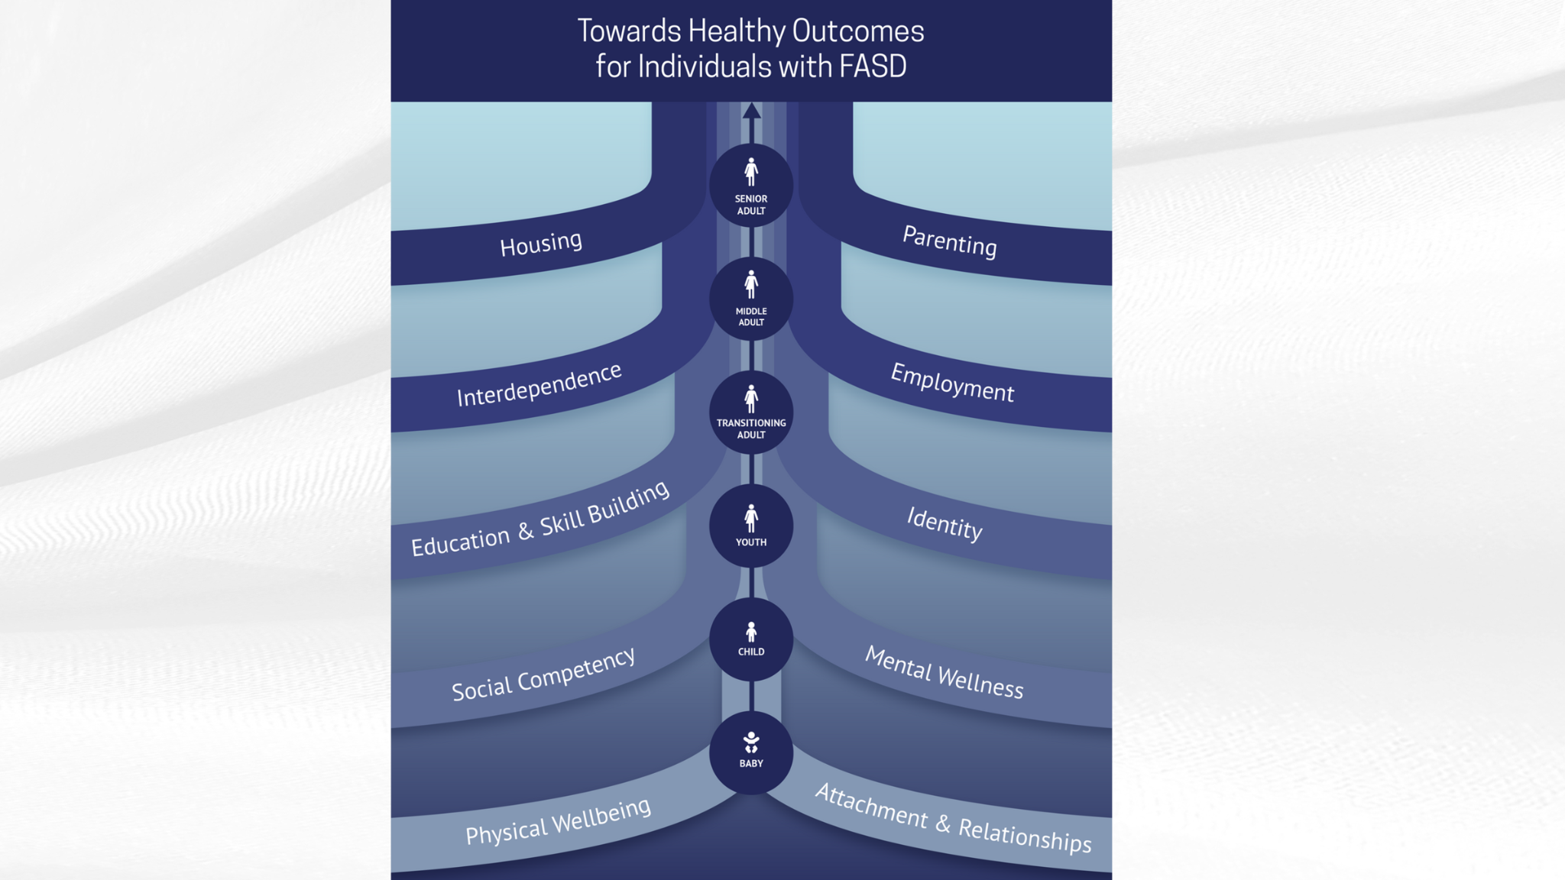
Interventions
Researchers have shown that interventions can improve cognitive (self-regulation, memory, attention), academic (math, language, literacy), behavioural, and social skills in individuals with FASD. Caregiver programs and supports also show promise.
Opportunities for skill growth
Meaningful success
Promote
well-being
Optimize opportunity
Implement Interventions
Notes:
The Towards Healthy Outcomes (THO) was introduced earlier in the Foundations presentation.
THO provides a strengths-based, evidence-informed approach to intervention across the lifespan for individuals with FASD. It was developed by CANFASD in collaboration with researchers, caregivers, and individuals with lived experience to support proactive, individualized planning and service delivery.
THO is structured around multiple domains of healthy functioning that are considered important for overall well-being and success.
One of these key domains is Education and Skill building, which is directly relevant to our work in schools.
Although THO was designed primarily as an intervention framework with the intention of guiding individualized supports and services, it provides a useful conceptual roadmap for understanding how educational planning fits into the broader context of lifelong well-being for individuals with FASD.
Within the Education and Skillbuilding Domain the following is recognized:
identifying and building on individual strengths;
supporting the development of academic and adaptive skills
tailoring instruction and supports to match the student’s profile and developmental needs; and promoting opportunities for skill generalization across settings.
As WRAP coaches, you play a key role in helping students with FASD develop competencies that contribute to healthy outcomes. Not just academically but in their ability to participate meaningfully in school, community, and later life.
The THO framework reminds us to think holistically, to coordinate with caregivers and other systems of support, and to use assessment and intervention planning (such as IPPs/IEPs) in ways that connect educational supports with broader healthy functioning goals.
THO - including the Education & Skillbuilding Domain can be found here: https://canfasd.ca/wp-content/uploads/publications/Towards-Healthy-Outcomes-2.0.pdf

Slide 64



Consistency
within a school
01
Principles of Practice
Collaboration
Between schools and school staff
02
Responsiveness
Between school staff and an individual and their family
03
Proactivity
By school staff
04
Notes:
Four overarching principles of practice can be used as a helpful way to frame intervention approaches:
1. Consistency – within a school requires:
Establishing a common understanding of FASD shared by all staff
Using common messages and approaches to providing services
Minimizing staff turnover and building relationships
Maintaining system structure and stability
Collaboration – between schools and school staff requires:
Integrated response systems at all organizational levels
Organizational support for complex case management
Intentional planning between types of services and levels of service delivery
Responsiveness – between school staff and an individual and their family requires:
Balance between dependence and independence
Expectations that are unique to individual strengths, needs, and culture
Supportive and adaptive environments to facilitate skill development
Proactivity – by school staff requires:
Early intervention to develop positive behaviours
Consideration of individual control and success-focused trajectory
Planning for transition periods

Slide 65

FASD Informed Support
Collaborative and thorough assessment lets you see the "big picture"
Diagnosis is a road to resources and support
Assessment process is responsive to needs
All professionals are equipped to help students succeed
Entire school and all school staff are FASD-informed
65
Notes:
Each individual with FASD is completely unique. Therefore, individualized approaches to support that consider a person’s unique strengths, challenges, needs, goals, and environments is critical. Contextual factors that may be important to consider include mental and physical health needs, histories of trauma and adversity, culture, gender, and other life circumstances.
School staff should prioritize working together with each student and their family to understand the individual and how to support them. Suggestions for working from an FASD-informed perspective include:
Seeking the ‘big picture’ through a collaborative and thorough assessment process
Considering the role of diagnosis as a road to resources and supports, not just a label
Ensuring that the assessment is responsive to prevent greater problems from happening down the line
Ensuring that all professionals working with students with FASD are equipped to help these students achieve success
Building the FASD capacity of the whole school and school staff by sharing information and ensuring meaningful understanding.

Slide 66

“
…getting information from the FASD worker has allowed me to see signs in a lot of kids and given me tools in the toolbox for my daily practice with kids. Ignorance is bliss but when you know things, you can try them; if I don’t know them, I will just assume they are having a bad day.
- Teacher
”
66
http://www.kpdsb.on.ca/assets/uploads/FASD/FASDFinalReport.pdf
Notes:
http://www.kpdsb.on.ca/assets/uploads/FASD/FASDFinalReport.pdf

Slide 67




Metacognitive
Learning & Language
Social
Behavioural
Executive Functioning
Example Interventions
Notes:
Targeted interventions in language and literacy and math have demonstrated positive academic and behavioural outcomes for children with FASD.
Metacognitive Strategies
Teaching metacognitive strategies like rehearsal, chunking, and positive self-talk to help students learn to approach problems thoughtfully rather than in an impulsive manner.
Learning and Language Strategies
Strategies like breaking complex information down into simple components, presenting information in multiple formats (ie. visual and nonverbal) helped improve comprehension.
Social Strategies:
Strategies like breaking down initial peer interactions into a simple three-step process of watching, waiting, and asking helped to improve social interactions.
Behaviour Strategies:
Regularly reviewing clear and explicit rules and positive reinforcement techniques were shown to be successful in increasing the occurrence of targeted behaviours.
Executive Functioning Strategies:
Role playing has been shown to be successful in helping students practice social interaction. This intervention involves the student and her peers playing the roles of the adult and children. These roles were guided by a checklist of behaviours that are needed to resolve social situations.

Slide 68

Strengths-Based Approach
Look at what students can do.
Look at their interests.
Identify their talents.
Opportunities for community engagement.
Encourage them to do positive activities that they are good at.
Notes:
As we talked about earlier in terms of THO and the Strengths-Based & Empowered underlying philosophy…Incorporating a strengths-based approach to intervention is extremely important. Research has shown that strengthening the strong parts of the brain helps the weaker areas of the brain​. Doing things we are good at also helps us feel good and have a sense of fulfillment. Implement a strengths-based approach by:
Look for what people can do rather than what they can’t​
Look for what people are interested in, that is the best way to engage them​
Search for talents​
Search for possibilities within the community for individuals with FASD to participate and contribute​
Encourage the individual to spend as much time as they can doing positive activities that they are good at​

Slide 69

Benefits of Strengths-Based Approach
Develop self-confidence
Encourage positive interaction
Prevent substance use
Build resilience
Build self-esteem
Notes:
Benefits to a strengths-based approach can include:
Being recognized for their strengths can help the individual develop self confidence​
Contributing to the community in a positive way encourages positive interactions to continue​
This approach will help in many other aspects:​
Prevent substance abuse​
Build resilience​
Build self-esteem

Slide 70

SECTION 6
Prevention
TOPICS:
Levels of Prevention
FASD Prevention & Schools
70

Slide 71



FASD Prevention
Experts recommend that couples go alcohol-free when they are:
Pregnant
Trying to get pregnant
At risk for an unplanned pregnancy
Notes:
Recent data show that risky drinking, or drinking above the recommended limit, among women of childbearing age (10 to 49 years) is rising. According to the Public Health Agency of Canada (2016), 56% of childbearing aged women reported binge drinking at least once vs. 44% in 2004.
Experts recommend that couples go alcohol-free if they’re pregnant, planning to get pregnant, or having unprotected sex (i.e. when there is potential for an unplanned pregnancy). If you have an unplanned pregnancy, avoid alcohol use as soon as possible to reduce the potential for harm.
Avoiding alcohol at any point during the pregnancy has benefits of development. Research shows that partners’ drinking habits influence the drinking pattern of mothers. A supportive environment and community are key to avoiding alcohol during a pregnancy.

Slide 72


Level 1
Raising public awareness
Levels of
FASD Prevention
Level 2
Opportunity for safe discussions
Level 3
Provision of supportive services
Level 4
Supporting new mothers
Notes:
FASD can be prevented, but FASD prevention is complex and involves so much more than just raising awareness of the risks of drinking during pregnancy.
There are four levels of FASD prevention:
The first level of prevention is about raising public awareness through campaigns and other broad strategies. Public policy initiatives and health promotion activities supportive of girls’ and women’s health are also key to this level of prevention.
The second level of prevention is about girls and women of childbearing years having the opportunity for safe discussion about reproductive health, contraception, pregnancy, alcohol use, and related issues, with their support networks and healthcare providers.
The third level of prevention focuses on the provision of supportive services that are specialized, culturally safe and accessible for women with alcohol problems, histories of violence and trauma and related health concerns. These trauma-informed, harm-reduction-oriented recovery services are needed not only for pregnant women, but also before pregnancy and throughout the childbearing years.
The fourth level of prevention is about supporting new mothers to maintain healthy changes they have been able to make during pregnancy. Postpartum support for mothers who were not able to make significant changes in their substance use during pregnancy is also vital to assist them to continue to improve their health and social support, as well as the health of their children.
Reference: You can review additional information regarding prevention on the CANFASD Website: https://canfasd.ca/topics/prevention/

Slide 73
FASD Prevention and Schools
Level 1
Level 2
Posters
Resources in school washrooms
Low-risk drinking guidelines
FASD prevention in the curriculum
Discussing risks during health classes
Connect with students who disclose pregnancy
Connect with students who disclose substance use
Notes:
This information may not be appropriate for all schools, depending on the schools’ resources, age range, comfort level, and cultural beliefs. Only present this information if it is appropriate for the school context.
School staff are in a unique position to potentially implement Level 1 and Level 2 prevention initiatives by 1) providing opportunities to educate students about the risks of alcohol consumption during pregnancy and 2) providing supports for students who may be pregnant or experiencing substance use challenges.
Examples of Level 1 initiatives might include:
Placing posters about alcohol and/or contraception use in school bathrooms
Having condoms and/or pregnancy tests available in bathrooms or by school counsellors
Showing examples of the Low-Risk Alcohol Drinking Guidelines
Integrating information about FASD prevention, alcohol use, and contraception into the school curriculum.
Examples of Level 2 initiatives may include:
Responding to a student who has disclosed their pregnancy to you
Connecting a student who has disclosed substance use challenges with additional supports
Discussing the risks of alcohol and substances, drinking during pregnancy in sexual education classes
Emphasizing the importance of contraceptives to prevent unintended pregnancies in sexual education classes
Above all: be respectful. If a student chooses to disclose sensitive health topics, respect their right to confidentiality. Be sensitive to their circumstances, such as their age or cultural background. Listen without judgement and refer them to additional supports as needed.
These conversations can often be very sensitive and may feel awkward or embarrassing. Ensure you read up on FASD prevention or engage with an FASD prevention expert prior to providing this support.

Slide 74

10 Components of FASD Prevention
Respectful
Relational
Self-determining
Women-centered
Harm reduction oriented
Trauma-informed
Health promoting
Culturally safe
Supportive of mothering
Uses a disability lens
Notes:
Presenters can remove this slide as needed
FASD prevention is not only important for the child, but is essential for women’s health. Researchers, community members, professionals, and experts have identified 10 fundamental components for FASD prevention that were created from a women’s health determinants perspective.
Respectful
Relational
Self-determining
Women-centered
Harm reduction oriented
Trauma-informed
Health promoting
Culturally safe
Supportive of mothering
Uses a disability lens

Slide 75

SECTION 7
Building Inclusive Schools
TOPICS:
Education Act
Principles of Inclusion
FASD-Informed Schools
Building Towards Inclusivity
Teams of Support
75

Slide 76

Education Act
Shared responsibility and requires collaboration, engagement and empowerment of all partners in the education system to ensure that all students achieve their potential.
Students are entitled to welcoming, caring, respectful and safe learning environments that respect diversity and nurture a sense of belonging and a positive sense of self.
An inclusive education system provides each student with the relevant learning opportunities and supports necessary to achieve success.
Notes:
Education is a shared responsibility and requires collaboration, engagement and empowerment of all partners in the education system to ensure that all students achieve their potential. Students are entitled to welcoming, caring, respectful and safe learning environments that respect diversity and nurture a sense of belonging and a positive sense of self. An inclusive education system provides each student with the relevant learning opportunities and supports necessary to achieve success.
Reference: Government of Alberta. (2023). Supporting students with special education needs: A guide for school authorities and stakeholders (Publication No. E00P3) https://open.alberta.ca/publications/e00p3

Slide 77


Principles of Inclusion
Anticipate, value, and support diversity and learner differences.
Healthy expectations for all learners.
Understand learners’ strengths and needs.
Remove barriers within learning environments.
Build capacity.
Collaborate for success.
Notes:
There are six key principles guiding Alberta’s vision for an inclusive education system. These principles need to be built into policy, practices, and actions at every level.
Anticipate, value and support diversity and learner differences: Welcoming, caring, respectful and safe learning environments create a sense of belonging for all learners and their families.
Healthy expectations for all learners: Educators and families act on the idea that, with the right instructional supports, every learner can be successful. However, it is important to remember that these expectations should be based on the learner’s challenges, strengths, needs, and goals. Creating a culture of high expectations begins with an accessible curriculum and meaningful and relevant learning experiences.
Understand learners’ strengths and needs: Meaningful data is gathered and shared at all levels of the system—by teachers, families, schools, school authorities and the Ministry—to understand and respond to the strengths and needs of individual learners.
Remove barriers within learning environments: All education partners work together to remove barriers within the learning environment so that all learners are successful and can participate in the school community.
Build capacity: Government, school and system leaders, teachers, education professionals, families and community partners have ongoing opportunities, relationships and resources that develop, strengthen and renew their understanding, skills and abilities to create flexible and responsive learning environments. Capacity building takes place at the personal, school and system levels.
Collaborate for success: All education stakeholders, including school and system staff, families, community partners, post-secondary institutions, teacher preparation programs and government are committed to collaboration to support the success of all learners.
Reference: Government of Alberta. (n.d.). Inclusive education. https://www.alberta.ca/inclusive-education

Slide 78

System and structural
change for inclusion
Policy
Successful inclusion of learners with FASD
Curriculum design, decision making, and delivery
Knowledge
of FASD
Practice
Actions
Collaboration and communication
No blame,
no shame
Adapted from Achieving Inclusion for Students with FASD in Australian Schools
Notes:
A framework was developed in Australia to support inclusion at the policy, practice, and action levels. Key elements of the framework include:
Knowledge of FASD
Collaboration and communication
No blame, no shame
Reference:
Learning with FASD. (n.d.). Learning with FASD: Strategies and supports for neurodiverse learners.
https://learningwithfasd.org.au/

Slide 79

Case for a
Different Approach
Flexible, individual-based responses.
Foster positive school experiences.
Gain knowledge and training in FASD.
Look beyond traditional approaches in classroom management.
Typical behavioural responses are not always interpreted appropriately by the individual with FASD.
79
Notes:
FASD affects each person uniquely, so flexible, individualized approaches are needed for working with students with FASD;
Students with FASD and positive school experiences are less likely to develop adverse outcomes
Teachers often report that they lack the knowledge and training in FASD but are eager to provide improved support to their students
Traditional approaches in classroom management may not be effective in supporting the needs of students with FASD

Slide 80
Recognizing and Supporting Students with FASD in the Classroom
Many students with FASD go unrecognized in school settings.
Misinterpreted behaviours can lead to unnecessary discipline.
Early recognition helps prevent escalation and exclusion.
Collaboration with families and school teams improves consistency.
80
(Kautz-Turnbull et al., 2025)
Notes:
Educators may be the first to see patterns that suggest underlying brain-based differences
When behaviour is viewed through a neurodevelopmental lens rather than as intentional defiance, we can shift from reactive discipline to proactive support.
Simple strategies, predictable routines, clear instructions, visual cues, and task breakdowns help students stay regulated and engaged
Ongoing collaboration with families and support teams ensures students experience consistent expectations across settings.
Reference:
Kautz‐Turnbull, C., Rockhold, M., Speybroeck, E., Myers, J., & Petrenko, C. L. M. (2025). Preventing exclusionary discipline and adverse life experiences in FASD: Teachers' ability to recognize students with FASD in the classroom and develop and implement preventative strategies to support learning and behavior. Alcohol: Clinical and Experimental Research, 49(8), 1828-1838. https://doi.org/10.1111/acer.70100

Slide 81



FASD Informed Schools
Caregivers
Teachers & school boards
Inclusive schools start with knowledge of FASD among all education professionals and caregivers
Communities
Notes:
Inclusivity begins with a knowledge of FASD among all educational professionals. In a study of school Superintendents researchers found most lacked more than a cursory knowledge of FASD yet over 50% had to deliver on a disciplinary meeting (suspension, expulsion) of a student with FASD.
In an FASD intervention project in North-Western Ontario, researchers found a number of positive impacts when school boards, communities, and caregivers were trained on how to support children with FASD:
Caregivers realized they weren’t alone;
Teachers reported that being aware of FASD, having tracking mechanisms, and connecting with knowledgeable support people was very helpful; and
Teachers reported better mental health and well-being.
What Educators Need to Know About FASD is a practical resource published by the Government of Manitoba to help teachers and school staff understand fetal alcohol spectrum disorder (FASD), how it affects learning and behaviour, and to provide classroom-based strategies for supporting students with FASD. The resource can be found here: https://www.gov.mb.ca/fs/fasd/pubs/fasdeducators_en.pdf

Slide 82

Three Areas of Focus
Understanding the whole student
Responding with dynamic environments
Optimizing student-centered programming
Notes:
Teachers have identified three important components of understanding FASD, and strategies for building this understanding:
Understanding the whole student
Take time to build and cultivate a relationship with the student
Focus on and emphasize the accomplishments over the challenging behaviours
Integrate choice with expectations
Responding within dynamic environments
Foster an inclusive atmosphere with student peers
Build the home-school relationships
Access individualized funding
Optimizing student-centered programming
Match supports with needs
Build on strengths
Address service gaps

Slide 83

Building Inclusivity for FASD
Classroom inclusion becomes more challenging over time.
Building inclusivity requires us to adapt to the needs of the learner
Needed: Flexible and responsive learning environments that can adapt to the changing needs of learners.
Notes:
Classroom inclusion may become more challenging over time. As children diagnosed with FASD transition to higher grades, their areas of need and challenges may become more obvious. All students experience challenges but students with FASD may experience challenges that isolate and differentiate them from their peers.
Building inclusivity for FASD in schools requires us to adapt to the needs of the learner. Every learner has unique needs. Some learners have profound and ongoing needs and others have short-term or situation-based needs. This calls for flexible and responsive learning environments that can adapt to the changing needs of learners.

Slide 84

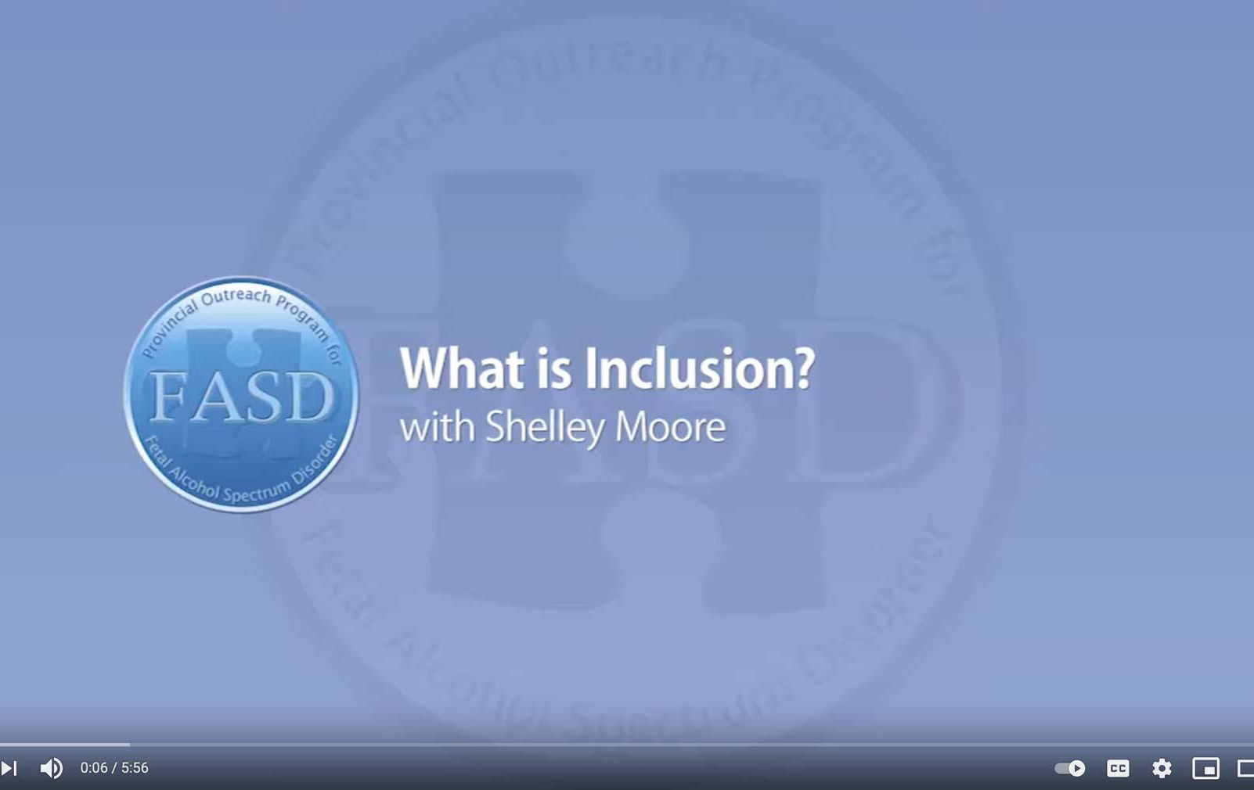
What is Inclusion?
with Shelley Moore
https://www.youtube.com/watch?v=D1fbTKYkU4k
Notes:
Consider this teacher’s experience trying to promote inclusion for her students in a space that wasn’t ideally structured for them: https://www.youtube.com/watch?v=D1fbTKYkU4k (5:56)

Slide 85

Belonging
6 elements to improve belonging:
Effective Listening
Supports
Positive Relationships
Early Programs
Common Interests
Extracurriculars
Notes:
A key element of inclusion is a sense of belonging. Students with FASD need a supportive school community that welcomes them, makes them feel safe, and makes them feel like a contributing member of the school.
In a study on student belonging in Quebec, researchers made six recommendations to improve feelings of belonging for students:
Training educators on effective listening strategies
Providing personal and academic supports for students
Encouraging positive social relationships
Ensuring early implementation of social competence programs
Providing education activities where students can develop common interests with peers
Encouraging extracurricular participation related to their various interests

Slide 86

Belonging in Alberta
The Belonging Project is an Alberta-based initiative from the Skills Society and the University of Alberta exploring belonging and inclusion for people with intellectual disabilities.
The project produced three plain-language summaries including:
  Belonging & Inclusion
  Lived Experience
  Provider Practices
The resources can be accessed here: https://resourcesforpractice.policywise.com/resource?id=137
Notes:
The Skills Society partnered with the University of Alberta to understand how belonging is experienced by adults with intellectual disabilities and what helps them feel connected, valued, and included in their communities.
The three summaries offer a different lens:
Belonging & Inclusion Summary outlines what belonging means and the key conditions that support it.
Lived Experience Summary captures insights directly from individuals with intellectual disabilities about what makes them feel welcomed and included.
Provider Practices Summary focuses on practical steps service providers can take to create environments that foster belonging.

Slide 87
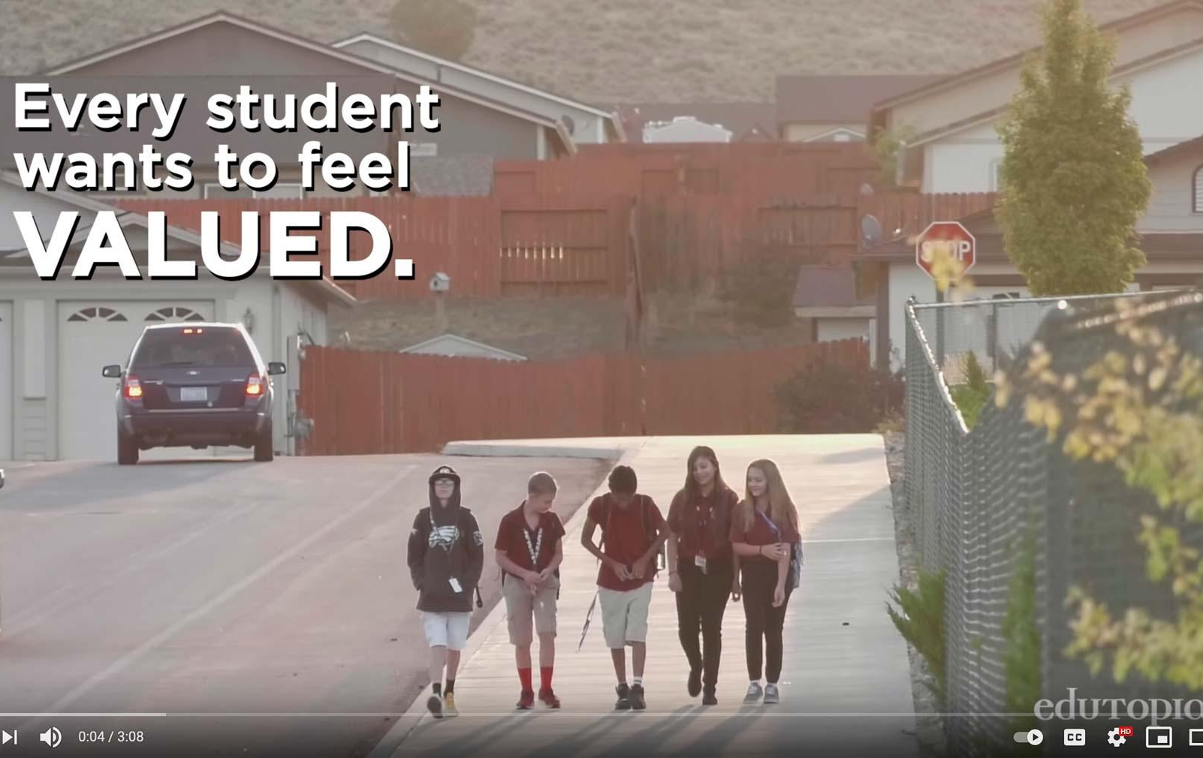
Making Sure Each Child is Known
by Edutopia
https://www.youtube.com/watch?v=xjZx0VdmgkE
Notes:
Consider this strategy implemented in a middle school in Nevada to ensure each student feels like they belong in their school: https://www.youtube.com/watch?v=xjZx0VdmgkE (3:08)

Slide 88
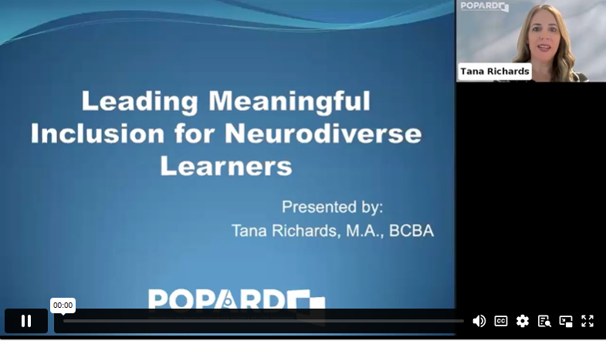
Leading Meaningful Inclusion for Neurodiverse Learners
by Tana Richards
https://popcon.ca/talks/leading-meaningful-inclusion-neurodiverse-learners
Notes:
In this video, Tana Richards, explores the shift from simply placing neurodiverse students in classrooms to creating learning environments where they are valued and connected. The presentation can be found here: https://popcon.ca/talks/leading-meaningful-inclusion-neurodiverse-learners (55:26)

Slide 89

Teams of Support
Educational
Assistant
School Administrators
Teacher
Communication & Collaboration
Consistent Strategies
Outside Agencies
Continuing Education
Caregivers
Notes:
Building capacity and collaboration are key elements to achieving success. The student and educator both need a strong and supportive network. Key stakeholders and their roles in supportive school communities include:
School Administrators
Identify gaps and seeks resources
Promote reflective practice
Commit to inclusivity
Provide leadership with vision
Communicate actively with caregivers
Teachers
Communicate with team
Commit to reflective practice
Incorporate classroom strategies
Compassionately engage with child
Communicate actively with caregivers
Educational Assistants
Provide one-on-one support when needed
Guided or directed by the teacher
Help develop/evaluate strategies
Compassionately engage with child
Maintain a safe environment
Outside Agencies
FASD Assessment and Diagnostic Clinics
Help provide a greater understanding of the student’s needs
FASD Support Providers
Provide resources for training as well as services for students
Caregivers
The core and most consistent member of the student’s support network
Provide a vast diversity of information regarding the student’s strengths, needs, and desires
Serve as the foundation of a strong and supportive network
Other stakeholders may include: school-based counsellors, sports coaches, wellness coaches, inclusive education coordinators, and counselling support professionals. Schools may have centralized supports and services, so it is important to bring in staff that are knowledgeable about those types of programs in order to best support individuals.
Together, the whole team of support needs to have a shared understanding of FASD and shared goals. Strategies for the support team include:
Using consistent strategies to support the student’s success.
Communicating and collaborating to decide on one strategy at a time to address a specific goal.
Developing a communications plan which outlines how the team can share information about successes and failures in a timely manner.

Slide 90

If Sarah didn’t eat her breakfast in the morning, Sarah’s caregivers need a way to communicate that with her teacher. That way, her teacher knows that Sarah’s routine was disrupted, and she may be dysregulated, which may lead to challenges in the classroom. As a team, Sarah’s caregiver and teacher can decide on a strategy to mitigate concerns, like providing Sarah with a granola bar during her first lesson. It can be as simple as an email or a phone call, but communication is huge in helping achieve success for these students.
90
Tracy Masterangelo, Adapted from the Supporting Self-Regulation with Individuals with FASD Presentation
Notes:
Tracy Masterangelo, Adapted from the Supporting Self-Regulation with Individuals with FASD Presentation

Slide 91
Working with Caregivers
Possible Stages
Seeking Diagnosis
Seeking Support
Educator, Advocate
1
2
3
4
5
Coming to Terms
New Understanding
Notes:
Caregivers of individuals with FASD often juggle multiple roles. They are their child’s primary provider, but often also take the role of advocate to raise awareness of FASD and secure supports for their children. Unlike most other support workers, a caregiver is a 24/7 occupation.
Caregivers of individuals with FASD report high levels of stress, even in comparison with caregivers of individuals with other developmental disabilities.
Caregivers may move through several stages in the process of receiving a diagnosis:
Seeking and possibly receiving a diagnosis
Processing emotions and coming to terms with the child’s difficulties
Seeking support and belonging within a knowledgeable community
Developing a new understanding of the child’s behaviour
Becoming an educator, advocate, and expert on the child and FASD
CanFASD has a resource guide for caregivers of FASD: https://canfasd.ca/wp-content/uploads/2018/03/Caregiver-Resource-Guide-FASD-March-2018.pdf
Similarly, Healthy Child Manitoba Developed a Resouce called ‘What Parents and Caregivers Need to Know about Fetal Alcohol Spectrum Disorder) which can be found here: https://www.gov.mb.ca/fs/fasd/pubs/fasd_caregivers.pdf
References:
Bobbitt, S. A., Baugh, L. A., Andrew, G. H., Cook, J. L., Green, C. R., Pei, J. R., & Rasmussen, C. R. (2016). Caregiver needs and stress in caring for individuals with fetal alcohol spectrum disorder. Research in Developmental Disabilities, 55, 100–113
Olson, H. C., Oti, R., Gelo, J., & Beck, S. (2009). “Family matters:” Fetal alcohol spectrum disorders and the family. Developmental Disabilities Research Reviews, 15(3), 235–249.
Watson, S. L., Coons, K. D., & Hayes, S. A. (2013). Autism spectrum disorder and fetal alcohol spectrum disorder. Part I: A comparison of parenting stress. Journal of Intellectual & Developmental Disability, 38(2), 95–104

Slide 92

Caregiver Needs and Educator Responses
  Being Heard by Educators
  Openness from Educators
  FASD-Informed Educators
  Involvement in Child’s Education
  Resources and Accommodations
  Supportive Knowledge Base
  Support and Understanding at Home
Notes:
Caregiver needs might include:
Being Heard by Educators
Openness from educators when communicating
FASD-Informed Educators
Educators who understand and are willing to meet the complex needs of students with FASD
Involvement in their Child’s Education
Active involvement in their child’s education to ensure proper fit
Resources and Accommodations
Practical resources that address their child’s complex needs
Supportive Knowledge Base
Gaining knowledge about FASD and to develop effective supports
Support and Understanding at Home
Develop successful parenting techniques for their child
Possible educator responses
Encourage parents to have a structured, consistent, predictable home environment
Share strategies and tips that have worked for other parents
Discuss the role of rules and expectations in the classroom
Explain how they create routines that increase compliance and self-management, both at home and school
Consider the concerns identified by caregivers and if this is something that the school can address. Offer caregivers online and video resources that address concerns parents have identified
Facilitate ongoing, open communication between home and school. This can be accomplished through weekly phone calls or using a communication book between home and school
Encourage parents to get accurate information about FASD from libraries, hotlines, community agencies or other sources
Encourage parents to talk to other families in the community who have children with special needs
Provide parents with information regarding network organizations with support groups in the community
Acknowledge and understand the difficult role of parents of children with special needs and support parents in this role
Assist parents in helping children develop appropriate social networks

Slide 93

Intentional practice requires
Constant Education
Shared learning within the student’s entire support system will enhance education outcomes.
Notes:
Every member of a student’s support team contributes to the student’s success through constant learning. FASD research has increased dramatically across the globe, so intentional best practice requires continuing education. Shared learning within the student’s entire support system will enhance education outcomes.

Slide 94

SECTION 8
Review

Slide 95




Understanding FASD
Notes:
We thought we might use a metaphor to wrap up what we’ve been talking about today. The driving metaphor helps describe how people with FASD experience the world.
Each brain works in its own way. Every person with FASD has a unique brain, like a unique vehicle.
Some vehicles travel smoothly on certain roads but struggle on others.
Some need extra maintenance or slower speeds to perform their best.
Some vehicles have a touchy brake pedal, that slows down and stops the car with the lightest touch.
Still others might have faulty brakes, or even no brakes! But a very sensitive gas pedal that revvs up quickly, sometimes without even meaning to!
What’s important is that the person learns to understand themselves, what is unique about their brain, and how to adapt. Supportive others like us can also do the same.
With the right conditions and support, all drivers can reach their destination.
In education contexts, this means that some students might be able to pick up on the unspoken rules and expectations easily with little support, but others students might need those things explained to them a few times, and others might do well with structure and predictability, whereas others need flexibility or quieter spaces.
Our job as WRAP coaches is to adjust the road conditions, not expect the car to change. When we understand this, we begin to view behaviour as a signal of what is needed, rather than a sign of defiance.

Slide 96

Review
Lifelong and
complex disability
Impacts 1 in 25 people in Canada
A complex disability unique to each person
Early diagnosis is crucial
Four levels to FASD prevention
Knowledge of FASD for all school staff
Whole school approach with collaboration
Notes:
Here are some of the key pieces of information you learned in this presentation:
FASD is a lifelong disability that can occur when a fetus is exposed to alcohol prenatally
FASD is one of the most common developmental disabilities in Canada, impacting an estimated 4% of Canadians or 1 in 25 people.
FASD is a complex disability. Each person will have unique strengths and challenges and will need individualized supports to meet their needs.
Early diagnosis is crucial because it can lead to early interventions and supports.
There are four different levels to FASD prevention that range from raising awareness to supporting mothers
Inclusivity requires knowledge and understanding of FASD by all members of school staff
In order to succeed, schools need to take a whole-school approach that requires open communication and collaboration between everyone involved with the student’s education, including teachers, caregivers, and support staff

Slide 97

WRaP Blog
wrap2fasd.org
FASD Networks in Alberta
fasdalberta.ca
CanFASD
canfasd.ca

Slide 98

Break
Slide
Take a short break

