Slide 1



School to Adulthood Transitions
What are next steps for students with FASD?
Learn More
Notes:
Edited: Fall-Winter 2025

Slide 2
Land
Acknowledgements
2
Notes:
Please find and include the appropriate land acknowledgement for the land you will be giving your presentation from (which may change between presentations depending on your location).
If you are unsure, https://native-land.ca/ is a resource that can tell you what territory you are on.

Slide 3
Presenter Introduction
Your Name
& Pronouns
Space to include a fun fact
Your Network
Email@emailaddress.com

Slide 4
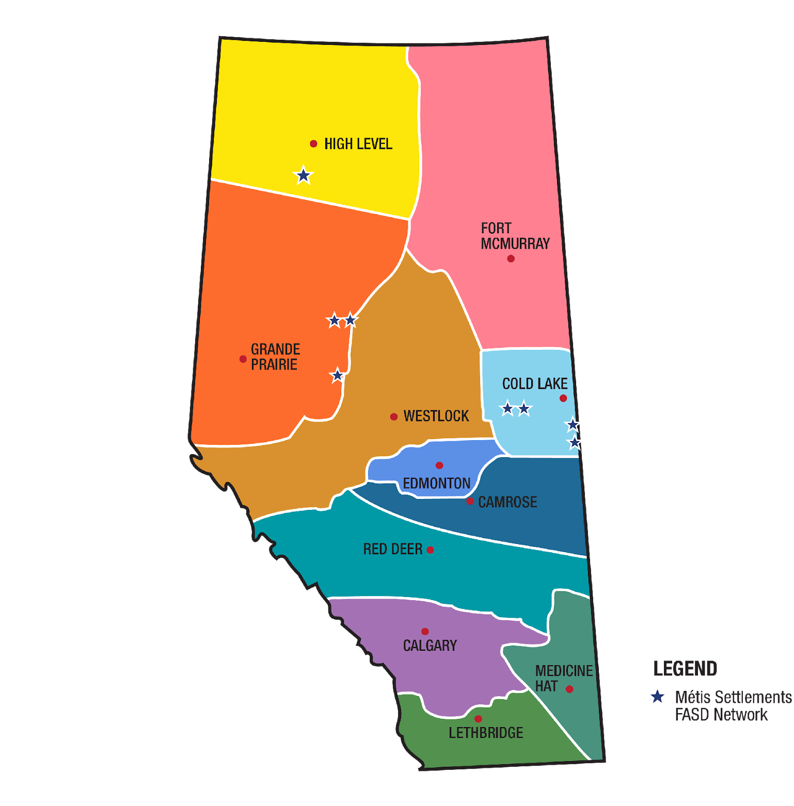
FASD Networks
In Alberta
www.FASDAlberta.ca
Notes:
A key innovation of Alberta’s response to FASD was the development and continued funding of 12 regionally based civil society FASD Service Networks, which have become the cornerstone for the delivery of FASD awareness, prevention, assessment and diagnosis, and supports for individuals with FASD, their families, and caregivers across the province.
In alignment with the strategic direction provided by the Government of Alberta, the FASD Service Networks build capacity in communities by enhancing existing services and by fostering the development of new ones.
The community-led FASD Service Networks have each designed a model of service delivery to meet the unique needs in their region.
The WRaP 2.0 project is implemented by the FASD Networks.

Slide 5
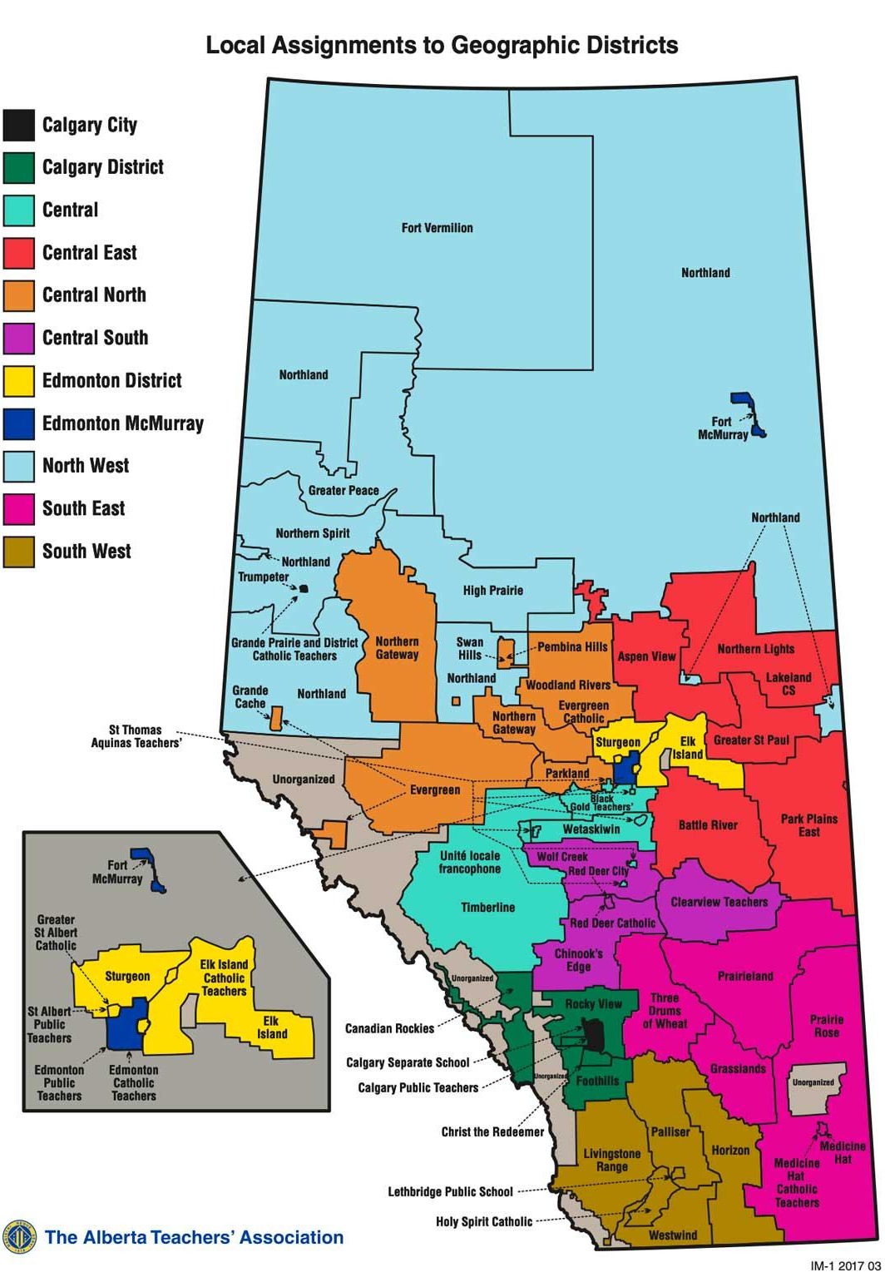
ATA Locals Map
View interactive map Local Assignments to Geographic Districts
Notes:
https://www.teachers.ab.ca/SiteCollectionDocuments/ATA/For%20Members/ATA%20Locals/IM1%202017%2003%2011x17%20Colour.pdf
The WRaP 2.0 project is a five-year project, from development to implementation to exit strategy, and it began February 1, 2021 and will run until everything is finalized by January 31, 2026.
It is province-wide and focuses on building the knowledge and capacity of educators to better support students with FASD.
The objectives of the project include:
Increase the capacity of teachers and schools to meet the educational needs of children and youth (ECS: Early Childhood Services: education programs that are offered by a school authority to Grade 12) with FASD
Teachers and school leaders will increase their knowledge and skills regarding how to support students with FASD by engaging in current best practices as shared by the FASD Networks through FASD instructional coaches.
Schools will enhance their capacity by incorporating FASD-informed approaches into their classroom communities, as part of a continuum of supports and services.

Slide 6

Introduction
This presentation will cover the challenges and strategies for support to improve the experience of students with Fetal Alcohol Spectrum Disorder transitioning from school into adulthood.
6

Slide 7
01
Overview of FASD
02
Building Inclusive Schools
03
Implementing Interventions
04
Transitions
Content
05
Supporting Transitions
06
Understanding Your Role
07
Transition Planning
08
Examples
09
Review
Notes:
Overview of FASD
Building Inclusive Schools
Implementing Interventions
Transitions
Supporting Transitions
Understanding Your Role
Transition Planning
Examples

Slide 8

SECTION 1
Overview
of FASD
TOPICS:
Prevalence
Definition
Language Matter
Signs and Symptoms
Protective Factors
8
Notes:
This presentation assumes you already went through a detailed overview of FASD with this audience using Presentation 1 - Foundations in FASD. This section just provides a refresher on the key elements covered in Presentation 1. You can supplement this section with additional slides and materials from Presentation 1 as needed.

Slide 9

Prevalence
1.6 million
people in Canada
44 -176, 000
4%
people in Alberta
of people
in Canada
1 in 25
people in Canada
Notes:
Researchers currently estimate that at least 4% of individuals in Canada have FASD.
This estimate translates to more than 1.6 million people in Canada or at least 1 in 25.
In Alberta, estimates are between 44,000 to 176,000, or 1-4% in the general population.
This means about one student in every classroom may have FASD.
Flannigan, K., Cauduro, E., Unsworth, K., Harding, K., & McFarlane, A. (2024). The prevalence of fetal alcohol spectrum disorder: Issue paper update. Canada FASD Research Network. https://canfasd.ca/wp-content/uploads/publications/Prevalence-1-Issue-Paper-Update-FINAL.pdf
Popova, S., Lange, S., Shield, K., Burd, L., & Rehm, J. (2019). Prevalence of fetal alcohol spectrum disorder among special subpopulations: a systematic review and meta‐analysis. Addiction, 114(7), 1150-1172. DOI: https://doi.org/10.1111/add.14598
Popova, S., Lange, S., Poznyak, V., Chudley, A. E., Shield, K. D., Reynolds, J. N., ... & Rehm, J. (2019). Population-based prevalence of fetal alcohol spectrum disorder in Canada. BMC public health, 19(1), 845. https://link.springer.com/article/10.1186/s12889-019-7213-3

Slide 10

Definition
“
Fetal Alcohol Spectrum Disorder (FASD) is a diagnostic term used to describe impacts on the brain and body of individuals prenatally exposed to alcohol.
FASD is a lifelong disability. Individuals with FASD will experience some degree of challenges in their daily living, and need support with motor skills, physical health, learning, memory, attention, communication, emotional regulation, and social skills to reach their full potential.
Each individual with FASD is unique and has areas of both strengths and challenges.
”
Notes:
This is the standard definition of FASD, developed by the Canada Fetal Alcohol Spectrum Disorder Research Network, or CanFASD (Harding et al., 2019). CanFASD strongly recommends that professionals adopt this definition in their practice because it can:
Reduce stigma
Increase everyone’s understanding of FASD
Reduce confusion about the disability
Improve consistency in how we talk about this disorder
Help us to focus on a more strengths-based approach
For conversations about FASD in more informal settings, a community definition was also developed:
“FASD is a lifelong disability that affects the brain and body of people who were exposed to alcohol in the womb. Each person with FASD has both strengths and challenges and will need special supports to help them succeed with many different parts of their daily lives.”
Reference:
Harding, K., Flannigan, K., & McFarlane, A. (2019, July). Policy action paper: Toward a standard definition of fetal alcohol spectrum disorder in Canada. Canada FASD Research Network. https://canfasd.ca/wp-content/uploads/2019/08/Toward-a-Standard-Definition-of-FASD-Final.pdf

Slide 11

Possible Diagnoses
01
02
At-risk for neurodevelopmental disorder and FASD associated with PAE
FASD with sentinel facial features
FASD without sentinel facial features
Diagnosis
Designation
Notes:
Prior to 2015, individuals could be diagnosed with Fetal Alcohol Syndrome (FAS), partial FAS (pFAS), or Alcohol-Related Neurodevelopmental Disorder (ARND).
The process for FASD assessment and diagnosis in Canada was most recently updated in 2015. There are 2 possible categories of FASD diagnosis:
FASD with sentinel facial features
FASD without sentinel facial features
FASD with or without sentinel facial features replaced FAS, pFAS, and ARND, which are no longer used as diagnostic terms.
An individual may also be given the designation of “At risk for neurodevelopmental disorder and FASD, associated with PAE” which is not a diagnosis, but means that the person is experiencing significant challenges that may eventually lead to a diagnosis.
In Canada, we use FASD as the general term to cover anyone who meets the criteria for diagnosis. The third “At-Risk” term is non-diagnostic, meaning the individual does not currently meet diagnostic criteria for FASD at the time of assessment but will require future follow-up and support.
Reference: Cook, J. L., Green, C. R., Lilley, C. M., Anderson, S. M., Baldwin, M. E., Chudley, A. E., Conry, J. L., LeBlanc, N., Loock, C. A., Lutke, J., Mallon, B. F., McFarlane, A. A., Temple, V. K., & Rosales, T. (2016). Fetal alcohol spectrum disorder: A guideline for diagnosis across the lifespan. Canadian Medical Association Journal, 188(3), 191–197. https://www.cmaj.ca/content/188/3/191

Slide 12


Prenatally Exposed to Alcohol
Level 1
Raising public awareness
Levels of
FASD Prevention
Level 2
Opportunity for safe discussions
Level 3
Provision of supportive services
Level 4
Supporting new mothers
Notes:
FASD can occur when someone is “prenatally exposed to alcohol”. But just because someone drinks during pregnancy does not mean their child will have FASD. The science isn't clear about timing and amount of exposure, so experts recommend that no alcohol is safest during pregnancy, and if you're trying to get pregnant or are breastfeeding.
FASD is technically preventable, but FASD prevention is really complex. There are four levels of prevention that all must be considered in order to support healthy pregnancies.
This is background knowledge on FASD. You should consult resources on FASD prevention if you plan to present or develop teachings on sexual or reproductive health or substance use.
Reference: You can review additional information regarding prevention on the CANFASD Website: https://canfasd.ca/topics/prevention/

Slide 13

FASD is a Lifelong Disability
Notes:
FASD is a life-long, whole body disorder so supports must be provided across the lifespan. An individual’s needs and strengths may change throughout their lives.
Strategies will need to be constantly reviewed and revised as the individual grows and changes and throughout transition periods. There is good evidence that early and appropriate supports in the education setting (and across other domains) can improve outcomes for people with FASD.
References:
Pei, J., Joly, V., Kennedy, K., & Flannigan, K. (2024). Towards Healthy Outcomes: A Framework for Integrated Community Intervention. Canada FASD Research Network in collaboration with the University of Alberta. https://canfasd.ca/wp-content/uploads/publications/Towards-Healthy-Outcomes-2.0.pdf
Cook, J. L., Green, C. R., Lilley, C. M., Anderson, S. M., Baldwin, M. E., Chudley, A. E., Conry, J. L., LeBlanc, N., Loock, C. A., Lutke, J., Mallon, B. F., McFarlane, A. A., Temple, V. K., & Rosales, T. (2016). Fetal alcohol spectrum disorder: A guideline for diagnosis across the lifespan. Canadian Medical Association Journal, 188(3), 191–197. https://www.cmaj.ca/content/188/3/191

Slide 14







Support Might be Required For:
Following or Participating in Conversations
Reading or Writing for Meaning
Learning and Memory
Being Impulsive, overwhelmed
Making Friends
Areas in Need of Support
Understanding Abstract Concepts
Being Sensitive to Stimuli
Notes:
Individuals with FASD are diverse, and many aspects of cognitive, behavioural, and physical functioning can be impacted by prenatal alcohol exposure. Possible areas of need that may require support: motor skills, physical health, learning, memory, attention, communication, emotional regulation, and social skills.
More specifically, to the classroom, areas of need may include:
Learning and memory (long-term processing pace)
Following or participating in conversations
Reading or writing for meaning
Using and understanding expressive/receptive language
Understanding abstract concepts like time and money
Being impulsive, distracted, overwhelmed
Making friends
Being sensitive to sounds, visual stimuli, textures and smells
Educational strategies that rely on an assumption of “normal” functioning of these cognitive processes are likely to be less effective for students with FASD.
References:
Cook, J. L., Green, C. R., Lilley, C. M., Anderson, S. M., Baldwin, M. E., Chudley, A. E., Conry, J. L., LeBlanc, N., Loock, C. A., Lutke, J., Mallon, B. F., McFarlane, A. A., Temple, V. K., & Rosales, T. (2016). Fetal alcohol spectrum disorder: A guideline for diagnosis across the lifespan. Canadian Medical Association Journal, 188(3), 191–197. https://www.cmaj.ca/content/188/3/191
Pei, J., Tremblay, M., McNeil, A., Poole, N., & McFarlane, A. (2017). Neuropsychological aspects of prevention and
intervention for FASD in Canada. Journal of Pediatric Neuropsychology, 3(1), 25-37. DOI: 10.1007/s40817-016-0020-1

Slide 15
















Each Individual with FASD is Unique
Notes:
“Each individual is unique and has areas of both strengths and areas in need of support.”
How it affects each person is unique, as is often said by people with FASD, “if you’ve met one person with FASD, you’ve met one person with FASD.” Each person demonstrates unique strengths and needs.
When supporting students, you need to consider their unique needs and strengths, as well as their environments and supports, to be effective in helping them succeed.
An educational approach that considers only their challenges won’t be effective because it doesn’t give students the opportunity to identify and develop their strengths.

Slide 16

Our Language Matters
Instead of…
Use…
Suffering with, Damaged by, Living with
Person or Individual with FASD
Mentally Disabled
Cognitive or Neurodevelopmental Disability
FASD Student
Student with FASD
Alcoholics, Addicts, and Alcoholic mother
Birth mother, or parent who use(d) substances during pregnancy
Admitted to Alcohol Use or Denied Alcohol Use
Reported Drinking Alcohol or Confirmed Alcohol Use
Notes:
Creating FASD-informed schools also means shifting our language around how we talk and think about FASD. How we talk about people with FASD matters.
Individuals with FASD are often stigmatized because of their diagnosis, their behaviours, and other possible traits that may be seen as different from others. A great deal of stigma also surrounds mothers and women who use substances during pregnancy and family members of people with FASD.
Language is an important tool is addressing stigma and stereotypes. We want to make sure the language we’re using is:
strengths-based
person-first (unless their preference is otherwise specified)
evidence-based; and
dignity-promoting
For example:
Use person or individual with FASD instead of suffering with, damaged by, living with FASD
Use cognitive or neurodevelopmental disability instead of mentally disabled
Use student with FASD instead of FASD students
Replace stigmatizing terms such as “alcoholic mother” with person-first terms such as “birth mother, or parent who use(d) substances during pregnancy.
Use reported drinking alcohol or confirmed alcohol use instead of admitted to alcohol use or denied alcohol use
Creating FASD-informed schools also means shifting our language around how we talk and think about FASD.
Additional information can be found within the Common Messages Guide: https://canfasd.ca/wp-content/uploads/publications/Common-Messages.pdf

Slide 17
Areas in Need of Support
vv
A
L
A
R
M
S
Reasoning
Adaptation
Sensory Processing Disorders
Attention
Language
Memory
Notes:
FASD often goes undiagnosed or misdiagnosed. Signs and symptoms are hard to recognize in babies and young children, so individuals with FASD often aren’t diagnosed until they are in school or teenagers. Many receive diagnosis in adulthood.
ALARMS is a tool that may help you identify a student with FASD in your classroom. ALARMS stands for Adaptation, Language, Attention, Reasoning, Memory, Sensory Processing Disorders:
Adaptation – students struggle getting started or stopping activities. At school this may look like trouble managing all the transitions happening throughout the day (i.e. moving from Math to art). Unsupervised time can also be really challenging for students with FASD because there is less structure and fewer rules to depend on.
Language – students with FASD are often gifted with expressive language but are challenged in the receptive language domain. This may make the child seem older than they are, but at the same point the child may have trouble understanding instructions or completing a task.
Attention – People with FASD often have a comorbid ADHD/ADD diagnosis. Paying attention to one task can be challenging.
Reasoning – Abstract concepts are challenging for people with FASD to understand. They often have trouble with math, science, and reading comprehension, and struggle to understand concepts like time and money.
Memory – People with FASD often have memory challenges and will experience gaps or holes in memory. They will often make the same mistakes again, or come back to school on Monday and can’t remember what they learned on Friday
Sensory Processing Disorders – people with FASD often struggle managing sensory input, organization, and output. They may be over or under stimulated in their environments. For some, they may experience sensory overloads, others may stay “tuned-out”
Remember: With this information, your role can be to identify students with possible PAE and follow school process to move towards diagnosis.
Pei, J., & Rinaldi, C. (2014). Understanding students with FASD: A guide to school-based intervention. Edmonton Regional Learning Consortium

Slide 18






Several factors can protect individuals with FASD and result in more positive outcomes:
Stable and nurturing home environment
Basic needs met
Early and effective supports and services
No experience with violence or trauma
Protective Factors
Developmental disabilities services
Diagnosed and flagged before the age of 6
Notes:
There are several protective factors that can result in positive outcomes and enable potential success for individuals with FASD. These include:
Nurturing and stable home and a consistent home environment:
In fact, living in a stable and nurturing home has been suggested to be one of the most important protective factors against negative outcomes for individuals with FASD Consistent home environment
Basic needs met
No experience with violence or trauma
A home environment free from violence is a key protective factor.
Implementing trauma-informed approaches in schools and communities helps create a more supportive environment. Received developmental disability services
Diagnosed or flagged before the age of 6 years
Receiving a diagnosis early is a critical component for success.
Early and effective support where needed
Original Ref: AFKA Understanding FASD half day PPT (from original)
New References: (Flannigan et al., 2020; Streissguth et al., 2004).

Slide 19

SECTION 2
Building Inclusive Schools
TOPICS:
Education Act
Principles of Inclusion
FASD-Informed Schools
Building Towards Inclusivity
Teams of Support
19

Slide 20

Education Act
Shared responsibility and requires collaboration, engagement and empowerment of all partners in the education system to ensure that all students achieve their potential.
Students are entitled to welcoming, caring, respectful and safe learning environments that respect diversity and nurture a sense of belonging and a positive sense of self.
An inclusive education system provides each student with the relevant learning opportunities and supports necessary to achieve success.
Notes:
Education is a shared responsibility and requires collaboration, engagement and empowerment of all partners in the education system to ensure that all students achieve their potential. Students are entitled to welcoming, caring, respectful and safe learning environments that respect diversity and nurture a sense of belonging and a positive sense of self. An inclusive education system provides each student with the relevant learning opportunities and supports necessary to achieve success.
The Education Act does not specifically mention FASD, but it establishes the framework for the K-12 system in Alberta, which includes provisions for students with disabilities and the roles and responsibilities of schools, parents, and the Ministry.
Reference:
Government of Alberta. (2023). Supporting students with special education needs: A guide for school authorities and stakeholders (Publication No. E00P3) https://open.alberta.ca/publications/e00p3

Slide 21


Principles of Inclusion
Anticipate, value and support diversity and learner differences
High expectations for all learners
Understand learners’ strengths and needs
Remove barriers within learning environments
Build capacity
Collaborate for success
Notes:
There are six key principles guiding Alberta’s vision for an inclusive education system. These principles need to be built into policy, practices, and actions at every level.
Anticipate, value and support diversity and learner differences: Welcoming, caring, respectful and safe learning environments create a sense of belonging for all learners and their families.
High expectations for all learners: Creating a culture of high expectations begins with an accessible curriculum and meaningful and relevant learning experiences. Educators and families act on the idea that, with the right instructional supports, every learner can be successful. However, it is important to remember that these expectations should be based on the learner’s challenges, strengths, needs, and goals.
Understand learners’ strengths and needs: Meaningful data is gathered and shared at all levels of the system—by teachers, families, schools, school authorities and the Ministry—to understand and respond to the strengths and needs of individual learners.
Remove barriers within learning environments: All education partners work together to remove barriers within the learning environment so that all learners are successful and can participate in the school community.
Build capacity: Government, school and system leaders, teachers, education professionals, families and community partners have ongoing opportunities, relationships and resources that develop, strengthen and renew their understanding, skills and abilities to create flexible and responsive learning environments. Capacity building takes place at the personal, school and system levels.
Collaborate for success: All education stakeholders, including school and system staff, families, community partners, post-secondary institutions, teacher preparation programs and government are committed to collaboration to support the success of all learners.
Reference: Government of Alberta. (n.d.). Inclusive education. https://www.alberta.ca/inclusive-education

Slide 22

System and structural
change for inclusion
Policy
Successful inclusion of learners with FASD
Curriculum design, decision making, and delivery
Knowledge
of FASD
Practice
Actions
Collaboration and communication
No blame,
no shame
Adapted from Achieving Inclusion for Students with FASD in Australian Schools
Notes:
A framework was developed in Australia to support inclusion at the policy, practice, and action levels. Key elements of the framework include:
Knowledge of FASD
Collaboration and communication
No blame, no shame
Reference/Resource:
Learning with FASD. (n.d.). Learning with FASD: Strategies and supports for neurodiverse learners. https://learningwithfasd.org.au/

Slide 23

Case for a
Different Approach
Flexible, individual-based responses prove to be most effective approaches
Students with FASD and positive school experiences are less likely to develop adverse outcomes
Teachers often report that they lack the knowledge and training in FASD
Research has found that traditional approaches in classroom management can be unsuccessful in supporting the needs of students with FASD
Typical behavioural responses are not always interpreted appropriately by the individual with FASD
23
Notes:
FASD affects each person uniquely, so flexible, individualized approaches are needed for working with students with FASD;
Students with FASD and positive school experiences are less likely to develop adverse outcomes
Teachers often report that they lack the knowledge and training in FASD but are eager to provide improved support to their students
Traditional approaches in classroom management may not be effective in supporting the needs of students with FASD

Slide 24

Recognizing and Supporting Students with FASD in the Classroom
Many students with FASD go unrecognized in school settings.
Misinterpreted behaviours can lead to unnecessary discipline.
Early recognition helps prevent escalation and exclusion.
Collaboration with families and school teams improves consistency.
24
(Kautz-Turnbull et al., 2025)
Notes:
Educators may be the first to see patterns that suggest underlying brain-based differences
When behaviour is viewed through a neurodevelopmental lens rather than as intentional defiance, we can shift from reactive discipline to proactive support.
Simple strategies, predictable routines, clear instructions, visual cues, and task breakdowns help students stay regulated and engaged
Ongoing collaboration with families and support teams ensures students experience consistent expectations across settings.
Reference: Kautz‐Turnbull, C., Rockhold, M., Speybroeck, E., Myers, J., & Petrenko, C. L. M. (2025). Preventing exclusionary discipline and adverse life experiences in FASD: Teachers' ability to recognize students with FASD in the classroom and develop and implement preventative strategies to support learning and behavior. Alcohol: Clinical and Experimental Research, 49(8), 1828-1838. https://doi.org/10.1111/acer.70100

Slide 25






Caregivers
FASD Informed Schools
Teachers & school boards
Knowledge of FASD among all education professionals and caregivers
Communities
Notes:
Inclusivity begins with a knowledge of FASD among all educational professionals. In a study of school Superintendents researchers found most lacked more than a cursory knowledge of FASD yet over 50% had to deliver on a disciplinary meeting (suspension, expulsion) of a student with FASD.
In an FASD intervention project in North-Western Ontario, researchers found a number of positive impacts when school boards, communities, and caregivers were trained on how to support children with FASD:
Caregivers realized they weren’t alone;
Teachers reported that being aware of FASD, having tracking mechanisms, and connecting with knowledgeable support people was very helpful; and
Teachers reported better mental health and well-being.
Resource: The Government of Alberta offers free online FASD training through the Canada FASD Research Network for educators and other professionals: https://www.alberta.ca/fasd-training-and-education
What Educators Need to Know About FASD is a practical resource published by the Government of Manitoba to help teachers and school staff understand fetal alcohol spectrum disorder (FASD), how it affects learning and behaviour, and to provide classroom-based strategies for supporting students with FASD. The resource can be found here: https://www.gov.mb.ca/fs/fasd/pubs/fasdeducators_en.pdf

Slide 26

What Educators Need to Know
Knowledge of FASD among all education professionals and caregivers
Notes:
This screenshot is from a short video featuring Myles Himmelreich, a speaker with lived experience of FASD. In this video, Myles explains that many behaviours seen in students with FASD stem from brain-based differences rather than defiance, and he encourages educators to use empathy, clarity, and individualized supports. For more information you can check out the video: https://www.fasdoutreach.ca/resources/all/m/myles-himmelreich-what-educators-need-know

Slide 27

Three Areas
of Focus
Understanding the whole student
Responding with dynamic environments
Optimizing student-centered programming
Notes:
Teachers have identified three important components of understanding FASD, and strategies for building this understanding:
Understanding the whole student
Take time to build and cultivate a relationship with the student
Focus on and emphasize the accomplishments over the challenging behaviours
Integrate choice with expectations
Responding within dynamic environments
Foster an inclusive atmosphere with student peers
Build the home-school relationships
Access individualized funding
Optimizing student-centered programming
Match supports with needs
Build on strengths
Address service gaps
References: Pei, J., Job, J., Poth, C., O'Brien-Langer, A., & Tang, W. (2015). Enhancing Learning Environments for Students Affected by Fetal Alcohol Spectrum Disorders: An Exploratory Study of Canadian Pre-Service Teacher Knowledge and Conceptions. Journal of Education and Training Studies, 3(5), 134-143. DOI: 10.11114/jets.v3i5.955

Slide 28

Building Towards Inclusivity for FASD
Classroom inclusion becomes more challenging over time
Building inclusivity in schools requires us to adapt to the needs of the learner
Flexible and responsive learning environments that can adapt to the changing needs of learners
Notes:
Classroom inclusion may become more challenging over time. As children diagnosed with FASD transition to higher grades, their areas of need and challenges may become more obvious. All students experience challenges but students with FASD may experience challenges that isolate and differentiate them from their peers.
Building inclusivity for FASD in schools requires us to adapt to the needs of the learner. Every learner has unique needs. Some learners have profound and ongoing needs and others have short-term or situation-based needs. This calls for flexible and responsive learning environments that can adapt to the changing needs of learners.

Slide 29

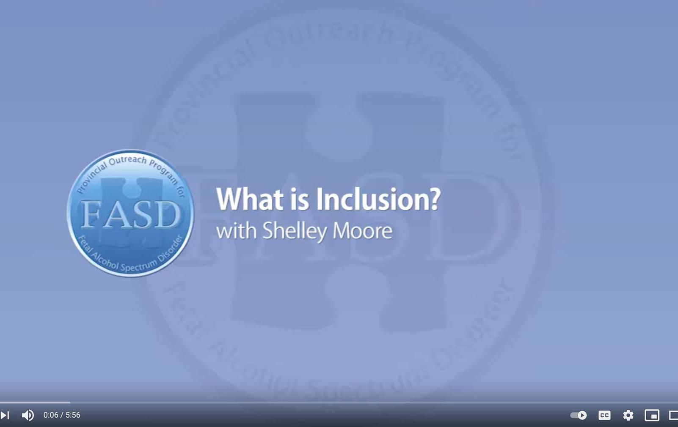
What is Inclusion?
with Shelley Moore
https://www.youtube.com/watch?v=D1fbTKYkU4k
Notes:
Consider this teacher’s experience trying to promote inclusion for her students in a space that wasn’t ideally structured for them: https://www.youtube.com/watch?v=D1fbTKYkU4k (5:56)

Slide 30

Belonging
6 elements to improve belonging:
Effective Listening
Supports
Positive Relationships
Early Programs
Common Interests
Extracurriculars
Notes:
A key element of inclusion is a sense of belonging. Students with FASD need a supportive school community that welcomes them, makes them feel safe, and makes them feel like a contributing member of the school.
In a study on student belonging in Quebec, researchers made six recommendations to improve feelings of belonging for students:
Training educators on effective listening strategies
Providing personal and academic supports for students
Encouraging positive social relationships
Ensuring early implementation of social competence programs
Providing education activities where students can develop common interests with peers
Encouraging extracurricular participation related to their various interests

Slide 31

Belonging in Alberta
The Belonging Project is an Alberta-based initiative from the Skills Society and the University of Alberta exploring belonging and inclusion for people with intellectual disabilities.
The project produced three plain-language summaries including:
  Belonging & Inclusion
  Lived Experience
  Provider Practices
The resources can be accessed here: https://resourcesforpractice.policywise.com/resource?id=137
Notes:
The Skills Society partnered with the University of Alberta to understand how belonging is experienced by adults with intellectual disabilities and what helps them feel connected, valued, and included in their communities.
The three summaries offer a different lens:
Belonging & Inclusion Summary outlines what belonging means and the key conditions that support it.
Lived Experience Summary captures insights directly from individuals with intellectual disabilities about what makes them feel welcomed and included.
Provider Practices Summary focuses on practical steps service providers can take to create environments that foster belonging.

Slide 32
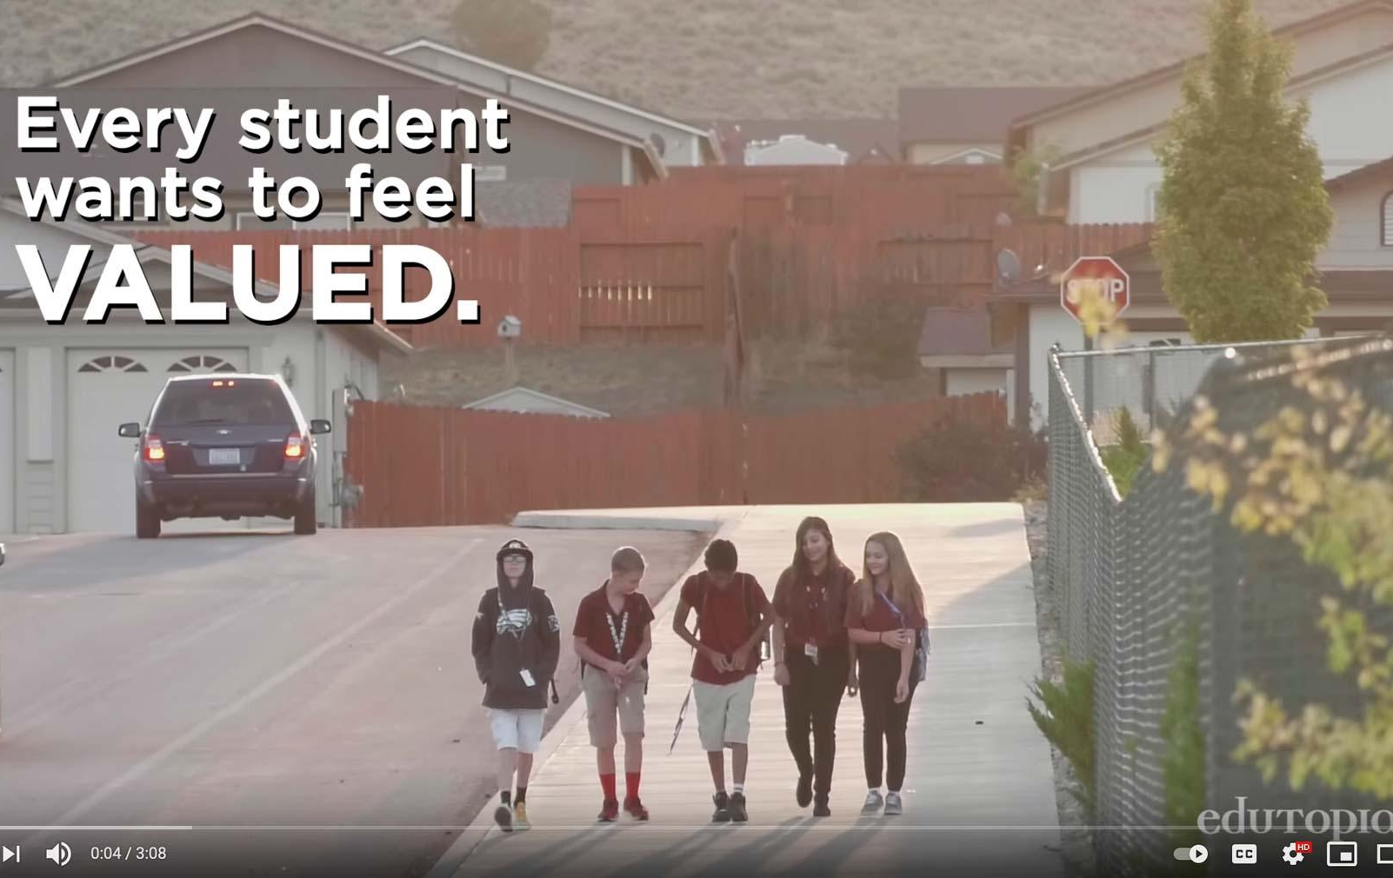
Making Sure Each Child is Known
by Edutopia
https://www.youtube.com/watch?v=xjZx0VdmgkE
Notes:
Consider this strategy implemented in a middle school in Nevada to ensure each student feels like they belong in their school: https://www.youtube.com/watch?v=xjZx0VdmgkE (3:08)

Slide 33

Teams of Support
Educational
Assistant
School Administrators
Teacher
Communication & Collaboration
Consistent Strategies
Outside Agencies
Continuing Education
Caregivers
Notes:
Building capacity and collaboration are key elements to achieving success. The student and educator both need a strong and supportive network. Key stakeholders and their roles in supportive school communities include:
School Administrators
Identify gaps and seeks resources
Promote reflective practice
Commit to inclusivity
Provide leadership with vision
Communicate actively with caregivers
Teachers
Communicate with team
Commit to reflective practice
Incorporate classroom strategies
Compassionately engage with child
Communicate actively with caregivers
Educational Assistants
Provide one-on-one support when needed
Guided or directed by the teacher
Help develop/evaluate strategies
Compassionately engage with child
Maintain a safe environment
Outside Agencies
FASD Assessment and Diagnostic Clinics
Help provide a greater understanding of the student’s needs
FASD Support Providers
Provide resources for training as well as services for students
Caregivers
The core and most consistent member of the student’s support network
Provide a vast diversity of information regarding the student’s strengths, needs, and desires
Serve as the foundation of a strong and supportive network
Other stakeholders may include: school-based counsellors, sports coaches, wellness coaches, inclusive education coordinators, and counselling support professionals. Schools may have centralized supports and services, so it is important to bring in staff that are knowledgeable about those types of programs in order to best support individuals.
Together, the whole team of support needs to have a shared understanding of FASD, shared understanding of each unique individual, and shared goals to support the student. Strategies for the support team include:
Using consistent strategies to support the student’s success.
Communicating and collaborating to decide on one strategy at a time to address a specific goal.
Developing a communications plan which outlines how the team can share information in a timely manner.

Slide 34

If Sarah didn’t eat her breakfast in the morning, Sarah’s caregivers need a way to communicate that with her teacher. That way, her teacher knows that Sarah’s routine was disrupted, and she may be dysregulated, which may lead to challenges in the classroom.
As a team, Sarah’s caregiver and teacher can decide on a strategy to mitigate concerns, like providing Sarah with a granola bar during her first lesson. It can be as simple as an email or a phone call, but communication is huge in helping achieve success for these students.
34
Tracy Masterangelo, Adapted from the Supporting Self-Regulation with Individuals with FASD Presentation
Notes:
Tracy Masterangelo, Adapted from the Supporting Self-Regulation with Individuals with FASD Presentation

Slide 35
Working with Caregivers
Possible Stages
Seeking Diagnosis
Seeking Support
Educator, Advocate
1
2
3
4
5
Coming to Terms
New Understanding
Notes:
Caregivers of individuals with FASD often juggle multiple roles. They are their child’s primary provider, but often also take the role of advocate to raise awareness of FASD and secure supports for their children. Unlike most other support workers, a caregiver is a 24/7 occupation.
Caregivers of individuals with FASD report high levels of stress, even in comparison with caregivers of individuals with other developmental disabilities.
Caregivers may move through several stages in the process of receiving a diagnosis:
Seeking and possibly receiving a diagnosis
Processing emotions and coming to terms with the child’s difficulties
Seeking support and belonging within a knowledgeable community
Developing a new understanding of the child’s behaviour
Becoming an educator, advocate, and expert on the child and FASD
CanFASD has a resource guide for caregivers of FASD: https://canfasd.ca/wp-content/uploads/2018/03/Caregiver-Resource-Guide-FASD-March-2018.pdf
Similarly, Healthy Child Manitoba Developed a Resouce called ‘What Parents and Caregivers Need to Know about Fetal Alcohol Spectrum Disorder) which can be found here: https://www.gov.mb.ca/fs/fasd/pubs/fasd_caregivers.pdf

Slide 36
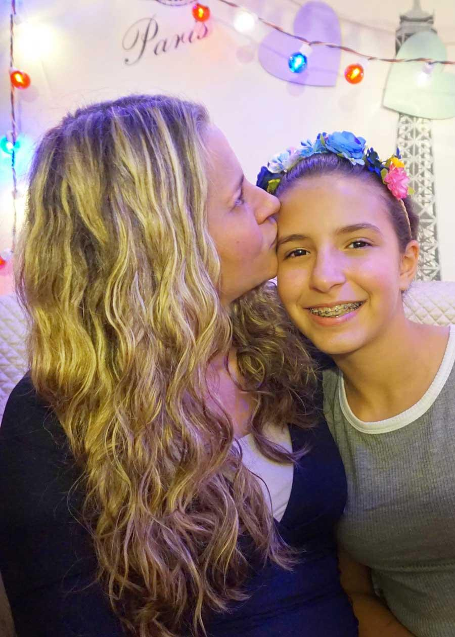
Caregiver Needs and Educator Responses
Caregiver needs:
  Being Heard by Educators
  Openness from Educators
  FASD-Informed Educators
  Involvement in Child’s Education
  Resources and Accommodations
  Supportive Knowledge Base
  Support and Understanding at Home
Notes:
Caregiver needs might include:
Being Heard by Educators
Openness from educators when communicating
FASD-Informed Educators
Educators who understand and are willing to meet the complex needs of students with FASD
Involvement in their Child’s Education
Active involvement in their child’s education to ensure proper fit
Resources and Accommodations
Practical resources that address their child’s complex needs
Supportive Knowledge Base
Gaining knowledge about FASD and to develop effective supports
Support and Understanding at Home
Develop successful parenting techniques for their child
Possible educator responses
Encourage parents to have a structured, consistent, predictable home environment
Share strategies and tips that have worked for other parents
Discuss the role of rules and expectations in the classroom
Explain how they create routines that increase compliance and self-management, both at home and school
Consider the concerns identified by caregivers and if this is something that the school can address. Offer caregivers online and video resources that address concerns
Facilitate ongoing, open communication between home and school. This can be accomplished through weekly phone calls or using a communication book between home and school
Encourage parents to get accurate information about FASD from libraries, hotlines, community agencies or other sources
Encourage parents to talk to other families in the community who have children with special needs
Provide parents with information regarding network organizations with support groups in the community
Acknowledge and understand the difficult role of parents of children with special needs and support parents in this role
Assist parents in helping children develop appropriate social networks

Slide 37

Intentional practices require
Constant Education
Shared learning within the student’s entire support system will enhance education outcomes.
Notes:
Intervention research is relatively new in the FASD field, but cognitive (self-regulation, memory, attention), academic (math, language, literacy), behavioural, social skills, and caregiver programs and supports have been promising
By implementing interventions and/or supports we create opportunities for targeted skill growth and development, while also shifting environmental supports and expectations in order to optimize opportunity. The goal is to promote well-being and generate opportunities for meaningful success.
Remember: meaningful outcomes come from meaningful understandings. We have to understand both the needs and strengths of an individual in order to create helpful interventions.

Slide 38

SECTION 3
Implementing Interventions
TOPICS:
Principles of Practice
Understanding Behaviour
Leverage Strengths
38

Slide 39
Interventions
Researchers have shown that interventions can improve cognitive (self-regulation, memory, attention), academic (math, language, literacy), behavioural, and social skills in individuals with FASD. Caregiver programs and supports also show promise.
Opportunities for skill growth
Meaningful success
Promote
well-being
Optimize opportunity
Implement Interventions
Notes:
Intervention research is relatively new in the FASD field, but cognitive (self-regulation, memory, attention), academic (math, language, literacy), behavioural, social skills, and caregiver programs and supports have been promising
By implementing interventions and/or supports we create opportunities for targeted skill growth and development, while also shifting environmental supports and expectations in order to optimize opportunity. The goal is to promote well-being and generate opportunities for meaningful success.
Remember: meaningful outcomes come from meaningful understandings. We have to understand both the needs and strengths of an individual in order to create helpful interventions.

Slide 40
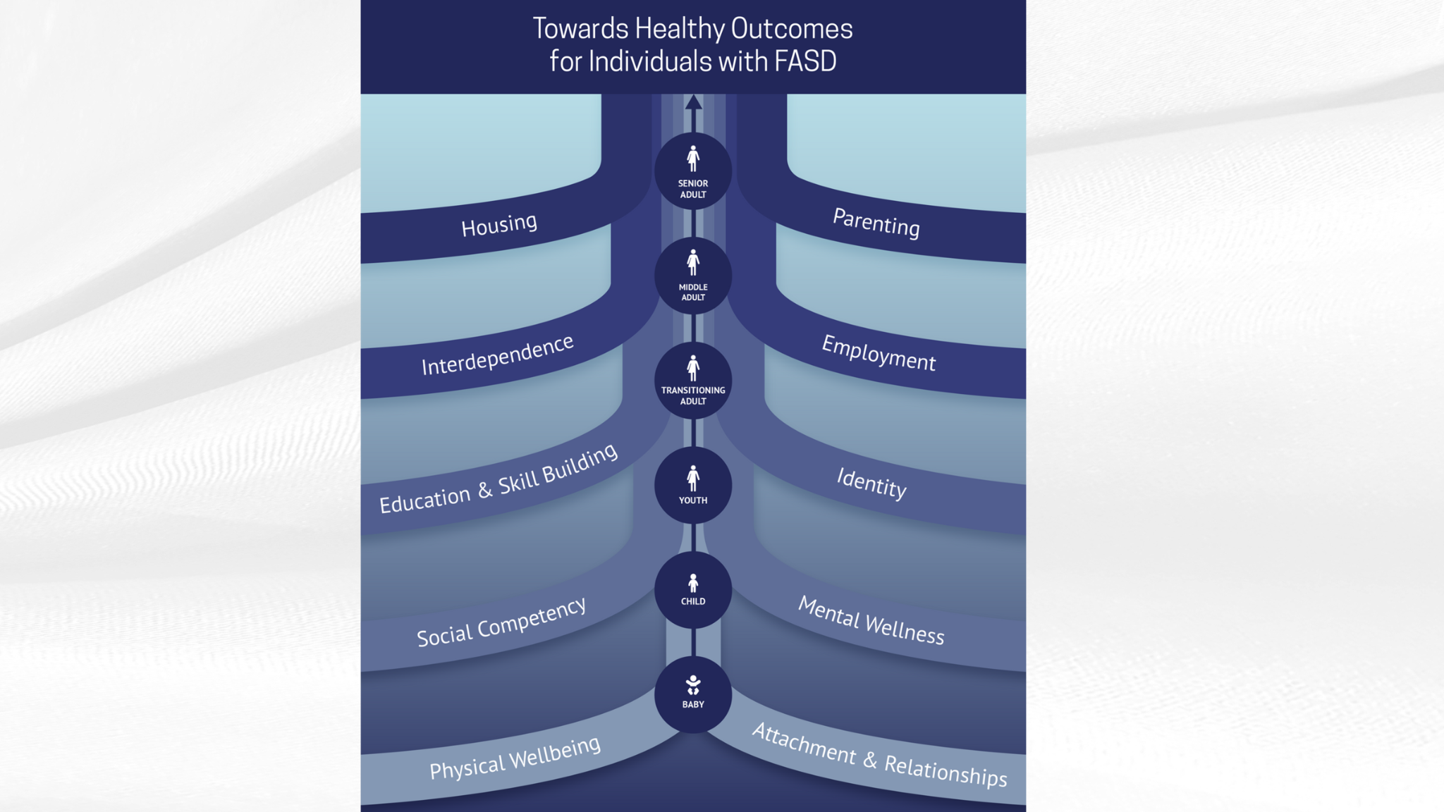
Interventions
Researchers have shown that interventions can improve cognitive (self-regulation, memory, attention), academic (math, language, literacy), behavioural, and social skills in individuals with FASD. Caregiver programs and supports also show promise.
Opportunities for skill growth
Meaningful success
Promote
well-being
Optimize opportunity
Implement Interventions
Notes:
The Towards Healthy Outcomes (THO) was introduced earlier in the Foundations presentation.
THO provides a strengths-based, evidence-informed approach to intervention across the lifespan for individuals with FASD. It was developed by CANFASD in collaboration with researchers, caregivers, and individuals with lived experience to support proactive, individualized planning and service delivery.
THO is structured around multiple domains of healthy functioning that are considered important for overall well-being and success.
One of these key domains is Education and Skill building, which is directly relevant to our work in schools.
Although THO was designed primarily as an intervention framework with the intention of guiding individualized supports and services, it provides a useful conceptual roadmap for understanding how educational planning fits into the broader context of lifelong well-being for individuals with FASD.
Within the Education and Skillbuilding Domain the following is recognized:
identifying and building on individual strengths;
supporting the development of academic and adaptive skills
tailoring instruction and supports to match the student’s profile and developmental needs; and promoting opportunities for skill generalization across settings.
As WRAP coaches, you play a key role in helping students with FASD develop competencies that contribute to healthy outcomes. Not just academically but in their ability to participate meaningfully in school, community, and later life.
The THO framework reminds us to think holistically, to coordinate with caregivers and other systems of support, and to use assessment and intervention planning (such as IPPs/IEPs) in ways that connect educational supports with broader healthy functioning goals.
THO - including the Education & Skillbuilding Domain can be found here: https://canfasd.ca/wp-content/uploads/publications/Towards-Healthy-Outcomes-2.0.pdf

Slide 41
Consistency
within a school
01
Principles of Practice
Collaboration
Between schools and school staff
02
Responsiveness
Between school staff and an individual and their family
03
Proactivity
By school staff
04
Notes:
Four overarching principles of practice can be used as a helpful way to frame intervention approaches
1. Consistency – within a school requires:
Establishing a common understanding of FASD shared by all staff
Using common messages and approaches to providing services
Minimizing staff turnover and building relationships
Maintaining system structure and stability
2. Collaboration – between schools and school staff requires:
Integrated response systems at all organizational levels
Organizational support for complex case management
Intentional planning between types of services and levels of service delivery
3. Responsiveness – between school staff and an individual and their family requires:
Balance between dependence and independence
Expectations that are unique to individual strength, needs, and culture
Supportive and adaptive environments to facilitate skill development
4. Proactivity – by school staff requires:
Early intervention to develop positive behaviours
Consideration of individual control and success-focused trajectory
Planning for transition periods

Slide 42


Brain
Understanding
Behaviour
NOT
As educators, we know, particularly for our students with complex needs, behavior can become their primary means of communication. It is important to remember all behaviour serves a purpose.
Blame
Notes:
In order to implement interventions effectively, we need to shift our mindset around behaviour. As educators, we know, particularly for our students with complex needs, behavior can become their primary means of communication. It is important to remember all behaviour serves a purpose.
All behaviour is goal-oriented, meaning that is functional and serves a purpose.
It may be difficult to determine the “reasons” behind the challenging behaviour
Instead of focusing on the resistive behaviour, explore what the goal is, the obstructions and how to use their strengths to achieve the goal
When trying to understand the behaviours, consider alternative explanations
We need to shift our thinking towards a brain not blame mindset.

Slide 43

Instead of thinking the student “just won’t” do something, question if the goal is achievable for this student.
Set a more achievable goal
It may seem like the student appears insensitive, but in reality, they are unable to show their feelings.
Provide positive adult relationships
Brain not Blame
It may seem like the student is being “bad” or “annoying” but in reality they are feeling frustrated or challenged. Be patient and provide support
Notes:
Instead of thinking the student “just won’t” do something, question if the goal is achievable for this student. If not, set a more achievable goal.
It may seem like the student appears insensitive, but in reality, they are unable to show their feelings. We can support them by providing positive adult relationships.
It may seem like the student is being “bad” or “annoying” but in reality they are feeling frustrated or challenged. Be patient and provide support.

Slide 44
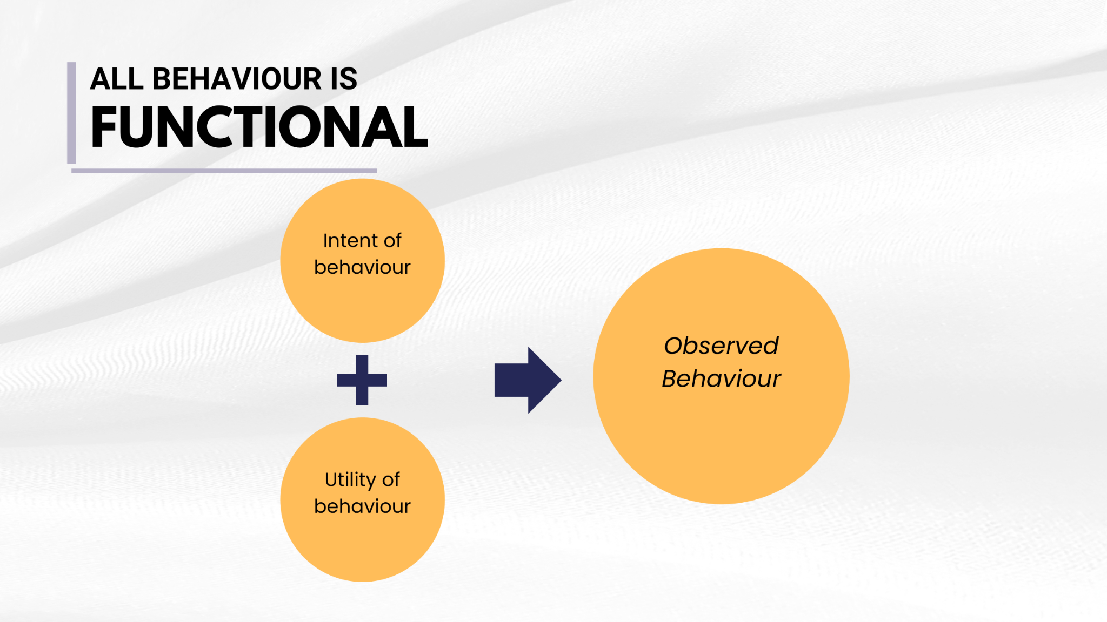
It may seem like they just can’t sit still but in reality they are overstimulated and overwhelmed
Provide opportunities to develop skills to better regulate emotions.
It may seem like a student is stealing when in reality they may have a lack of understanding of boundaries or ownership Provide opportunities to have ownership
Brain not Blame
It may seem like a student is deliberately lying, but they may be using storytelling to cover up memory problems.
Stay calm and ask more concrete questions to get to the “truth”
Notes:
It’s important that we understand that we as other people can only see the observed behaviour; what is missing (usually) are the underlying intentions around the behaviour, along with its usefulness.
We might not fully understand why someone is late to a counselling/WRAP appointment with us, or why a stranger yelled at us when we parked our car.
But we especially won’t be able to understand when we look at their behaviour and don’t consider what might be underlying it.

Slide 45
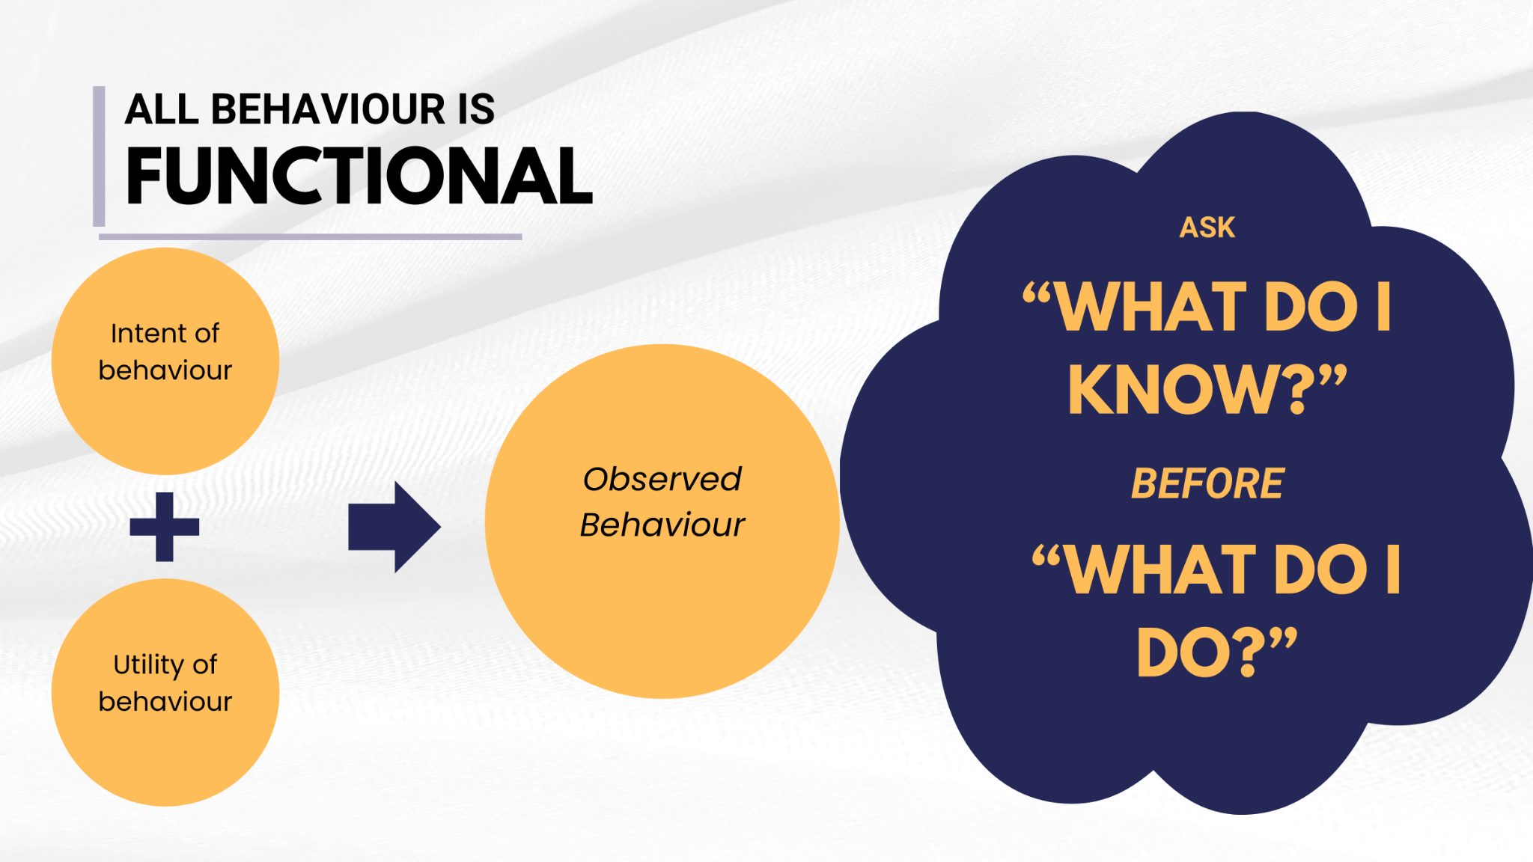
It may seem like they just can’t sit still but in reality they are overstimulated and overwhelmed
Provide opportunities to develop skills to better regulate emotions.
It may seem like a student is stealing when in reality they may have a lack of understanding of boundaries or ownership Provide opportunities to have ownership
Brain not Blame
It may seem like a student is deliberately lying, but they may be using storytelling to cover up memory problems.
Stay calm and ask more concrete questions to get to the “truth”
Notes:
And we certainly won’t be able to develop that understanding of the underlying causes of behaviour when we then jump right into thinking: What do I do? How do I solve this problem?
When we do that, we are likely to miss two crucial underlying pieces of information:
The underlying intention or the “why” behind the behaviour and
The function of the behaviour, or the need the behaviour is meeting.
Understanding the underlying causes of behaviour makes our lives easier. We can take a moment to pause before moving into action and first ask ourselves, “What do I know” about this person, this situation, this behaviour?
It gives us some space to understand the behaviour. It provides more information that will be super useful when it's time for us to begin considering solutions.

Slide 46

It may seem like they just can’t sit still but in reality they are overstimulated and overwhelmed
Provide opportunities to develop skills to better regulate emotions.
It may seem like a student is stealing when in reality they may have a lack of understanding of boundaries or ownership Provide opportunities to have ownership
Brain not Blame
It may seem like a student is deliberately lying, but they may be using storytelling to cover up memory problems.
Stay calm and ask more concrete questions to get to the “truth”
Notes:
By shifting our initial thinking from “what do I do” to “what do I know”, we are setting ourselves up to think about the situation from a mindset of curiosity and openness, which helps to inform our understanding and way forward, rather than jumping into judgment and action.
When we can think of ourselves as explorers or scientists who are curious about what we are seeing, we can approach situations with openness and understanding.

Slide 47

The Shift
From seeing child as:
To understanding child as:
Bad
Lazy
Lies
Doesn’t Try
Mean
Doesn’t Care, Shut Down
Refuses to Sit Still
Fussy, Demanding
Resisting
Trying to Make Me Mad
Trying to Get Attention
Acting Younger
Thief
Inappropriate
Not Trying to Get to the Obvious
Frustrated, Defended, Challenged
Tries Hard
Confabulates/Fills In
Exhausted or Can’t Start; Tired of Always Failing
Defensive, Hurt, Abused
Can’t Show Feelings
Overstimulated
Oversensitive
Doesn’t Get It
Can’t Remember
Needing Contact, Support
Being Younger
Doesn’t Understand Ownership
May Not Understand Properties
Needing More Reteaching
Notes:
We need to shift how we see students with FASD from willful to identifying the behaviour you are seeing.

Slide 48

Personal and Professional Shift
Personal shift from:
To feelings of:
Hopelessness
Fear
Chaos, Confusion
Anger
Power Struggles
Frustration
Exhaustion
No Good Outcomes
Isolation
Hope
Understanding
Organization, Meaningfulness
Reframing Perceptions, Defusing
Working with, Rather than at
Trying Differently, Not Harder
Re-energized, New Options to Try
Seeing, Supporting Strengths
Networking, Collaboration
Notes:
Then we may also see a personal shift from feelings of:
Hopelessness to feelings of hope
Feelings of fear to feelings of understanding
Exhaustion to feelings energized and having new options to try
Using tools like:
Reframing perceptions, defusing anger
Working with rather than working at the student
Trying differently not trying harder
Seeing and supporting strengths
Networking and collaboration
And we will see a professional shift from traditional approaches with traditional interventions and consequences aimed at changing people to ourselves being able to recognize brain differences, prevent problems, develop effective strategies, and focus on changing environments.

Slide 49

Leveraging Strengths
Supporting Students
Unique Needs and Strengths
Unique Environment
Notes:
As we mentioned above, each individual with FASD is unique and will have their own strengths and challenges. Students with FASD are consistently underestimated because they often struggle in areas where ability is traditionally measured, like reading, spelling, and math. Being in an environment where strengths are celebrated can transform the learning experience.
Educators should recognize and celebrate these strengths of students with FASD and provide opportunities for learners to use and build on their strengths.
Strengths Among Individuals with FASD is a report from the Canada FASD Research Network that highlights the unique personal, relational, and community strengths of individuals with fetal alcohol spectrum disorder (FASD), offering a strengths-based perspective to inform practice, policy, and support. The report can be accessed here: https://canfasd.ca/wp-content/uploads/2018/10/Strengths-Among-Individuals-with-FASD.pdf

Slide 50

Clearing the Clouds
By Melissa Dobson
https://www.youtube.com/watch?v=xOEiEjxlxnU
Notes:
Clearing the Clouds is a short film by Melissa Dobson, a caregiver who describes her experience of learning more about her child’s strengths and needs (4:02). https://www.youtube.com/watch?v=xOEiEjxlxnU

Slide 51






Personal Strengths
Caring with a strong sense of justice
Friendly and outgoing
Energetic
Helpful and keen to please
Non-judgemental
Good with younger children, the elderly, and/or animals
Notes:
For individuals with FASD, personal strengths may include:
Being helpful and keen to please​
Give them roles within the class which allow them to do this successfully​
Phrase tasks as a request, use suggestions or weighted choices, rather than phrasing it as a demand but ensure they have a clear understanding of their role and the task itself
Sometimes individuals with FASD can appear objectionable if they’re told to do something but will comply if asked for their cooperation instead​
Explain why the task is important rather than responding with “because I said so”
Being caring with a strong sense of justice​
They often want to help people who are upset or sad, especially if someone seems vulnerable​. Support them by:
Discussing socially appropriate ways to show care in different situations
Being non-judgemental​
They tend not to judge, reject, or bully those who do not fit the social norm​ and often choose friends who have complex needs of their own:
Support them in recognizing healthy friendships, strengthening them, and keeping them
Friendly and Outgoing​
They may be well known across the school community for their ability to speak to anyone and everyone​
Teach appropriate social skills, what information to share about ourselves, and what information to not​
Patient with and Interacts Well with Younger Children, the Elderly, and/or Animals​
Look for opportunities to work with younger children such as working with a school club or coaching a sports team​
Energetic​
They may be hands-on, concrete, active learners​. Support them by:
Provide movement-based learning tasks​
Ensure the task is simple, clearly explained, and finite
References:
Flannigan, K., Wrath, A., Ritter, C., McLachlan, K., Harding, K. D., Campbell, A., ... & Pei, J. (2021). Balancing the story of fetal alcohol spectrum disorder: A narrative review of the literature on strengths. Alcoholism: Clinical and experimental research, 45(12), 2448-2464. https://doi.org/10.1111/acer.14733
Kautz-Turnbull, C., Adams, T. R., & Petrenko, C. L. (2022). The strengths and positive influences of children with fetal alcohol spectrum disorders. American journal on intellectual and developmental disabilities, 127(5), 355-368. https://doi.org/10.1352/1944-7558-127.5.355

Slide 52





Learning Strengths
Hands on, concrete learner
Lateral thinkers with points of insight in certain areas
Athletic, sporty, creative, or musical
Persistent, determined, and hardworking
Excellent long term visual memories
Notes:
For individuals with FASD, learning strengths may include:
Hands-On, Concrete Learners​
They learn best when they can interact with actual object or items to help their learning​
Learners may need support to transfer learning from one context to another​
Lateral Thinkers with Points of Insight in Certain Areas​
Often have creative solutions or unusual insights​. Support them by:
Encouraging them to think about and explain their thinking (metacognitive strategies)​
Praise their insights​
Athletic, Sporty, Creative, or Musical​
Build opportunities for the learner to share their skills and possibly teach others​
Encourage social skills, body movements, creative skills and organisational skills
Persistent, Determined, and Hard-Working​
Their determination to keep trying can be a positive attribute if channelled correctly. Support them by:
Ensuring that the task is of the right level and length to be completed​
Giving clear visual indications of time remaining​
Strong Long Term Visual Memories​
People with FASD are often visual learners​. Support them by:
Breaking tasks into visual steps​
Allowing learners to record information in a way that suits their visual learning styles

Slide 53
Interventions
Researchers have shown that interventions can improve cognitive (self-regulation, memory, attention), academic (math, language, literacy), behavioural, and social skills in individuals with FASD. Caregiver programs and supports also show promise.
Opportunities for skill growth
Meaningful success
Promote
well-being
Optimize opportunity
Implement Interventions
Notes:
The Towards Healthy Outcomes (THO) was introduced earlier in the Foundations presentation.
As WRAP coaches, you play a key role in helping students with FASD develop competencies that contribute to healthy outcomes. Not just academically but in their ability to participate meaningfully in school, community, and later life.
Within THO there is a domain called Interdependence which is especially relevant to education and transitions.
Interdependence recognizes that success is not about complete independence, but about knowing when and how to access support while building meaningful skills.
In education and transition planning, the goal is to balance autonomy with appropriate supports, ensuring individuals are not expected to do more than their brain can manage alone, while still being supported to participate, contribute, and grow.
THO - including the Interdependence Domain can be found here: https://canfasd.ca/wp-content/uploads/publications/Towards-Healthy-Outcomes-2.0.pdf

Slide 54
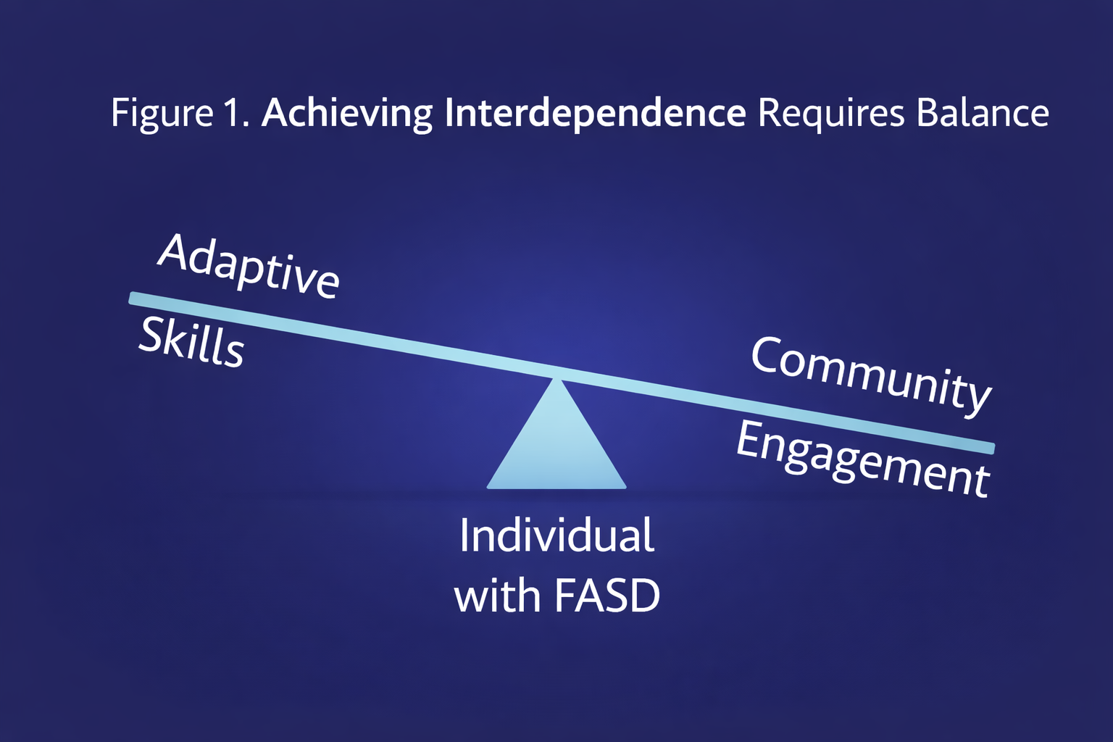
Interdependence: Balancing Autonomy with Support
Adulthood
For people with FASD, interdependence is promoted through developmentally appropriate expectations and individualized support alongside learning opportunities.
Notes:
Another way to explain interdependence is that it seeks to balance autonomy with supports. As people age and develop, they often seek greater autonomy and opportunities for choice in their lives. By young adulthood, people are often expected to demonstrate more independence, which can create tensions for people with FASD. But for people with FASD, typical representations of independence are not always realistic, nor do they take into account the unique strengths, needs, and areas for support the person might need.
Interdependence can be viewed as a spectrum, ranging from Reminders and scheduling assistants to decision-making supports to daily assistance from family members or support workers. We all need different supports and lean on different people at different times in all of our lives. For example, I need my optometrist to monitor my eyesight and give me new glasses. That’s not something I just do independently. Instead, we rely on others to meet our unique and evolving needs throughout the lifespan.
As individuals transition to adulthood, new skills are required to meet growing needs for personal autonomy and choice.

Slide 55
Interdependence: Things to Know
Refers to how we engage with other sin our daily lives and how we give and receive support from others. | Community Engagement: sense of belonging and involvement in our community.
Adaptive Skills Support daily living: Conceptual and Practical Skills. | As we grow and develop across the lifespan, our skills and interactions with our community also evolve.
Adulthood
Notes:
Interdependence is a new domain in THO 2.0, and is the amalgamation of the Community Engagement and Adaptive Functioning domains from the original THO document.
Interdependence was brought to our attention through interviews with caregivers, who highlighted the need for autonomy on the parts of the individuals with FASD they support alongside their need for supports and community engagement.
The desire to belong to a community is an important and natural part of our lives, and having a sense of belonging to a community is a positive influence on wellbeing. The joy of community integration is not only about physical involvement but also about a psycho-social sense of community.
Community integration can be informed by a person’s adaptive skills, which are based on developmental and sociocultural standards for day-to-day functioning and social responsibility that gradually develop across the lifespan.
Adaptive functioning is age-dependent and not solely related to ability but also opportunity and experience. Adaptive skills can be used to foster interdependence across the lifespan. Individuals with FASD demonstrate a considerable range of abilities and interpersonal qualities that inform the types of interpersonal supports an individual requires in adulthood.
Adaptive Skills support daily living:
Conceptual skills: reading, writing, math
Social Skills: communication, relationships, interpersonal understanding
Practical skills: grooming, eating, hygiene
What's important to highlight about interdependence is that it is reciprocal in nature, support is given and received.
Personal growth for people with FASD can be promoted in an environment that sets developmentally appropriate expectations for interdependence and provides individualized support based on the person's unique strengths and needs alongside scaffolded learning opportunities.

Slide 56

SECTION 4
Transitions
TOPICS:
What are Transitions?
Determination and Perseveration
Challenges and Best Practices
56

Slide 57

What are Transitions?
  Changes to relationships, routines, expectations or roles
  Occur naturally throughout
  our lifespan
  Can be small or big
  A normal part of life
Notes:
Transitions are any events that result in changes to relationships, routines, expectations or roles. Transitions occur naturally throughout our lifespan and can be small (like transitioning from one class to another) or big (like transitioning from high school into adulthood).
Transitions are a normal part of life. Big transitions may bring up a number of different emotions, like sadness or excitement. For individuals with FASD, transitions can be especially challenging.

Slide 58


Challenges to Transitions
High School
Adulthood
Changes to existing supports and services
Disrupted routines
Increased expectations
Require ongoing supports
Notes:
As individuals with FASD age, they are presented with new developmental challenges in their lives. These may be especially challenging for individuals with FASD because of the inconsistency between the developmental abilities and chronological age of individuals with FASD and the expectations that are placed on them based on their age.
Individuals with FASD will have experienced many different transition periods prior to their transition from school to adulthood but different stages can bring on new and complex issues never seen or experienced before.
Ask: What are some transition periods that you can think of?
Kindergarten to elementary
Elementary to high school
High school to postsecondary education (college, university)
Transitioning between classrooms
Transitioning between activities
Moving houses or cities
Having friends move away
Getting a new sibling
Transitions to adulthood are seen as particularly stressful because it often means changes to existing services and supports. Many individuals with FASD become dependent on structured routines and struggle when this routine is disrupted. There is also an expectation of increased responsibilities and independence in many areas of life. However, many individuals may require ongoing support from social services, parents, and caregivers in order to manage their daily routines.
Individuals with FASD may also struggle with transitions, particularly during the adolescent/emerging adulthood period, because of the adverse outcomes they may experience (i.e. mental health problems, difficulty with academic achievement, trouble with the law, substance use, etc.).

Slide 59

“
When we are all on the same page, we have a better chance of addressing the needs of these students – academically and personally – and giving them the tools they need to live independent lives after high school.
– Teacher
”
59
http://www.kpdsb.on.ca/assets/uploads/FASD/FASDFinalReport.pdf
Notes:
http://www.kpdsb.on.ca/assets/uploads/FASD/FASDFinalReport.pdf

Slide 60





Provide a lot of notice before a change
Give reminders that a change will occur
Give clear visual indicators of time remaining to aid transition
Be understanding if the individual is upset about the change
Ensure the task is of the right level and length to be completed
Determination and Perseveration
Encourage support throughout periods of change
Notes:
Like we talked about before, one characteristic of individual with FASD is that they are determined and persistent. This determination can be a positive attribute if channelled correctly, but it may also make transitions difficult.
This characteristic means individuals with FASD often have trouble switching gears, stopping an activity, or transitioning into a new one. They may react strongly to changes in settings, programs, and/or personnel.
Strategies to address determination and preservation include:
Provide a lot of notice before a change​
Give reminders that a change will occur​
Give clear visual indications of time remaining to aid transition​
Recognize that change may cause a student anxiety, frustration, fear and be understanding of these emotions
Ensure the task is of the right level and length to be completed
Encourage support throughout periods of change (i.e. friends, family, mentors, coaches)

Slide 61
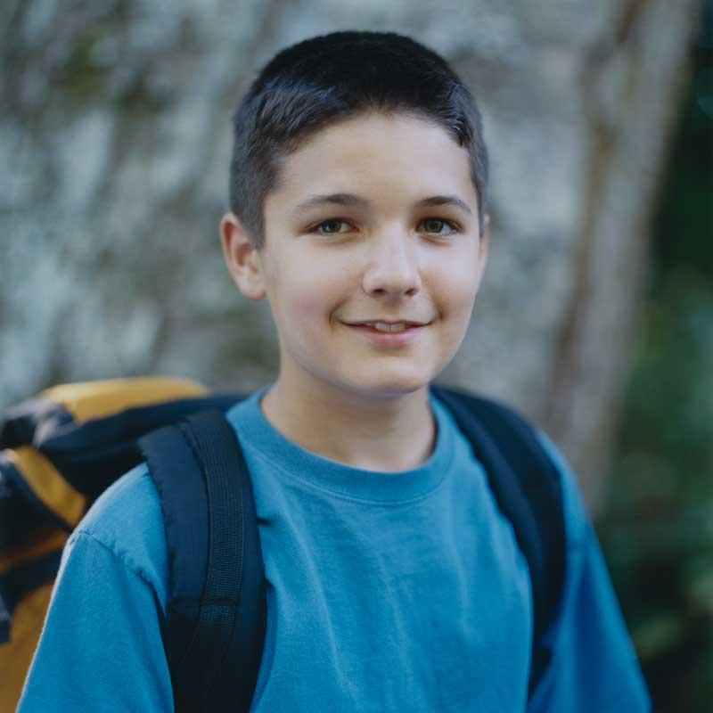
Challenges Throughout Lifespan
Challenges
Services
Best Practices
Adolescence
Mental health
Academic disengagement
Legal issues
Inappropriate sexual behaviours
Alcohol and/or drug use
Cognitive challenges
Positive peer relationships
Continuing mental health team
Special education
Justice and policing advocates
Counsellors
Daily living support
Positive social groups and mentors
Routines, structures and clear and consistent expectations
Instructional scaffolding, modelling, hands-on practice, and repetition for daily living skills
Specific assistance for planning, organizing, time management, and initiating projects and assignments
Safe and non-judgmental environments encouraging openness and support
Parental awareness of peer relationships
Intentional social modeling
Notes:
Here are some challenges that individuals with FASD may face across the lifespan, the services they may need access to, and the best practices for support during this time period.

Slide 62

Challenges Throughout Lifespan
Challenges
Services
Best Practices
Adaptive functioning
Daily life skills
Cognitive disabilities
Mental health challenges
Alcohol and/or drug use
Independent living
Finding employment
Housekeeping
Financial matters
Family planning
Assisted living support
Mental health, addiction, and employment counsellors
Supported transportation
Financial manager
Family and personal support workers
Counselling and medication
Support network for challenges
Financial management
Psychological assessment and medical support
Provide opportunities for community involvement and belonging
Emerging Adult
Notes:
Here are some challenges that individuals with FASD may face across the lifespan, the services they may need access to, and the best practices for support during this time period.

Slide 63

SECTION 5
Supporting
Transitions
TOPICS:
Barriers to Transitions
Key Elements to Support Transitions
Collaboration
63

Slide 64

Barriers to Transitions
31%
of caregivers reported challenges with transition points in education
Notes:
When asked about barriers and challenges at transition points, the most common answer caregivers of individuals with FASD gave was challenges with education: 31% of respondents indicated they had difficulty with transition points in schools, limited awareness among teaching staff, or limited access to educational supports.

Slide 65

“
There will be many transitions over the lifetime, relationships, friendships, parenting, caregiving, etc.
The most notable one for the education system will be transition from schools, but most importantly transition from High School to adulthood.
The school should be very involved during the whole of high school to set the stage for this transition.
– Caregiver
”
65
FASD Educator and Caregiver, Personal Communication, July 2021​

Slide 66
Preparing Students
Collaboration
Individualized Program Plans (IPPs)
Key Elements to Support Transitions
Transition Planning
Notes:
There are several key elements that you should consider to support students through school transition periods. These include:
Preparing Students
Collaboration
IPPs
Transition Planning (which we will discuss in depth in the next session)

Slide 67





Preparing Students
01
Forewarn (or frontload)
02
Anticipate
03
State
04
Act
Notes:
Transitions become more frequent, and potentially more difficult, as the grades increase. Warning students about transition periods ahead of time and preparing them for what they can expect can help. There are 4 tips you can use to prepare students for transitions:
Forewarn (or Frontload)
Provide lots of notice before a change
Give clear visual indications of time remaining
Anticipate
Restate the change
Expect and plan for resistance
Wait a few minutes
Be understanding if an individual is upset about the change
State
Tell the student exactly what action is required next
Use visual cues
Act
State the immediate action
Examples of possible transitions in school and how to support them:
Transitioning to and from recess
Prepare them for the change
Build a schedule and routine for recess
Prepare activities for recess if needed (kindergarten)
Think of recess as a body break for the child
Give them plenty of time and reminders so they know when the change will happen (i.e set alarms, give two-minute, five-minute, 10-minute warnings)
Changing classrooms
Give plenty of warning
Create a visual schedule they can refer to
Have a buddy take them from class to class consistently
New teachers every year
Meet the teacher in advance a few times to build a relationship
Get acquainted with the new classroom
Ensure the teacher is aware of the individual’s disability and how best to support
Constant communication between the teacher and home
Through a communication binder between teacher and home
What is reasonable and manageable for each partnership will vary depending on the school and the family
Riding the bus:
Familiarize them with the bus driver
Families/caregivers may go with the child a few times to get them used to it
Practice on city buses, school buses, and field trips
Have a plan if something is left on the bus
Have reminders for bus times (i.e. alarms)
Transitioning to high school (usual challenges being lack of supports, increase of expectations, and less supervision):
Prepare for transition
Talk about the changes
Take them to the new school ahead of time
Allow them to meet teachers and see classrooms ahead of time
Structure learning so all classes are in the same spot year round
Connect them with a mentor (a friend)
Help develop social cues
Create structure
Build a relationship with the teacher and staff
Leaving High School
Talk about future plans way in advance of the actual transition
Make goals that are specific, step by step, and include the voices of the student
Take steps towards achieving goals (i.e. build skills for employment or post-secondary)
Prepare them for big events that are upcoming (i.e. graduations)

Slide 68

Supporting Transitions
by Nicole Hanes
Notes:
At the BCPOP conference, Nicole Hanes (SLP) presented on social, relational, and family supports, explored environmental accommodations, and considered the role of student agency and voice in the transition process. This video can be found here (37.17):
https://popcon.ca/talks/supporting-school-transitions-students-brain-based-differences

Slide 69
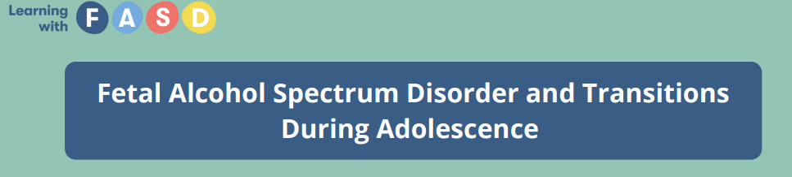
Resource
https://learningwithfasd.org.au/wp-content/uploads/Transitions-Factsheet_V2.pdf
Notes:
Learning with FASD has created a resource regarding transitions during adolescence which can be found here: https://learningwithfasd.org.au/wp-content/uploads/Transitions-Factsheet_V2.pdf
This factsheet highlights that students with FASD often struggle with transitions due to difficulties with memory, planning, flexibility, and EF
Transitions that feel routine for peers (e.g., moving between classes or changing schools) can create stress for students with FASD as we discussed.
This resource offers practical, school-based strategies to make transitions more predictable and supportive.

Slide 70
Collaboration
Families
Students
Other Schools
Community Services
Government
Support Systems
Other School Staff
FASD Networks
Notes:
We do not support a person alone. We work alongside their family, school, community, health care, and social services systems.
Collaboration and responsibility is needed from all supporters working alongside students with FASD.
Professional collaboration means systems talking to each other, sharing
information, and planning together. It lowers the chance of interpreting behaviour
as defiance or lack of effort. Shared understanding means that all systems understand the unique
strengths and support needs of the person with FASD they work with.
ii. When professionals collaborate, expectations become clearer and more
predictable. Even small changes in communication can improve day to day life.

Slide 71

Collaboration with Caregivers
Educator and caregiver collaboration requires:
FASD-Informed Educators
Caregiver involvement in education
Resources and accommodations
Supportive knowledge base
Support and understanding at home
Notes:
Every student benefits when educators and caregivers regularly communicate, work toward a common goal, and regularly review strategy effectiveness together.
Students recently diagnosed with FASD or those who are not diagnosed must have the two most important people in the lives (their caregiver and their educator) working together and recognizing their needs will change with development
Educator/caregiver collaboration requires:
FASD-Informed Educators
Caregiver involvement in education
Resources and accommodations
Supportive knowledge base and continuous learning
Support and understanding at home and at school

Slide 72
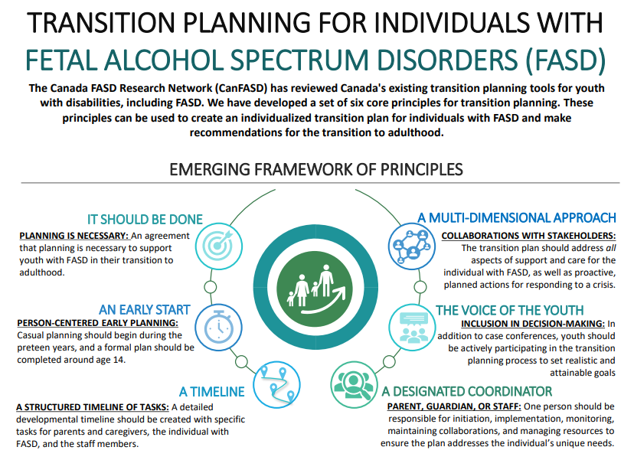
Transition Planning
& Resources
Notes:
Resources for Caregivers looking to support individuals with FASD through periods of transition are here: A review of transition planning tools for youth with FASD: https://edmontonfetalalcoholnetwork.org/wp-content/uploads/2019/11/41026-JoDD-24-1-v11f-81-98-Coons-Harding-et-al.pdf and a corresponding infographic that summarizes the review: https://canfasd.ca/wp-content/uploads/2019/11/Transition-Planning-for-Individuals-with-FASD-Infographic.pdf

Slide 73

“
Transitions of life that happen (particularly separation or death) will present itself in school.
These transitions will require communication with parents with an agreement on how to explain and support the youth through these transitions and how the peers can help.
It is not just a collaboration, but a partnership with caregivers.
– Caregiver
”
73
FASD Educator and Caregiver, Personal Communication, July 2021​

Slide 74

Collaboration with Support Teams
A support team may be made up of:
Teacher
Social worker
Caregiver
Tutor
Coach
Teaching assistant
FASD support person
Respite provider
Summer camp leader
Older siblings
Family members
Notes:
The student may be connected with a number of professionals on their support team. FASD networks often have transition coordinators to support transitions, and teachers may be asked to work with these teams.
A support team may be made up of a teacher, social worker, caregiver, tutor, coach, educational assistant, FASD support person, respite provider, summer camp leader, older siblings, family members etc.
The Alberta FASD Service Network is one of the strongest in the country. Reach out to service providers in your area and ask for resources and supports if you need it.

Slide 75


Individualized Program Plans (IPP)
Creating an Individualized Program Plan (IPP)
Identify student needs
Set goals and objectives
Identifying possible supports
Ask questions like:
What skills and behaviours will this student need in future environments?
What is the student good at?
What areas does the student need help in?
Notes:
The development of an Individualized Program Plan (IPP) can help prepare students for transition periods. An IPP is also known as an Individualized Education Plan (IEP), Instructional Support Plan (ISP), Positive Behaviour Support Plan (BSP/PBSP). There are helpful because it ensures transition planning can be built into the IPP. For example:
Identify student needs by exploring questions like “What skills and behaviours will this student need in future environments?”, “What is the student good at?” What areas does the student need help in?”
Setting goals and objectives:
Kindergarten: skills needed for successful transition from Kindergarten to Grade 1 might form the basis of a young student’s long-term goals.
Middle School: Aspects of career exploration or work experience might be incorporated in goals for students in middle school
High School: and developing self-advocacy skills might be a goal for a student in senior grades
Identifying supports students will need to be successful in future environments can be reflected in the accommodations section.
Transition planning can be summarized in a separate section of the IPP, which identifies changes that are upcoming, and the learning team’s plans for helping the student successfully make these changes.
https://education.alberta.ca/media/384992/indidivualized-program-planning-2006.pdf

Slide 76

SECTION 6
Understanding Your Role
TOPICS:
Commitment
Support Caregivers
Support Students
76

Slide 77

Commitment
To participate in the transition planning process you must:
Individuals with FASD require a committed circle of support
Determine your availability
Determine how you want to be contacted
Determine what support you can provide
Is your commitment realistic?
Notes:
Individuals with FASD require a committed circle of support. This means that the young person needs to have individuals in their life who are available to offer support on a regular basis.
The role of the school could be different depending on each students support system. If the support team includes a Transition Coordinator, then the school can be an active participant to support the process. If the parent is leading this process, then the school may want to identify a school person to provide more assistance to the process. And if no one has actively stepped forward to lead the process, then the school may be in a position to provide this support.
To participate in the transition planning process you must:
Determine your availability (i.e. how daily, once a week, biweekly, monthly meetings)
Determine how you want to be contacted (face to face, phone)
Determine what support you can provide? (Information?)
Is your commitment realistic?

Slide 78



Support Caregivers
Share strategies and tips that have worked for other caregivers
Discuss the role of rules and expectations
Discuss the role and importance of the transition plan
Explain how to create routines that improve success and behaviours
Encourage caregivers to connect with other families who have children with special needs
Help children develop appropriate social networks
Never assume
Provide clear and open communication with caregivers
Connect families to local FASD supports where available
Notes:
Caregivers are essential to the transition process. You can support caregivers by:
Sharing strategies and tips that have worked for other caregivers
Discussing the role of rules and expectations and outline expectations for each party
Discussing the role of the transition plan and emphasizing its importance in helping plan for the future
Explaining how the team can create routines that improve success and behaviours both at home and at school
Encouraging parents to talk to other families in the community who have children with FASD or other special needs
Assisting parents in helping children develop appropriate social networks
Never assuming. Always ask caregivers for clarification before proceeding
Providing clear communication pathways and keep caregivers updates
Where available, connecting families to local FASD supports as needed and forwarding resources and information about FASD as you receive it, as caregivers may not be aware of available services.

Slide 79



Support Students
Plan for the transition process early
Help students explore opportunities for post-secondary, employment, apprenticeships, education and other community-based services
Help find grants and funding
Help students find supports and services
Remind students of deadlines and necessary documentation for applying to post-secondary programs and services
Notes:
Some students with FASD can do the academic work, but some can find it very challenging. The school and caregivers need to determine when the student is not performing academically, at which point they could be switched to a more life skills, vocational program.
Support students through their transitions to adulthood by:
Starting to plan for the transition process early (i.e. Grade 9 or before if possible)
Continually discussing careers and helping students explore opportunities for post-secondary employment, apprenticeships, education and other community-based services.
Helping find grants and funding
Examples: disability-related supports, financial support from post-secondary institutions
Helping students find supports and services
i.e. transvocational programs that prepare individuals with developmental disabilities to get employment, supports for students in post-secondary settings
i.e. connecting students to a local FASD service network if available
Supporting students to apply for post-secondary services or programs
Ensuring students have the necessary documentation from their schools to receive appropriate support in post-secondary settings.
Informing students and caregivers about deadlines well in advance and continually remind students
Create a plan to support students to meet all deadlines
Consider the questions you need to ask to help the student explore and prepare for post-secondary education. You may ask questions like:
How will this program meet the student’s learning and career needs and goals?
What supports and accommodations do they provide?
Are there any costs and fees?
How are parents and family members involved?
What are the admission criteria?

Slide 80

SECTION 7
Transition Planning
TOPICS:
Transition Plans
Challenges
Best Practices
80

Slide 81



Transition Planning
A process of preparing for the move from one phase of life to another. It is designed to assist youth and families during the transition to adulthood.
School
Adulthood
There is no one way to transition plan for someone with FASD.
Notes:
Transition planning is a process of preparing for the move from one phase of life to another.
Transition planning is designed to assist youth and families during the transition to adulthood by providing information, service referrals, and planning for the future. Transition planning can help to alleviate some of the challenges and behaviours that arise surrounding transition periods.
The transition plan should address several critical areas. The transition plan should:
Reflect the youth’s vision and goals for the future; focus on the proactive shift from child to adult services;
Identify and build upon the youth’s strengths and natural support systems;
Promote the youth’s greatest level of independence possible and their inclusion within their community;
Promote self-determination;
Identify and address the youth’s and their family’s individual needs during the transition period; and
Prepare for necessary services and supports to be in place when the youth turns 18

Slide 82

Challenges to Transition Planning
Difficulties discussing conceptual topics
Current supports may not be able to continue
Recognizing areas of need
Developmental age
Geographical areas
Availability of dedicated coordinators
Notes:
Challenges in transition planning for someone with FASD may include:
Difficulties discussing conceptual topics (i.e. future plans)
Current supports may not be able to continue to provide the same level of support (i.e. aging parents, grandparents, loss of access to child/adolescent services and supports)
If there are good supports in place, some areas of need may not previously have been identified or considered. Future plans may need to be modified or reconsidered.
Youth may not be at the developmental age to be thinking about planning for adulthood
Geographical areas may not have the appropriate supports to help students with transition planning
Some students may not have a dedicated team member who can coordinate and implement the transition plan, so the responsibility falls on caregivers

Slide 83

01
It should be done
02
An early start
03
Timeline
04
Designated coordinator
05
Voice of youth
06
Multi-dimensional
Best Practices for Transition Plans
Notes:
There is no “one way” to prepare a successful transition plan for someone with FASD. The main characteristics of successful transition planning is that it has 1) intentional and anticipated planning with 2) effective knowledge transfer among all people involved.
According to researchers, in examining documents about transition planning for people with FASD, they found six overarching best practices:
It should be done
An early start
A timeline
Designated transition plan coordinator
Voice of youth
Multi-dimensional approach

Slide 84

A transition plan should be in place
Can support students to succeed
Supports students through change
1. It should
be done
Notes:
This is pretty self-explanatory. Transition planning is shown to help support people with FASD to succeed during periods of change. A transition plan should be in place.

Slide 85

Successful transitions should start early
Strategies for school staff
Help students develop skills to support transitions
Give opportunities to explore different professions/trades
Identify interests and skills
2. An early start
Notes:
Successful transitions should begin as early as possible, well in advance of the actual change or event. This early planning ensures that:
planning is always future-oriented;
that there is program continuity throughout a student’s school years; and
that necessary programming and supports are in place.
Early planning also helps students understand at a young age that changes and challenges are part of life. Learning to manage transitions early in life helps to develop skills and behaviours that can adapt and be flexible to new situations.
Specific age recommendations for transition planning into adulthood varies, but some researchers recommend informal discussions with the youth about the transition at age 9 and developing a formal plan at around age 14. This timeline gives students and their families time to become familiar with available services and settings, and time to put the necessary plans into action so students will reach their goals.
Strategies for teachers:
Help students develop skills early on that support them through transition periods (i.e. confidence in public speaking helps students develop the skills to advocate for themselves)
Give opportunity to explore different professions/trades
Identify things that the student likes or is good at, which helps identify skills they can build on in the future
Review what skills the student needs to develop in order to support their transition goals

Slide 86

Transition planning should be:
Step by step
Time sensitive
Plans may change across the lifetime
3. A Timeline
Notes:
A transition plan should include a specific step-by-step and time-sensitive task plan.
It is important to note that transition plans may change throughout the lifespan. The membership of the transition support team may also change over time, depending on the student’s needs, and staff and agency changes. The team must be committed to follow up and should meet at various stages of the student’s transitions.

Slide 87

Responsible for initiating and carrying out a transition plan
Strategies for school staff:
Become familiar with the transition plan coordinator
Ask how you can support the individual towards their goals
Assist parents/caregivers in knowing the transition needs
4. Designated Coordinator
Notes:
A Transition Plan Coordinator is responsible for initiating and carrying out a transition plan. They can be a parent, caregiver, guardian, or a staff member in the social service agency, whom the youth and their parents feel comfortable with. Some FASD Service Networks in Alberta have designated transition plan coordinators that can be assigned to students, where available.
Coordinators are responsible for initiating the process, facilitating the team building, ensuring collaborative effort in developing the task plan, monitoring the task plan implementation, linking all stakeholders and resources together, and ensuring that the plan addresses the individual unique needs of the youth.
Strategies for school staff:
Become familiar with the transition plan coordinator
Ask how you can support people with FASD achieve their goals
Assist parents/caregivers in knowing the transition needs and implementing the appropriate steps in the school system

Slide 88

Youth should be included in planning
Students need opportunities to express opinions, expectations, questions, choices, and concerns
Strategies for school staff:
Provide students the opportunities to gather information
Help students identify the skills needed
5. Voice of Youth
Notes:
The student is the most important person in the planning for transitions because they have the greatest stake in what is planned and decided. They need ongoing opportunities to express opinions, expectations, questions, choices, and concerns. Students must be involved in the transition planning process from as early as possible and should participate in the decision-making.
It is important to identify students’ strengths, abilities and talents, and incorporate them into programming decisions. The goals should reflect the wishes and dreams of the youth in both short-term and long-term plans and should be realistic and attainable.
Because individuals with FASD require formal services throughout their lifetime and ongoing support from parents and caregivers, many individuals may not be self-sufficient by the age of 18. Some may need consistent support into adulthood to manage daily living routines. Research suggests that caregivers of people with FASD are cautious about their child’s ability to attend post-secondary education. However, it is important that both the child’s and parents’ goals and opinions are taken into consideration. Teachers and parents should talk to the student about their thoughts on post-secondary training, entering the work force, options for living situations, and the kinds of recreational and leisure activities they would like for their future. Teachers also need to understand and respect the family’s wishes and preferences for their child and should encourage caregivers to identify what their family vision looks like in the future.
Sample strategies for how to support students:
Provide students with opportunities to gather information to make informed decisions
I.e. visit different schools, talk to others, arrange for guest speakers
Encourage students to explore and share goals for the future
I.e. talk about goals, create a picture or word collage, help them write a journal entry from the perspective of an ideal day in future lives
Use multiple and unique ways to help students identify interests. Looking for themes in their answers.
This process needs to be completed many times, not just once, moods and experiences can change a student with FASD’s perspective and desires frequently.
Help students become more self-confident and self-aware. This can help them set realistic goals and develop the skills necessary to achieve those goals.
Provide educational opportunities to help students identify and explore their own strengths and interests
Help students identify the skills needed to make their goals a reality and develop these skills.
Be aware of overwhelming students with too much information at one time
Encourage youth to seek other supports as needed

Slide 89

Should address a number of crucial focus areas:
stable income or life skills and job training;
medical and mental health services;
structured environment;
Strategies for school staff:
Encourage and reward the development of skills beyond academics
6. Multidimensional Approach
Notes:
The transition plan should address a number of different focuses like:
stable source of income support, employment, or life skills and job training;
medical and mental health services;
creating a simple and structured work and life environment;
advocacy casework;
housing and residential supports;
assistance in financial management and supervision;
community engagement opportunities and positive social life;
support network with regular involvement;
responding to risky behaviour;
mechanisms to respond to crisis (e.g., legal, financial, social, health, and mental health).
Students with special education needs may face different challenges as they make transitions into new settings, like challenges with academics, social interaction, employment and interpersonal skills. As a result, planning for transition should focus not only on the academic skills, but also on other knowledge and skills needed for success, including the ability to:
monitor their own performance
problem-solve in new situations
interact appropriately with peers and adults
understand and explain their learning strengths, and the type of supports and accommodations that will help them in dealing with their learning needs.
Sample strategies for how to support students:
Highlight the student’s areas of strength
Encourage and reward the development of skills beyond academics
I.e. social skills, self-regulation skills, creating a routine, time management skills
Help students access an updated psychology report at 17

Slide 90

CanFASD Webinar: Transitional Planning for Students with
FASD
Notes:
CanFASD hosted a Webinar Understanding the Past to Shape the Future: Transitional Planning for Students with FASD, which can be found here: https://www.youtube.com/watch?v=SuaPfb_9ZLM

Slide 91
A Lifespan Approach
Transitions plans may change throughout the lifespan
Notes:
Transition plans may change throughout the lifespan.
It’s also important to note that the membership of the transition support team may change over time, depending on the student’s needs, and staff and agency changes. The team must be committed to follow up and meet at various stages of the student’s transitions.

Slide 92

“
School staff usually have only 13 years with their students. When the last transition is done, the school’s role in life transitions most likely complete until [the students] come back as parents.
– Caregiver
”
92
https://www.von.ca/sites/default/files/files/_fasdtool_fullproof_final_1.pdf
Notes:
https://www.von.ca/sites/default/files/files/_fasdtool_fullproof_final_1.pdf

Slide 93

Continuity
Builds on previous stages and sets necessary groundwork for future stages
Notes:
Transition planning should also place a focus on continuity.

Slide 94

“
Just because these children can start to thrive in the right environment doesn’t mean that we can stop supporting them. This is a lifelong disability, which will surface again if not consistently supported.
– Parent
”
94
https://www.von.ca/sites/default/files/files/_fasdtool_fullproof_final_1.pdf
Notes:
https://www.von.ca/sites/default/files/files/_fasdtool_fullproof_final_1.pdf

Slide 95

SECTION 8
Examples
TOPICS:
Transition Plan
Boyle Street Education Centre
95

Slide 96
Transition Plan Example
Purpose of this Transition Plan
Transition Planning is the process of planning for the future. It involves goal setting, creating a plan and determining what supports an individual may need as they transition from one phase of life to another. Transition Planning during the adolescent years is particularly helpful as it encourages young people to think about life after high school. Transition Planning can help prepare adolescents and young adults for interdependent living by helping identify their strengths, interests, and areas of need.
The Transition Coordinator with ________ has worked closely with John and his support network to create this transition plan. It includes information regarding John’s short and long-term goals, interests, strengths, diagnostic information and a list of holistic recommendations that John and his supports may find helpful.
Transitioning to adulthood can be a challenge for many young people. We hope that this guide will help alleviate some of the stress that John and his supports may experience as they begin planning for John’s future. If you have any questions, please do not hesitate to call.

Slide 97


Participants
Diagnostic Information
Client
Caregiver
Teacher
Educational Assistant
FASD Outreach Coordinator
Social Worker
Employer
Assessed by:
Diagnosis:
Domains Significantly Impaired:
Additional Diagnosis:
Other Significant Findings:

Slide 98
Background
Strengths
We began transition planning with John in September 2021. John was referred to the program by his school supports to provide additional guidance to him and his support network.
John is a 19-year-old male who resides in Edmonton with his family. John is the oldest child out of three children. John has lived with his mom since birth. His mother and step-father had full custody throughout John’s life. There is contact with his biological father, but their relationship is not positive. His father lives in Calgary.
John is a student at ______ School. He is enrolled in the Knowledge and Employment Program and is scheduled to finish in June 2022. John’s school supports sees the potential to upgrade to a High School Diploma in his future. John is interested in roofing and building as a potential career path.
John’s supports describe him as an authentic, disciplined young man. He is focused on his education and is determined to finish his schooling this year. John utilizes school supports and is vocal when he needs to be.
Once John has a full understanding of a task, he can commit to it and be efficient enough to complete it. John works relatively well with repetition and this strength may be a future career path for him.

Slide 99
Holistic Recommendations
1. Health and Wellness
Refer to overall physical and emotional well-being
2. Education
Refers to current educational status and any post-secondary intent
3. Recreation
Refers to extracurricular considerations and concerns
4. Social Development
Refers to the client’s ability to work with others
5. Income and Finances
Refer to current income and money management skills
6. Daily Living Skills
Refers to skills necessary for living interdependently
7. Employment
Refers to current employment status and aspirations for the future
8. Culture
Refers to the background and heritage a client originates from

Slide 100
Recommendations for Success
It is recommended that John’s supports give him more responsibility at home in preparation for interdependent living; for example, creating a chore checklist where new chores are added over time and helping John organize and cook a family meal weekly.
It is recommended that John and his supports help him obtain appropriate employment after graduating high school.
It is recommended to share his diagnosis to his future employer for John to be successful and supported in the workplace.
It is recommended that John’s supports continue to teach him about healthy relationships and healthy boundaries. This could help John avoid vulnerable and manipulating situations.

Slide 101
Recommendations for Success cont’d
It is recommended that John’s supports continue to teach him about healthy relationships and healthy boundaries. This could help John avoid vulnerable and manipulating situations.
It is recommended that John’s supports connect him with a budgeting education program to learn skills for managing him income and finances appropriately.
It is recommended that John shares his diagnosis and updated assessment with future educational supports, so they will know how to support him appropriately.
It is recommended that John’s supports connect with the Outreach Coordinator when planning for post-secondary.

Slide 102
THO: Employment
&
FASD (It’s Never Too Early!)
Opportunities for skill growth
Meaningful success
Promote
well-being
Implement Interventions
Notes:
The Towards Healthy Outcomes (THO) was introduced earlier in this presentation.
As WRAP coaches, you play a key role in helping students with FASD develop competencies that contribute to healthy outcomes. Not just academically but in their ability to participate meaningfully in school, community, and later life.
Another domain that is of importance to transitioning from school to adult transitions is Employment.
Within THO, employment is not just about having a job, but about supporting meaning, contribution, and belonging.
Planning early matters because work skills build gradually and are closely tied to education, social competency, regulation, and identity.
Early planning allows teams to focus on strengths, interests, and environmental fit rather than waiting for crises or job loss.
Support needs often change over time, so employment planning benefits from flexibility, scaffolding, and shared understanding among caregivers, educators, and employers.
Starting early helps reduce mismatches between expectations and capacity and increases the likelihood of stable, positive work experiences.
Planning Ahead?
The Canada FASD Research Network created a guide to support the employment journeys of individuals with FASD, including preparing for, obtaining, and maintaining successful employment for support service providers and employment professionals: canfasd.ca/employment
THO - including the Employment Domain can be found here: https://canfasd.ca/wp-content/uploads/publications/Towards-Healthy-Outcomes-2.0.pdf

Slide 103
THO:
Housing
&
FASD
Opportunities for skill growth
Meaningful success
Promote
well-being
Optimize opportunity
Implement Interventions
Notes:
A second domain from THO is Housing.
In THO, housing is a developmental domain that evolves across the lifespan rather than a single transition point.
Planning early is important because housing stability is closely connected to mental wellness, physical well-being, employment, and relationships.
Many individuals with FASD benefit from interdependent living arrangements that balance autonomy with reliable support.
Early conversations allow families and systems to explore realistic options, identify supports, and avoid abrupt or unsafe transitions.
Like any transition or change, proactive planning increases predictability, reduces stress, and helps individuals move toward housing situations that match their needs and goals over time.
Planning Ahead? The Canada FASD Research Network, in partnership with the University of Alberta, created a systematic and person-centered framework for supporting housing workers, caregivers, and supportive others walking alongside individuals with FASD in their housing journey https://canfasd.ca/topics/Housing-Homelessness/

Slide 104
Recommendations for Supports
To help John reach his short and long-term goals, he requires supportive individuals in his life to help him stay on track. It is essential for John’s caregivers to remember that he will need continued support throughout his lifetime to be successful.
Although John is doing well with the current supports in place, he will require guidance when he is ready to leave the home. John and his supports may benefit from a Transition Program when planning for post-secondary.

Slide 105
Example Goal: Academic Success
Task
Responsibility
Timeline
Attend school every day as scheduled
Complete all required course work
Check in with progress of course work
Parents will ensure regular school attendance
Complete all assignments required to receive certificate of completion
Transition Coordinator will check in with parents and teacher monthly to ensure student is on the right track
September 2021 – June 2022
September 2021 – June 2022
January 2022 – June 2022
What are other goals that students with FASD may be facing?
What kind of tasks can help them achieve their goal?
Notes:
Other goals:
Obtain and maintain employment
Academic Support
Obtain Driver’s License
Develop Life Skills
Connect with Counselling

Slide 106
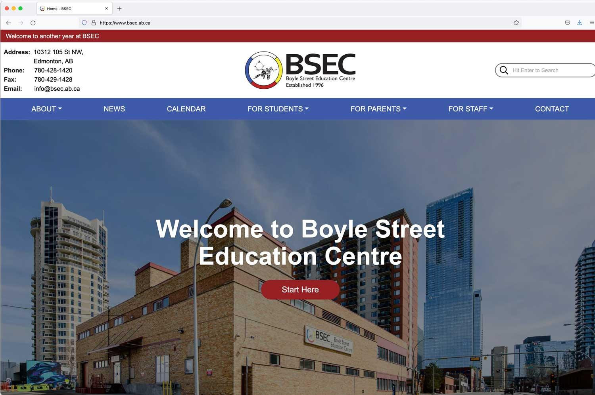
Boyle Street Education Centre
https://www.bsec.ab.ca/
Notes:
https://www.bsec.ab.ca/services/
High school in Edmonton
--- exist to serve students who are looking for an alternative to the mainstream.

Slide 107

SECTION 9
Review
TOPICS:
Overview of FASD
Strategies
107

Slide 108

Foundations Review
FASD is a lifelong and complex disability
Each person is unique and has different strengths and challenges
Protective factors can reduce the risk of adverse outcomes
Inclusivity requires knowledge of FASD, communication and collaboration, and a ‘no blame, no shame’ approach
School staff should be
FASD-informed
Intentional action, reflective thinking, and assimilation of ideas
Notes:
FASD is a lifelong and complex disability that can occur when a fetus is prenatally exposed to alcohol
Each person is unique and has different strengths and challenges, and will need individualized supports to meet their needs
Protective factors can reduce the risk of adverse outcomes
School staff should be FASD-informed
Inclusivity requires knowledge and understanding of FASD by all members of school staff
In order to succeed, schools need to take a whole-school approach that requires open communication and collaboration between everyone involved with the student’s education, including teachers, caregivers, and support

Slide 109


Transitions Review
Transitions are a normal part of life, and can be small or big
Key Elements to Support Transitions:
Preparing Students, Collaboration, IPPs, Transition Planning
Transition Planning:
should be done, have an early start, timeline, designated coordinator, voice of youth, and be multi-dimensional
Transition Planning is designed to assist youth and families during the transition to adulthood
Transition plans should also focus on a lifespan approach and continuity
Notes:
Transitions are a normal part of life, and can be big or small
Key elements to supporting transitions include preparing students, collaboration with other agencies and caregivers, IPPs, and transition planning
Transition planning is designed to assist youth and families during the transition to adulthood by building upon the individual’s strengths and preparing for necessary services and supports to be in place when they turn 18
Best practices for transition planning include:
It should be done
An early start
Timeline
Designated Coordinator
Voice of Youth
Multi-dimensional
Transition plans should also focus on lifespan approach and continuity
The plans may change throughout the lifespan
Each stage in the process builds on previous stages and sets the groundwork for future stages

Slide 110

WRaP Blog
wrap2fasd.org
FASD Networks in Alberta
fasdalberta.ca
CanFASD
canfasd.ca

Slide 111

Break
Slide
Take a short break

