Slide 1



Teaching Strategies for Students
with FASD
What is Fetal Alcohol Spectrum Disorder?
Learn More
Notes:
Revised: FALL-Winter 2025

Slide 2
Land
Acknowledgements
2
Notes:
Please find and include the appropriate land acknowledgement for the land you will be giving your presentation from (which may change between presentations depending on your location).
If you are unsure, https://native-land.ca/ is a resource that can tell you what territory you are on.

Slide 3
Presenter Introduction
Your Name
& Pronouns
Space to include a fun fact
Your Network
Email@emailaddress.com

Slide 4
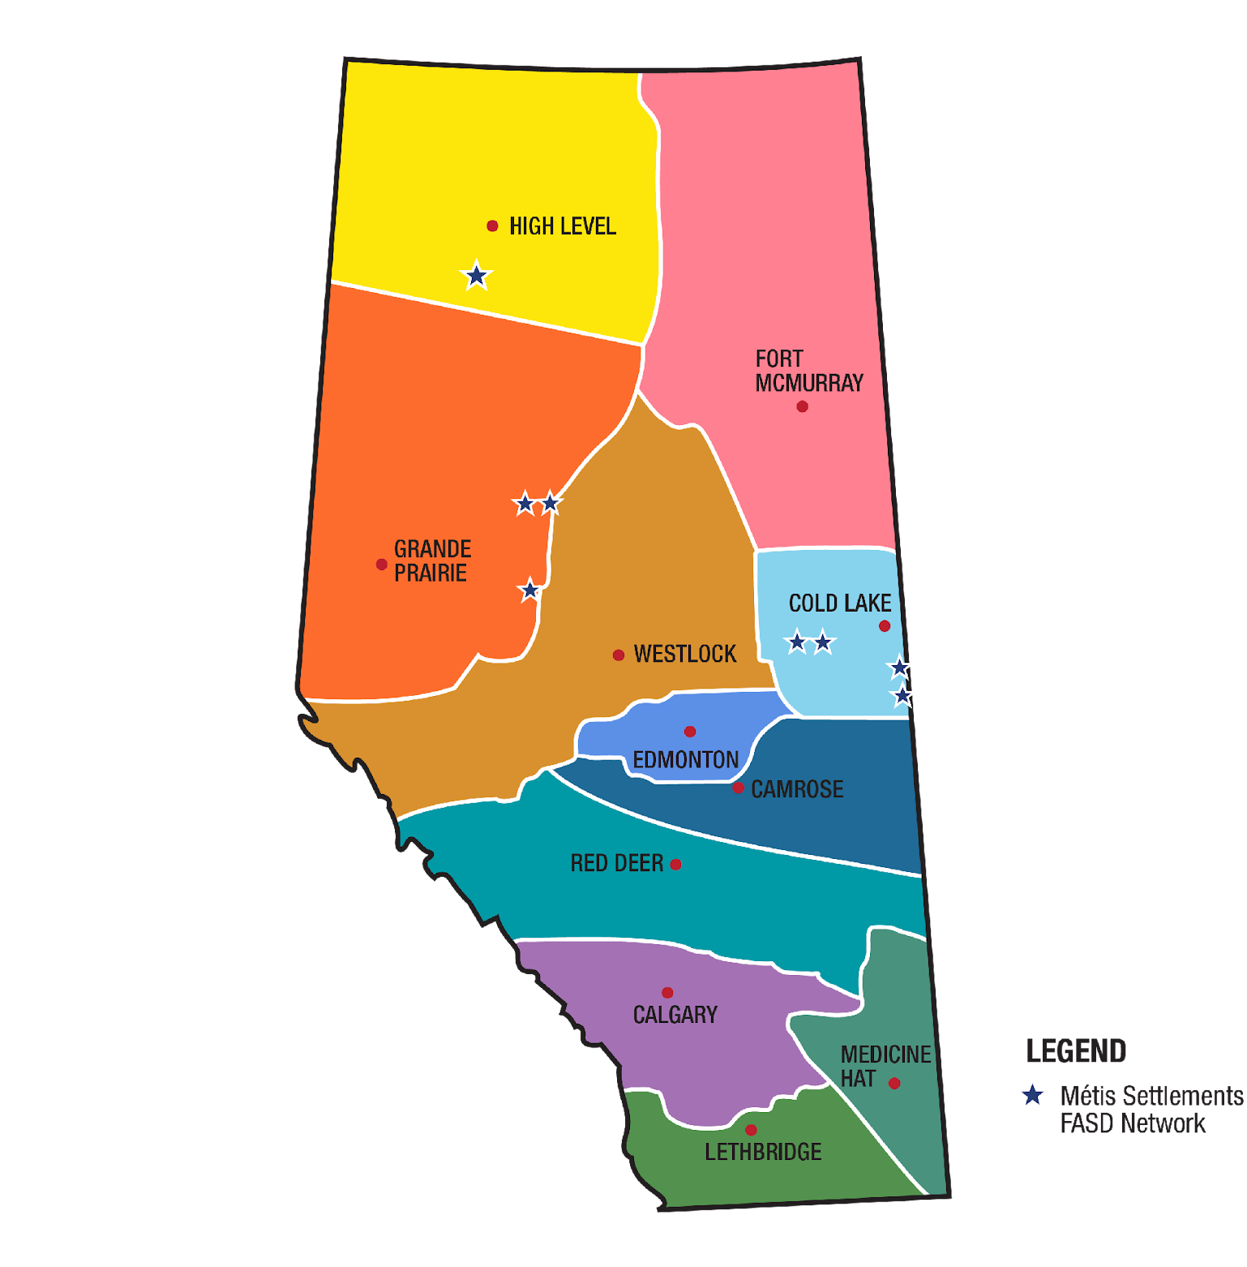
FASD Networks
In Alberta
www.FASDAlberta.ca
Notes:
A key innovation of Alberta’s response to FASD was the development and continued funding of 12 regionally based civil society FASD Service Networks, which have become the cornerstone for the delivery of FASD awareness, prevention, assessment and diagnosis, and supports for individuals with FASD, their families, and caregivers across the province.
In alignment with the strategic direction provided by the Government of Alberta, the FASD Service Networks build capacity in communities by enhancing existing services and by fostering the development of new ones.
The community-led FASD Service Networks have each designed a model of service delivery to meet the unique needs in their region.
The WRaP 2.0 project is implemented by the FASD Networks.

Slide 5
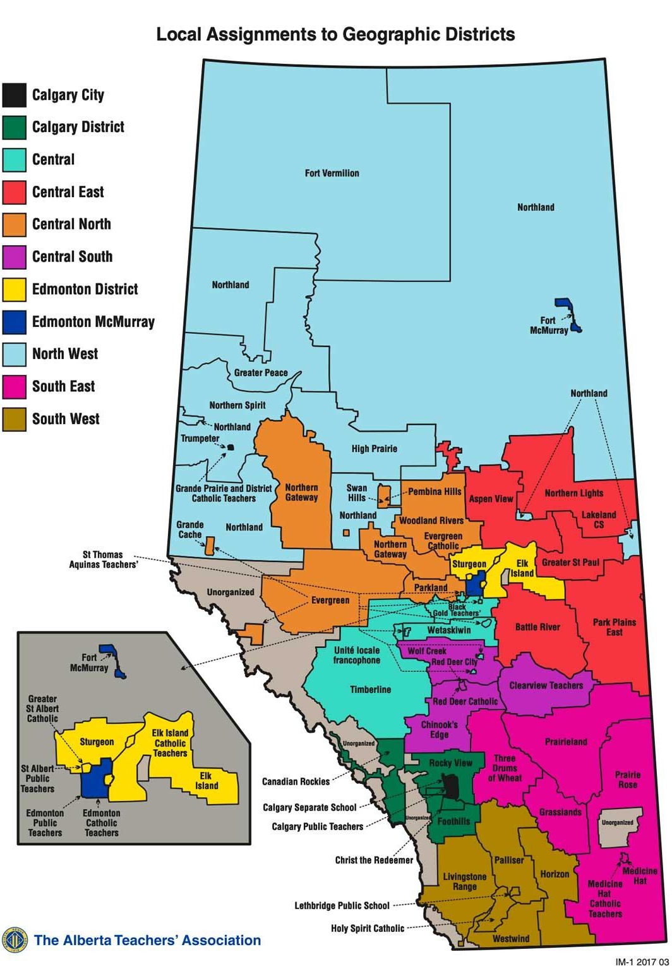
ATA Locals Map
View interactive map Local Assignments to Geographic Districts
Notes:
https://www.teachers.ab.ca/SiteCollectionDocuments/ATA/For%20Members/ATA%20Locals/IM1%202017%2003%2011x17%20Colour.pdf
The WRaP 2.0 project is a five-year project, from development to implementation to exit strategy, and it began February 1, 2021 and will run until everything is finalized by January 31, 2026.
It is province-wide and focuses on building the knowledge and capacity of educators to better support students with FASD.
The objectives of the project include:
Increase the capacity of teachers and schools to meet the educational needs of children and youth (ECS: Early Childhood Services: education programs that are offered by a school authority to Grade 12) with FASD
Teachers and school leaders will increase their knowledge and skills regarding how to support students with FASD by engaging in current best practices as shared by the FASD Networks through FASD instructional coaches.
Schools will enhance their capacity by incorporating FASD-informed approaches into their classroom communities, as part of a continuum of supports and services.

Slide 6

Introduction
This presentation will cover teaching strategies that you can use to support students with FASD to succeed in the school environment.
6
Notes:
This presentation will cover teaching strategies that you can use to support students with FASD to succeed in the school environment. Many of these strategies may be familiar to school staff, but it is important to remember that strategies to support students with FASD should be individualized to the student. Often the frequency and “intensity” of supports for students with FASD will differ.

Slide 7
01
Overview of FASD
02
Building Inclusive Schools
Content
03
Implementing Interventions
04
Accommodations
05
Teaching Strategies
06
Educator Self-Care and Wellness
07
Examples
08
Review
Notes:
This presentation is broken into 8 modules. Today we will cover:
Overview of FASD
Building Inclusive Schools
Implementing Interventions
Accommodations
Teaching Strategies
Educator Self-Care and Wellness Strategies
Examples
Review
As the presenter, you can choose which modules and information to cover based on your allotted time.

Slide 8

“
Education/knowledge is developing, but it’s going to be a long process but the fact that groups are asking for presentations/workshops shows that awareness is being heightened.
- Key Worker
”
http://www.kpdsb.on.ca/assets/uploads/FASD/FASDFinalReport.pdf
8
Notes:
http://www.kpdsb.on.ca/assets/uploads/FASD/FASDFinalReport.pdf

Slide 9

SECTION 1
Overview
of FASD
TOPICS:
Prevalence
Definition
Language Matter
FASD and the Brain
Signs and Symptoms
Protective Factors
9
Notes:
This presentation assumes you already went through a detailed overview of FASD with this audience using Presentation 1 - Foundations in FASD. This section just provides a refresher on the key elements covered in Presentation 1. You can supplement this section with additional slides and materials from Presentation 1 as needed.

Slide 10

Prevalence
1.6 million
people in Canada
44 -176, 000
4%
people in Alberta (1-4% of the population)
of people
in Canada
1 in 25
people in Canada
Notes:
Researchers currently estimate that at least 4% of individuals in Canada have FASD.
This estimate translates to more than 1.6 million people in Canada or at least 1 in 25.
In Alberta, estimates are 1-4% in the general population.
This means about one student in every classroom may have FASD.
References:
Flannigan, K., Cauduro, E., Unsworth, K., Harding, K., & McFarlane, A. (2024). The prevalence of fetal alcohol spectrum disorder: Issue paper update. Canada FASD Research Network. https://canfasd.ca/wp-content/uploads/publications/Prevalence-1-Issue-Paper-Update-FINAL.pdf
Popova, S., Lange, S., Shield, K., Burd, L., & Rehm, J. (2019). Prevalence of fetal alcohol spectrum disorder among special subpopulations: a systematic review and meta‐analysis. Addiction, 114(7), 1150-1172. DOI: https://doi.org/10.1111/add.14598
Popova, S., Lange, S., Poznyak, V., Chudley, A. E., Shield, K. D., Reynolds, J. N., ... & Rehm, J. (2019). Population-based prevalence of fetal alcohol spectrum disorder in Canada. BMC public health, 19(1), 845. https://link.springer.com/article/10.1186/s12889-019-7213-3

Slide 11

Definition
“
Fetal Alcohol Spectrum Disorder (FASD) is a diagnostic term used to describe impacts on the brain and body of individuals prenatally exposed to alcohol.
FASD is a lifelong disability. Individuals with FASD will experience some degree of challenges in their daily living, and need support with motor skills, physical health, learning, memory, attention, communication, emotional regulation, and social skills to reach their full potential.
Each individual with FASD is unique and has areas of both strengths and challenges.
”
Notes:
This is the standard definition of FASD, developed by the Canada Fetal Alcohol Spectrum Disorder Research Network, or CanFASD (Harding et al., 2019). CanFASD strongly recommends that professionals adopt this definition in their practice because it can:
Reduce stigma
Increase everyone’s understanding of FASD
Reduce confusion about the disability
Improve consistency in how we talk about this disorder
Help us to focus on a more strengths-based approach
For conversations about FASD in more informal settings, a community definition was also developed:
“FASD is a lifelong disability that affects the brain and body of people who were exposed to alcohol in the womb. Each person with FASD has both strengths and challenges and will need special supports to help them succeed with many different parts of their daily lives.”
Reference:
Harding, K., Flannigan, K., & McFarlane, A. (2019, July). Policy action paper: Toward a standard definition of fetal alcohol spectrum disorder in Canada. Canada FASD Research Network. https://canfasd.ca/wp-content/uploads/2019/08/Toward-a-Standard-Definition-of-FASD-Final.pdf

Slide 12

Possible Diagnoses
01
02
At-risk for neurodevelopmental disorder and FASD associated with PAE
FASD with sentinel facial features
FASD without sentinel facial features
Diagnosis
Designation
Notes:
Prior to 2015, individuals could be diagnosed with Fetal Alcohol Syndrome (FAS), partial FAS (pFAS), or Alcohol-Related Neurodevelopmental Disorder (ARND).
The process for FASD assessment and diagnosis in Canada was most recently updated in 2015. There are 2 possible categories of FASD diagnosis:
FASD with sentinel facial features
FASD without sentinel facial features
FASD with or without sentinel facial features replaced FAS, pFAS, and ARND, which are no longer used as diagnostic terms.
An individual may also be given the designation of “At risk for neurodevelopmental disorder and FASD, associated with PAE” which is not a diagnosis, but means that the person is experiencing significant challenges that may eventually lead to a diagnosis.
In Canada, we use FASD as the general term to cover anyone who meets the criteria for diagnosis. The third “At-Risk” term is non-diagnostic, meaning the individual does not currently meet diagnostic criteria for FASD at the time of assessment but will require future follow-up and support.
Reference: Cook, J. L., Green, C. R., Lilley, C. M., Anderson, S. M., Baldwin, M. E., Chudley, A. E., Conry, J. L., LeBlanc, N., Loock, C. A., Lutke, J., Mallon, B. F., McFarlane, A. A., Temple, V. K., & Rosales, T. (2016). Fetal alcohol spectrum disorder: A guideline for diagnosis across the lifespan. Canadian Medical Association Journal, 188(3), 191–197. https://www.cmaj.ca/content/188/3/191

Slide 13

FASD is a Lifelong Disability
vv
Notes:
FASD is a life-long, whole body disorder so supports must be provided across the lifespan. An individual’s needs and strengths may change throughout their lives.
Strategies will need to be constantly reviewed and revised as the individual grows and changes and throughout transition periods. There is good evidence that early and appropriate supports in the education setting (and across other domains) can improve outcomes for people with FASD.
References:
Pei, J., Joly, V., Kennedy, K., & Flannigan, K. (2024). Towards Healthy Outcomes: A Framework for Integrated Community Intervention. Canada FASD Research Network in collaboration with the University of Alberta. https://canfasd.ca/wp-content/uploads/publications/Towards-Healthy-Outcomes-2.0.pdf
Cook, J. L., Green, C. R., Lilley, C. M., Anderson, S. M., Baldwin, M. E., Chudley, A. E., Conry, J. L., LeBlanc, N., Loock, C. A., Lutke, J., Mallon, B. F., McFarlane, A. A., Temple, V. K., & Rosales, T. (2016). Fetal alcohol spectrum disorder: A guideline for diagnosis across the lifespan. Canadian Medical Association Journal, 188(3), 191–197. https://www.cmaj.ca/content/188/3/191
Himmelreich, M., Lutke, C. J., & Hargrove, E. T. (2020). The lay of the land: Fetal alcohol spectrum disorder (FASD) as a whole-
body diagnosis. In S. L. A. Straussner & C. S. Fewell (Eds.), The Routledge handbook of social work and addictive behaviors
(1st ed.). Routledge.
Vanderpeet, C., Akison, L., Moritz, K., Hayes, N., & Reid, N. (2025). Beyond the Brain: The Physical Health and Whole-Body Impact
of Fetal Alcohol Spectrum Disorders. Alcohol Research: Current Reviews, 45(1), 05. 10.35946/arcr.v45.1.05

Slide 14







Support Might be Required for:
Following or Participating in Conversations
Reading or Writing for Meaning
Learning and Memory
Being Impulsive, overwhelmed
Making Friends
Areas in Need of Support
Understanding Abstract Concepts
Being Sensitive to Stimuli
Notes:
Individuals with FASD are diverse, and many aspects of cognitive, behavioural, and physical functioning can be impacted by prenatal alcohol exposure. Possible areas of need that may require support: motor skills, physical health, learning, memory, attention, communication, emotional regulation, and social skills.
More specifically, to the classroom, areas of need may include:
Learning and memory (long-term processing pace)
Following or participating in conversations
Reading or writing for meaning
Using and understanding expressive/receptive language
Understanding abstract concepts like time and money
Being impulsive, distracted, overwhelmed
Making friends
Being sensitive to sounds, visual stimuli, textures and smells
Educational strategies that rely on an assumption of “normal” functioning of these cognitive processes are likely to be less effective for students with FASD.
References:
Cook, J. L., Green, C. R., Lilley, C. M., Anderson, S. M., Baldwin, M. E., Chudley, A. E., Conry, J. L., LeBlanc, N., Loock, C. A., Lutke, J., Mallon, B. F., McFarlane, A. A., Temple, V. K., & Rosales, T. (2016). Fetal alcohol spectrum disorder: A guideline for diagnosis across the lifespan. Canadian Medical Association Journal, 188(3), 191–197. https://www.cmaj.ca/content/188/3/191
Pei, J., Tremblay, M., McNeil, A., Poole, N., & McFarlane, A. (2017). Neuropsychological aspects of prevention and
intervention for FASD in Canada. Journal of Pediatric Neuropsychology, 3(1), 25-37. DOI: 10.1007/s40817-016-0020-1

Slide 15

“
‘I’ve got it!’ But the next day, where did it go? It is so frustrating for a teacher to see a child learn something and not be able to retain it…think what it must feel like to the student. Don’t give up!
- Teacher
”
A Quick Guidebook for Schools – Lakeland Center – Heather MacFarlene
15
Notes:
A Quick Guidebook for Schools – Lakeland Center – Heather MacFarlene

Slide 16
















Each Individual with FASD is Unique
Notes:
“Each individual is unique and has areas of both strengths and areas in need of support”.
How it affects each person is unique, as is often said by people with FASD, “if you’ve met one person with FASD, you’ve met one person with FASD.” Each person demonstrates unique strengths and needs.
When supporting students, you need to consider their unique needs and strengths, as well as their environments and supports, to be effective in helping them succeed.
An educational approach that considers only their challenges won’t be effective because it doesn’t give students the opportunity to identify and develop their strengths.

Slide 17

Common Areas of Need:
Motor Skills
Brain Structure and Functioning
Cognitive
Language
Academic Achievement
Memory
Attention
Executive Functioning
Affect Regulation
Adaptive Behaviour, Social Skills
Notes:
Primary disabilities are difficulties that are directly associated with the impacts of PAE on the brain and body. These impacts are typically categorized in the following brain domains:
Motor Skills
Specific actions that can be carried out by coordinating large muscle groups (gross motor; such as walking, balancing, and jumping), or smaller muscle groups (fine motor; more precise movements, such as writing, and using zippers and buttons)
Neuroanatomy/Neurophysiology (Brain Structure and Functioning)
This might include structural abnormalities. Some people with FASD may have seizures
Cognition (Thinking and Reasoning)
refers to our ability to think and process information. Assessment in this domain typically focuses on verbal comprehension (an individual’s ability to use and understand language and vocabulary), fluid or perceptual reasoning (an individual’s ability to solve novel visual or nonverbal problems), processing speed (the speed with which an individual can take in and respond to information), and working memory (an individual’s ability to hold and manipulate information ‘online’ in their mind).
Language (Expressive and Receptive)
broadly refers to an individual’s ability to communicate effectively, both in terms of understanding and producing language. It also includes higher-level language skills such as narrative (e.g., story-telling) and complex/abstract comprehension abilities (e.g., understanding sarcasm)
Academic Achievement
Academic skills refer to an individual’s ability to learn and carry out work relating to reading, writing, and math
Memory
refers to an individual’s ability to acquire, store, retain, and retrieve verbal and visual information from their mind, either intentionally (e.g., remembering information for a test) or unintentionally (e.g., ‘remembering’ how to ride a bike)
Attention
refers to the process of selectively focusing on something specific in our environment, which involves resisting distractions and irrelevant information. Attention is a critical component of learning and memory. It can refer to inattention (difficulty maintaining focus); selective attention (difficulty ignoring visual or auditory stimuli in the environment) or sustained attention (difficulty paying attention for long periods of time)
Executive Function, including impulse control
involves the higher-level thinking skills used to organize and control one’s own thoughts and behaviours in order to meet a long-term goal. The exact components of executive functioning are sometimes debated, but in an FASD assessment they include working memory, inhibition and impulse control (hyperactivity), planning and problem-solving, and cognitive flexibility. Other related and overlapping skills include self-monitoring, organizing and prioritizing, and shifting focus from one area or task to another.
Affect Regulation (Controlling Emotions)
refers to an individual’s ability to change or maintain their feelings or emotional state through effortful control in order to meet the demands of their environment. In an FASD assessment, affect regulation is specific to depressive and anxiety disorders as defined in the Diagnostic Statistical Manual of Mental Disorders – 5th Edition (DSM-5).
Adaptive Behaviour, Social Skills, or Social Communication
are the daily living skills and abilities that are necessary to function socially and practically in the home and community in an age-appropriate manner, such as communication, interpersonal skills, self-care, domestic skills, functional academics (e.g., money math), etc.
Reference: Cook, J. L., Green, C. R., Lilley, C. M., Anderson, S. M., Baldwin, M. E., Chudley, A. E., Conry, J. L., LeBlanc, N., Loock, C. A., Lutke, J., Mallon, B. F., McFarlane, A. A., Temple, V. K., & Rosales, T. (2016). Fetal alcohol spectrum disorder: A guideline for diagnosis across the lifespan. Canadian Medical Association Journal, 188(3), 191–197. https://www.cmaj.ca/content/188/3/191

Slide 18

Our Language Matters
Instead of…
Use…
Suffering with, Damaged by, Living with
Person or Individual with FASD
Mentally Disabled
Cognitive or Neurodevelopmental Disability
FASD Student
Student with FASD
Alcoholics, Addicts, and Alcoholic mother
Birth mother, or parent who use(d) substances during pregnancy
Admitted to Alcohol Use or Denied Alcohol Use
Reported Drinking Alcohol or Confirmed Alcohol Use
Notes:
Creating FASD-informed schools also means shifting our language around how we talk and think about FASD. How we talk about people with FASD matters.
Individuals with FASD are often stigmatized because of their diagnosis, their behaviours, and other possible traits that may be seen as different from others. A great deal of stigma also surrounds mothers and women who use substances during pregnancy and family members of people with FASD.
Language is an important tool is addressing stigma and stereotypes. We want to make sure the language we’re using is:
strengths-based
person-first (unless their preference is otherwise specified)
evidence-based; and
dignity-promoting
For example:
Use person or individual with FASD instead of suffering with, damaged by, living with FASD
Use cognitive or neurodevelopmental disability instead of mentally disabled
Use student with FASD instead of FASD students
Replace stigmatizing terms such as “alcoholic mother” with person-first terms such as “birth mother, or parent who use(d) substances during pregnancy.
Use reported drinking alcohol or confirmed alcohol use instead of admitted to alcohol use or denied alcohol use
Creating FASD-informed schools also means shifting our language around how we talk and think about FASD.
Additional information can be found within the Common Messages Guide: https://canfasd.ca/wp-content/uploads/publications/Common-Messages.pdf

Slide 19

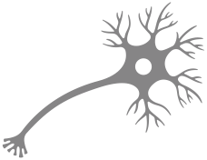

FASD and the Brain
Neuron
The brain begins as a tube (the brain stem)
Brain cells (neurons) grow from the brain stem in an upward and outward direction to build the brain
If alcohol is consumed during pregnancy, it may disrupt the growth and distribution of the neurons in a variety of ways, and may even kill some neurons
Brain Stem
Notes:
Alcohol is a teratogen, which is a substance that disturbs the development of an embryo or fetus
The brain begins as a tube (the brain stem). Brain cells (neurons) grow from the brain stem in an upward and outward direction to build the brain. Exposure to alcohol during pregnancy may disrupt the growth and distribution of the neurons in a variety of ways and may even kill some neurons. Alcohol impacts each developing brain different based on the timing and amount of alcohol consumed.
A developing fetus receives all nutrients and oxygen from what its mother eats and drinks. These nutrients travel through the placenta via the umbilical cord. A fetus’ system breaks down alcohol very slowly compared to adults. Exposure to alcohol can impact fetal brain and body development.
Understanding the function of different areas of the brain:
Amygdala – decision making; fight or flight or freeze response; area of the brain for perceived fear
Basal Ganglia – cognitive functioning; motor control; executive functioning
Caudate Nucleus – planning the execution of movement, but also learning, memory, reward, motivation, emotion
Cerebellum – motor control; motor learning
Corpus Callosum – connecting and processing between two sides of the brain; speed of processing
Frontal Lobe – high level executive functions; impulse control; planning; voluntary movement
Hippocampus – learning and memory and emotional regulation
Nucleus Accumbens – reward, pleasure, laughter, addiction, aggression, fear, and the placebo effect
Parietal Lobe – integrating sensory information; spatial awareness; mathematical ability; dypraxia

Slide 20
Areas in Need of Support
vv
A
L
A
R
M
S
Reasoning
Adaptation
Sensory Processing Disorders
Attention
Language
Memory
Notes:
FASD often goes undiagnosed or misdiagnosed. Signs and symptoms are hard to recognize in babies and young children, so individuals with FASD often aren’t diagnosed until they are in school or teenagers. Many receive diagnosis in adulthood.
ALARMS is a tool that may help you identify a student with FASD in your classroom. ALARMS stands for Adaptation, Language, Attention, Reasoning, Memory, Sensory Processing Disorders:
Adaptation – students struggle getting started or stopping activities. At school this may look like trouble managing all the transitions happening throughout the day (i.e. moving from Math to art). Unsupervised time can also be really challenging for students with FASD because there is less structure and fewer rules to depend on.
Language – students with FASD are often gifted with expressive language but are challenged in the receptive language domain. This may make the child seem older than they are, but at the same point the child may have trouble understanding instructions or completing a task.
Attention – People with FASD often have a comorbid ADHD/ADD diagnosis. Paying attention to one task can be challenging.
Reasoning – Abstract concepts are challenging for people with FASD to understand. They often have trouble with math, science, and reading comprehension, and struggle to understand concepts like time and money.
Memory – People with FASD often have memory challenges and will experience gaps or holes in memory. They will often make the same mistakes again, or come back to school on Monday and can’t remember what they learned on Friday
Sensory Processing Disorders – people with FASD often struggle managing sensory input, organization, and output. They may be over or under stimulated in their environments. For some, they may experience sensory overloads, others may stay “tuned-out”
Remember: With this information, your role can be to identify students with possible PAE and follow school process to move towards diagnosis.
Pei, J., & Rinaldi, C. (2014). Understanding students with FASD: A guide to school-based intervention. Edmonton Regional Learning Consortium

Slide 21






Several factors can protect individuals with FASD and result in more positive outcomes:
Stable and nurturing home environment
Basic needs met
Early intervention and effective supports and services
No experience with violence or trauma
Protective Factors
Developmental disabilities services
Diagnosed and flagged before the age of 6
Notes:
There are several protective factors that can result in positive outcomes and enable potential success for individuals with FASD. These include:
Nurturing and stable home and a consistent home environment:
In fact, living in a stable and nurturing home has been suggested to be one of the most important protective factors against negative outcomes for individuals with FASD Consistent home environment
Basic needs met
No experience with violence or trauma
A home environment free from violence is a key protective factor.
Implementing trauma-informed approaches in schools and communities helps create a more supportive environment. Received developmental disability services
Diagnosed or flagged before the age of 6 years
Receiving a diagnosis early is a critical component for success.
Early and effective support where needed
Original Ref: AFKA Understanding FASD half day PPT (from original)
New References: (Flannigan et al., 2020; Streissguth et al., 2004).

Slide 22

SECTION 2
Building Inclusive Schools
TOPICS:
Education Act
Principles of Inclusion
FASD-Informed Schools
Building Towards Inclusivity
Teams of Support
22

Slide 23

Education Act
Shared responsibility and requires collaboration, engagement and empowerment of all partners in the education system to ensure that all students achieve their potential.
Students are entitled to welcoming, caring, respectful and safe learning environments that respect diversity and nurture a sense of belonging and a positive sense of self.
An inclusive education system provides each student with the relevant learning opportunities and supports necessary to achieve success.
Notes:
Education is a shared responsibility and requires collaboration, engagement and empowerment of all partners in the education system to ensure that all students achieve their potential. Students are entitled to welcoming, caring, respectful and safe learning environments that respect diversity and nurture a sense of belonging and a positive sense of self. An inclusive education system provides each student with the relevant learning opportunities and supports necessary to achieve success.
The Education Act does not specifically mention FASD, but it establishes the framework for the K-12 system in Alberta, which includes provisions for students with disabilities and the roles and responsibilities of schools, parents, and the Ministry.
Reference:
Government of Alberta. (2023). Supporting students with special education needs: A guide for school authorities and stakeholders (Publication No. E00P3) https://open.alberta.ca/publications/e00p3

Slide 24


Principles of Inclusion
Anticipate, value and support diversity and learner differences
High expectations for all learners
Understand learners’ strengths and needs
Remove barriers within learning environments
Build capacity
Collaborate for success
Notes:
There are six key principles guiding Alberta’s vision for an inclusive education system. These principles need to be built into policy, practices, and actions at every level.
Anticipate, value and support diversity and learner differences: Welcoming, caring, respectful and safe learning environments create a sense of belonging for all learners and their families.
High expectations for all learners: Creating a culture of high expectations begins with an accessible curriculum and meaningful and relevant learning experiences. Educators and families act on the idea that, with the right instructional supports, every learner can be successful. However, it is important to remember that these expectations should be based on the learner’s challenges, strengths, needs, and goals.
Understand learners’ strengths and needs: Meaningful data is gathered and shared at all levels of the system—by teachers, families, schools, school authorities and the Ministry—to understand and respond to the strengths and needs of individual learners.
Remove barriers within learning environments: All education partners work together to remove barriers within the learning environment so that all learners are successful and can participate in the school community.
Build capacity: Government, school and system leaders, teachers, education professionals, families and community partners have ongoing opportunities, relationships and resources that develop, strengthen and renew their understanding, skills and abilities to create flexible and responsive learning environments. Capacity building takes place at the personal, school and system levels.
Collaborate for success: All education stakeholders, including school and system staff, families, community partners, post-secondary institutions, teacher preparation programs and government are committed to collaboration to support the success of all learners.
Reference: Government of Alberta. (n.d.). Inclusive education. https://www.alberta.ca/inclusive-education

Slide 25

System and structural
change for inclusion
Policy
Successful inclusion of learners with FASD
Curriculum design, decision making, and delivery
Knowledge
of FASD
Practice
Actions
Collaboration and communication
No blame,
no shame
Adapted from Achieving Inclusion for Students with FASD in Australian Schools
Notes:
A framework was developed in Australia to support inclusion at the policy, practice, and action levels. Key elements of the framework include:
Knowledge of FASD
Collaboration and communication
No blame, no shame
Reference/Resource:
Learning with FASD. (n.d.). Learning with FASD: Strategies and supports for neurodiverse learners. https://learningwithfasd.org.au/

Slide 26

Case for a
Different Approach
Flexible, individual-based responses prove to be most effective approaches
Students with FASD and positive school experiences are less likely to develop adverse outcomes
Teachers often report that they lack the knowledge and training in FASD
Research has found that traditional approaches in classroom management can be unsuccessful in supporting the needs of students with FASD
Typical behavioural responses are not always interpreted appropriately by the individual with FASD
26
Notes:
FASD affects each person uniquely, so flexible, individualized approaches are needed for working with students with FASD;
Students with FASD and positive school experiences are less likely to develop adverse outcomes
Teachers often report that they lack the knowledge and training in FASD but are eager to provide improved support to their students
Traditional approaches in classroom management may not be effective in supporting the needs of students with FASD

Slide 27
Recognizing and Supporting Students with FASD in the Classroom
Many students with FASD go unrecognized in school settings.
Misinterpreted behaviours can lead to unnecessary discipline.
Early recognition helps prevent escalation and exclusion.
Collaboration with families and school teams improves consistency.
27
(Kautz-Turnbull et al., 2025)
Notes:
Educators may be the first to see patterns that suggest underlying brain-based differences
When behaviour is viewed through a neurodevelopmental lens rather than as intentional defiance, we can shift from reactive discipline to proactive support.
Simple strategies, predictable routines, clear instructions, visual cues, and task breakdowns help students stay regulated and engaged
Ongoing collaboration with families and support teams ensures students experience consistent expectations across settings.
Reference:
Kautz‐Turnbull, C., Rockhold, M., Speybroeck, E., Myers, J., & Petrenko, C. L. M. (2025). Preventing exclusionary discipline and adverse life experiences in FASD: Teachers' ability to recognize students with FASD in the classroom and develop and implement preventative strategies to support learning and behavior. Alcohol: Clinical and Experimental Research, 49(8), 1828-1838. https://doi.org/10.1111/acer.70100

Slide 28

What Educators Need to Know
Knowledge of FASD among all education professionals and caregivers
Notes:
This screenshot is from a short video featuring Myles Himmelreich, a speaker with lived experience of FASD. In this video, Myles explains that many behaviours seen in students with FASD stem from brain-based differences rather than defiance, and he encourages educators to use empathy, clarity, and individualized supports. For more information you can check out the video: https://www.fasdoutreach.ca/resources/all/m/myles-himmelreich-what-educators-need-know

Slide 29






Caregivers
FASD Informed Schools
Teachers & school boards
Knowledge of FASD among all education professionals and caregivers
Communities
Notes:
Inclusivity begins with a knowledge of FASD among all educational professionals. In a study of school Superintendents researchers found most lacked more than a cursory knowledge of FASD yet over 50% had to deliver on a disciplinary meeting (suspension, expulsion) of a student with FASD.
In an FASD intervention project in North-Western Ontario, researchers found a number of positive impacts when school boards, communities, and caregivers were trained on how to support children with FASD:
Caregivers realized they weren’t alone;
Teachers reported that being aware of FASD, having tracking mechanisms, and connecting with knowledgeable support people was very helpful; and
Teachers reported better mental health and well-being.
Resource: The Government of Alberta offers free online FASD training through the Canada FASD Research Network for educators and other professionals: https://www.alberta.ca/fasd-training-and-education
What Educators Need to Know About FASD is a practical resource published by the Government of Manitoba to help teachers and school staff understand fetal alcohol spectrum disorder (FASD), how it affects learning and behaviour, and to provide classroom-based strategies for supporting students with FASD. The resource can be found here: https://www.gov.mb.ca/fs/fasd/pubs/fasdeducators_en.pdf

Slide 30

Three Areas of Focus
Understanding the whole student
Responding with dynamic environments
Optimizing student-centered programming
Notes:
Teachers have identified three important components of understanding FASD, and strategies for building this understanding:
Understanding the whole student
Take time to build and cultivate a relationship with the student
Focus on and emphasize the accomplishments over the challenging behaviours
Integrate choice with expectations
Responding within dynamic environments
Foster an inclusive atmosphere with student peers
Build the home-school relationships
Access individualized funding
Optimizing student-centered programming
Match supports with needs
Build on strengths
Address service gaps

Slide 31

Building Towards Inclusivity for FASD
Classroom inclusion becomes more challenging over time
Building inclusivity in schools requires us to adapt to the needs of the learner
Flexible and responsive learning environments that can adapt to the changing needs of learners
Notes:
Classroom inclusion may become more challenging over time. As children diagnosed with FASD transition to higher grades, their areas of need and challenges may become more obvious. All students experience challenges but students with FASD may experience challenges that isolate and differentiate them from their peers.
Building inclusivity for FASD in schools requires us to adapt to the needs of the learner. Every learner has unique needs. Some learners have profound and ongoing needs and others have short-term or situation-based needs. This calls for flexible and responsive learning environments that can adapt to the changing needs of learners.

Slide 32

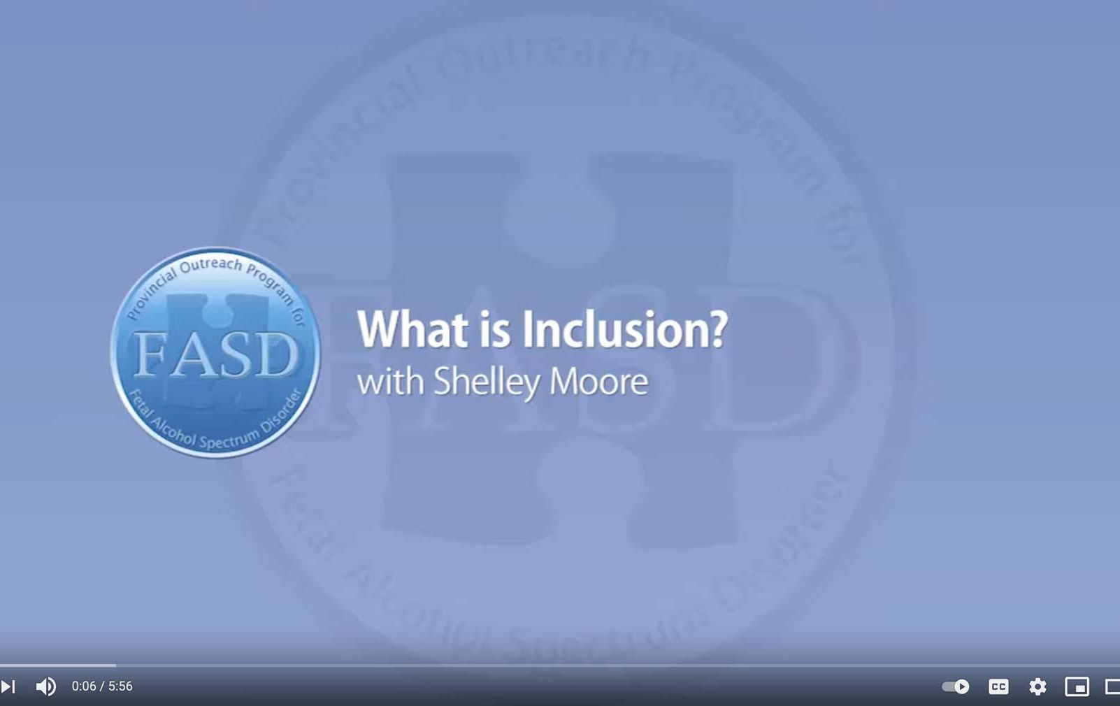
What is Inclusion?
with Shelley Moore
https://www.youtube.com/watch?v=D1fbTKYkU4k
Notes:
Consider this teacher’s experience trying to promote inclusion for her students in a space that wasn’t ideally structured for them: https://www.youtube.com/watch?v=D1fbTKYkU4k (5:56)

Slide 33

Belonging
6 elements to improve belonging:
Effective Listening
Supports
Positive Relationships
Early Programs
Common Interests
Extracurriculars
Notes:
A key element of inclusion is a sense of belonging. Students with FASD need a supportive school community that welcomes them, makes them feel safe, and makes them feel like a contributing member of the school.
In a study on student belonging in Quebec, researchers made six recommendations to improve feelings of belonging for students:
1. Training educators on effective listening strategies
Providing personal and academic supports for students
Encouraging positive social relationships
Ensuring early implementation of social competence programs
Providing education activities where students can develop common interests with peers
Encouraging extracurricular participation related to their various interests

Slide 34

Belonging in Alberta
The Belonging Project is an Alberta-based initiative from the Skills Society and the University of Alberta exploring belonging and inclusion for people with intellectual disabilities.
The project produced three plain-language summaries including:
  Belonging & Inclusion
  Lived Experience
  Provider Practices
The resources can be accessed here: https://resourcesforpractice.policywise.com/resource?id=137
Notes:
The Skills Society partnered with the University of Alberta to understand how belonging is experienced by adults with intellectual disabilities and what helps them feel connected, valued, and included in their communities.
The three summaries offer a different lens:
Belonging & Inclusion Summary outlines what belonging means and the key conditions that support it.
Lived Experience Summary captures insights directly from individuals with intellectual disabilities about what makes them feel welcomed and included.
Provider Practices Summary focuses on practical steps service providers can take to create environments that foster belonging.

Slide 35
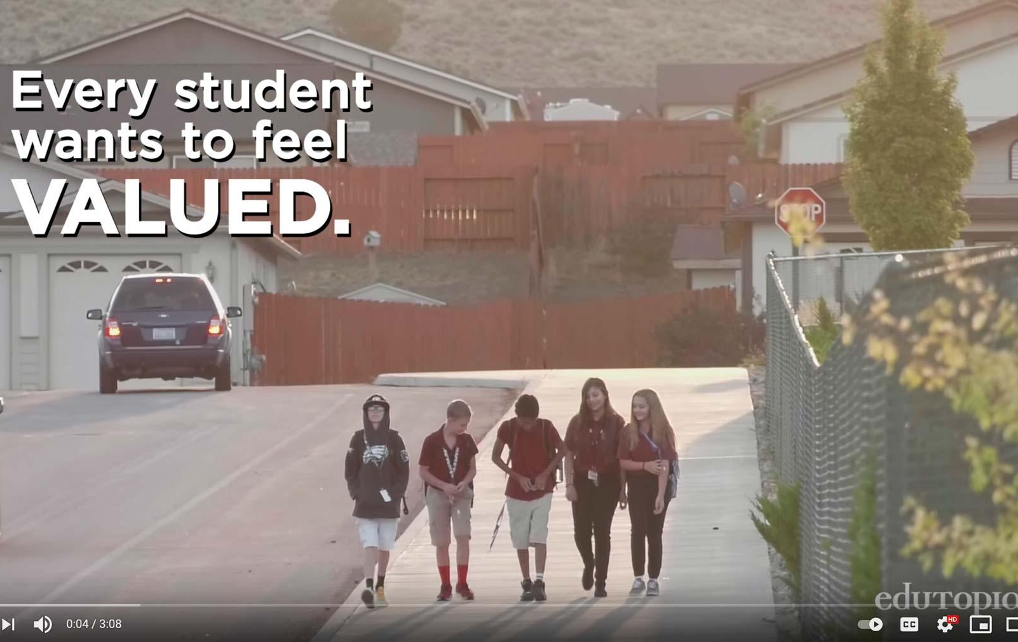
Making Sure Each Child is Known
by Edutopia
https://www.youtube.com/watch?v=xjZx0VdmgkE
Notes:
Consider this strategy implemented in a middle school in Nevada to ensure each student feels like they belong in their school: https://www.youtube.com/watch?v=xjZx0VdmgkE (3:08)

Slide 36

Teams of Support
Educational
Assistant
School Administrators
Teacher
Communication & Collaboration
Consistent Strategies
Outside Agencies
Continuing Education
Caregivers
Notes:
Building capacity and collaboration are key elements to achieving success. The student and educator both need a strong and supportive network. Key stakeholders and their roles in supportive school communities include:
School Administrators
Identify gaps and seeks resources
Promote reflective practice
Commit to inclusivity
Provide leadership with vision
Communicate actively with caregivers
Teachers
Communicate with team
Commit to reflective practice
Incorporate classroom strategies
Compassionately engage with child
Communicate actively with caregivers
Educational Assistants
Provide one-on-one support when needed
Guided or directed by the teacher
Help develop/evaluate strategies
Compassionately engage with child
Maintain a safe environment
Outside Agencies
FASD Assessment and Diagnostic Clinics
Help provide a greater understanding of the student’s needs
FASD Support Providers
Provide resources for training as well as services for students
Caregivers
The core and most consistent member of the student’s support network
Provide a vast diversity of information regarding the student’s strengths, needs, and desires
Serve as the foundation of a strong and supportive network
Other stakeholders may include: school-based counsellors, sports coaches, wellness coaches, inclusive education coordinators, and counselling support professionals. Schools may have centralized supports and services, so it is important to bring in staff that are knowledgeable about those types of programs in order to best support individuals.
Together, the whole team of support needs to have a shared understanding of FASD, shared understanding of each unique individual, and shared goals to support the student. Strategies for the support team include:
Using consistent strategies to support the student’s success.
Communicating and collaborating to decide on one strategy at a time to address a specific goal.
Developing a communications plan which outlines how the team can share information in a timely manner.

Slide 37

If Sarah didn’t eat her breakfast in the morning, Sarah’s caregivers need a way to communicate that with her teacher. That way, her teacher knows that Sarah’s routine was disrupted, and she may be dysregulated, which may lead to challenges in the classroom. As a team, Sarah’s caregiver and teacher can decide on a strategy to mitigate concerns, like providing Sarah with a granola bar during her first lesson. It can be as simple as an email or a phone call, but communication is huge in helping achieve success for these students.
37
Tracy Masterangelo, Adapted from the Supporting Self-Regulation with Individuals with FASD Presentation
Notes:
Tracy Masterangelo, Adapted from the Supporting Self-Regulation with Individuals with FASD Presentation

Slide 38
Working with Caregivers
Possible Stages
Seeking Diagnosis
Seeking Support
Educator, Advocate
1
2
3
4
5
Coming to Terms
New Understanding
Notes:
Caregivers of individuals with FASD often juggle multiple roles. They are their child’s primary provider, but often also take the role of advocate to raise awareness of FASD and secure supports for their children. Unlike most other support workers, a caregiver is a 24/7 occupation.
Caregivers of individuals with FASD report high levels of stress, even in comparison with caregivers of individuals with other developmental disabilities.
Caregivers may move through several stages in the process of receiving a diagnosis:
Seeking and possibly receiving a diagnosis
Processing emotions and coming to terms with the child’s difficulties
Seeking support and belonging within a knowledgeable community
Developing a new understanding of the child’s behaviour
Becoming an educator, advocate, and expert on the child and FASD
CanFASD has a resource guide for caregivers of FASD: https://canfasd.ca/wp-content/uploads/2018/03/Caregiver-Resource-Guide-FASD-March-2018.pdf
Similarly, Healthy Child Manitoba Developed a Resouce called ‘What Parents and Caregivers Need to Know about Fetal Alcohol Spectrum Disorder) which can be found here: https://www.gov.mb.ca/fs/fasd/pubs/fasd_caregivers.pdf
References:
Bobbitt, S. A., Baugh, L. A., Andrew, G. H., Cook, J. L., Green, C. R., Pei, J. R., & Rasmussen, C. R. (2016). Caregiver needs and stress in caring for individuals with fetal alcohol spectrum disorder. Research in Developmental Disabilities, 55, 100–113
Olson, H. C., Oti, R., Gelo, J., & Beck, S. (2009). “Family matters:” Fetal alcohol spectrum disorders and the family. Developmental Disabilities Research Reviews, 15(3), 235–249.
Watson, S. L., Coons, K. D., & Hayes, S. A. (2013). Autism spectrum disorder and fetal alcohol spectrum disorder. Part I: A comparison of parenting stress. Journal of Intellectual & Developmental Disability, 38(2), 95–104

Slide 39

“
The other thing that is really important is daily communication between home and school. Reporting to parents the great things that happen and the things we need to work on is crucial. Things like student illnesses, poor sleep, food intake, or medication changes is information that can make or break the day at school for a student with FASD.
- Teacher
”
A Quick Guidebook for Schools – Lakeland Center – Heather MacFarlene
39
Notes:
A Quick Guidebook for Schools – Lakeland Center – Heather MacFarlene

Slide 40

Caregiver Needs and Educator Responses
Caregiver needs:
  Being Heard by Educators
  Openness from Educators
  FASD-Informed Educators
  Involvement in Child’s Education
  Resources and Accommodations
  Supportive Knowledge Base
  Support and Understanding at Home
Notes:
Caregiver needs might include:
Being Heard by Educators
Openness from educators when communicating
FASD-Informed Educators
Educators who understand and are willing to meet the complex needs of students with FASD
Involvement in their Child’s Education
Active involvement in their child’s education to ensure proper fit
Resources and Accommodations
Practical resources that address their child’s complex needs
Supportive Knowledge Base
Gaining knowledge about FASD and to develop effective supports
Support and Understanding at Home
Develop successful parenting techniques for their child
Possible educator responses
Encourage parents to have a structured, consistent, predictable home environment
Share strategies and tips that have worked for other parents
Discuss the role of rules and expectations in the classroom
Explain how they create routines that increase compliance and self-management, both at home and school
Consider the concerns identified by caregivers and if this is something that the school can address. Offer caregivers online and video resources that address concerns
Facilitate ongoing, open communication between home and school. This can be accomplished through weekly phone calls or using a communication book between home and school
Encourage parents to get accurate information about FASD from libraries, hotlines, community agencies or other sources
Encourage parents to talk to other families in the community who have children with special needs
Provide parents with information regarding network organizations with support groups in the community
Acknowledge and understand the difficult role of parents of children with special needs and support parents in this role
Assist parents in helping children develop appropriate social networks.
Caregivers who receive FASD-specific training are often better able to understand their child’s learning needs and communicate effectively with school staff (Millians, 2023).
CanFASD also offers evidence-based, culturally sensitive online training for caregivers and professionals, providing practical tools and varying levels of learning to support positive outcomes across the lifespan.
Information about the training can be found here: https://canfasd.ca/online-learners/

Slide 41

Intentional practices require
Constant Education
Shared learning within the student’s entire support system will enhance education outcomes.
Notes:
Intervention research is relatively new in the FASD field, but cognitive (self-regulation, memory, attention), academic (math, language, literacy), behavioural, social skills, and caregiver programs and supports have been promising
By implementing interventions and/or supports we create opportunities for targeted skill growth and development, while also shifting environmental supports and expectations in order to optimize opportunity. The goal is to promote well-being and generate opportunities for meaningful success.
Remember: meaningful outcomes come from meaningful understandings. We have to understand both the needs and strengths of an individual in order to create helpful interventions.

Slide 42

SECTION 3
Implementing Interventions
TOPICS:
Principles of Practice
Understanding Behaviour
Leverage Strengths
Individualized Program Plans
42

Slide 43
Interventions
Researchers have shown that interventions can improve cognitive (self-regulation, memory, attention), academic (math, language, literacy), behavioural, and social skills in individuals with FASD. Caregiver programs and supports also show promise.
Opportunities for skill growth
Meaningful success
Promote
well-being
Optimize opportunity
Implement Interventions
Notes:
Intervention research is relatively new in the FASD field, but cognitive (self-regulation, memory, attention), academic (math, language, literacy), behavioural, social skills, and caregiver programs and supports have been promising
By implementing interventions and/or supports we create opportunities for targeted skill growth and development, while also shifting environmental supports and expectations in order to optimize opportunity. The goal is to promote well-being and generate opportunities for meaningful success.
Remember: meaningful outcomes come from meaningful understandings. We have to understand both the needs and strengths of an individual in order to create helpful interventions.

Slide 44
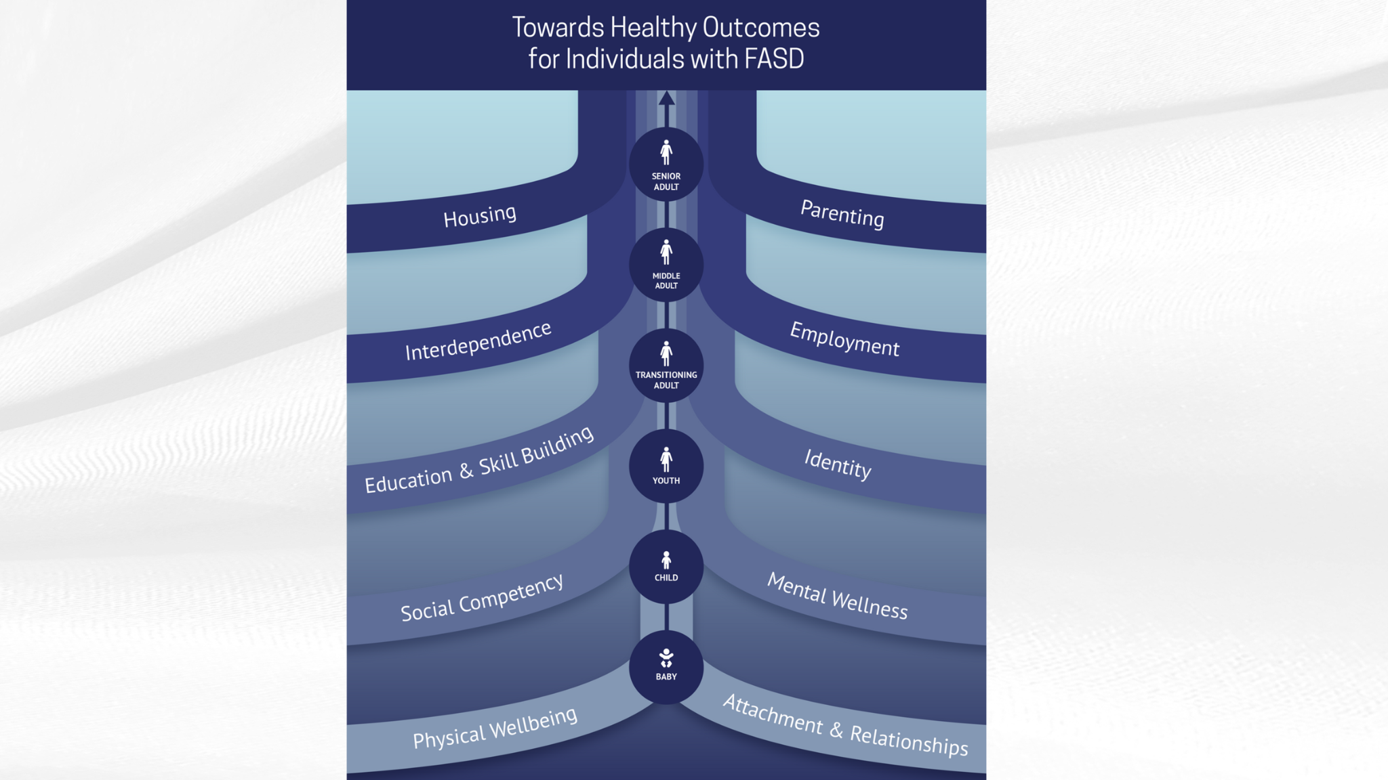
Interventions
Researchers have shown that interventions can improve cognitive (self-regulation, memory, attention), academic (math, language, literacy), behavioural, and social skills in individuals with FASD. Caregiver programs and supports also show promise.
Opportunities for skill growth
Meaningful success
Promote
well-being
Optimize opportunity
Implement Interventions
Notes:
The Towards Healthy Outcomes (THO) was introduced earlier in the Foundations presentation.
THO provides a strengths-based, evidence-informed approach to intervention across the lifespan for individuals with FASD. It was developed by CANFASD in collaboration with researchers, caregivers, and individuals with lived experience to support proactive, individualized planning and service delivery.
THO is structured around multiple domains of healthy functioning that are considered important for overall well-being and success.
One of these key domains is Education and Skill building, which is directly relevant to our work in schools.
Although THO was designed primarily as an intervention framework with the intention of guiding individualized supports and services, it provides a useful conceptual roadmap for understanding how educational planning fits into the broader context of lifelong well-being for individuals with FASD.
Within the Education and Skillbuilding Domain the following is recognized:
identifying and building on individual strengths;
supporting the development of academic and adaptive skills
tailoring instruction and supports to match the student’s profile and developmental needs; and promoting opportunities for skill generalization across settings.
As WRAP coaches, you play a key role in helping students with FASD develop competencies that contribute to healthy outcomes. Not just academically but in their ability to participate meaningfully in school, community, and later life.
The THO framework reminds us to think holistically, to coordinate with caregivers and other systems of support, and to use assessment and intervention planning (such as IPPs/IEPs) in ways that connect educational supports with broader healthy functioning goals.
THO - including the Education & Skillbuilding Domain can be found here: https://canfasd.ca/wp-content/uploads/publications/Towards-Healthy-Outcomes-2.0.pdf

Slide 45
Consistency
within a school
01
Principles of Practice
Collaboration
Between schools and school staff
02
Responsiveness
Between school staff and an individual and their family
03
Proactivity
By school staff
04
Notes:
Four overarching principles of practice can be used as a helpful way to frame intervention approaches
1. Consistency – within a school requires:
Establishing a common understanding of FASD shared by all staff
Using common messages and approaches to providing services
Minimizing staff turnover and building relationships
Maintaining system structure and stability
2. Collaboration – between schools and school staff requires:
Integrated response systems at all organizational levels
Organizational support for complex case management
Intentional planning between types of services and levels of service delivery
3. Responsiveness – between school staff and an individual and their family requires:
Balance between dependence and independence
Expectations that are unique to individual strength, needs, and culture
Supportive and adaptive environments to facilitate skill development
4. Proactivity – by school staff requires:
Early intervention to develop positive behaviours
Consideration of individual control and success-focused trajectory
Planning for transition periods

Slide 46
Framework of Practice
Reconceptualizing practice as evolutionary
Developing alternative strategies
Intentional Actions
Learning about dynamic influences
Assimilate Ideas
Reflective Thinking
Notes:
These principles of practice underlie a framework of practice that drive classroom strategies for students with FASD.
Intentional Actions – Using actions based on the student’s needs, their environments, and necessary supports to achieve desired learning and developmental goals.
As a team, we really need to ensure the intervention is geared towards the individual student and make a whole team effort to implement that intervention to achieve a specific goal. ​
Reflective Thinking – Using evaluation, assessment, and explanations in reflection.
This means that after we implement an intervention, we come back and reflect on whether the intervention worked. If it didn't work, we scrap that intervention and move on. Failure is OK. Fail means our First Attempt In Learning. ​
Assimilation of Ideas – Using reflection to influence future decisions.
Reflecting on what's working can help us in choosing future goals and future interventions.

Slide 47
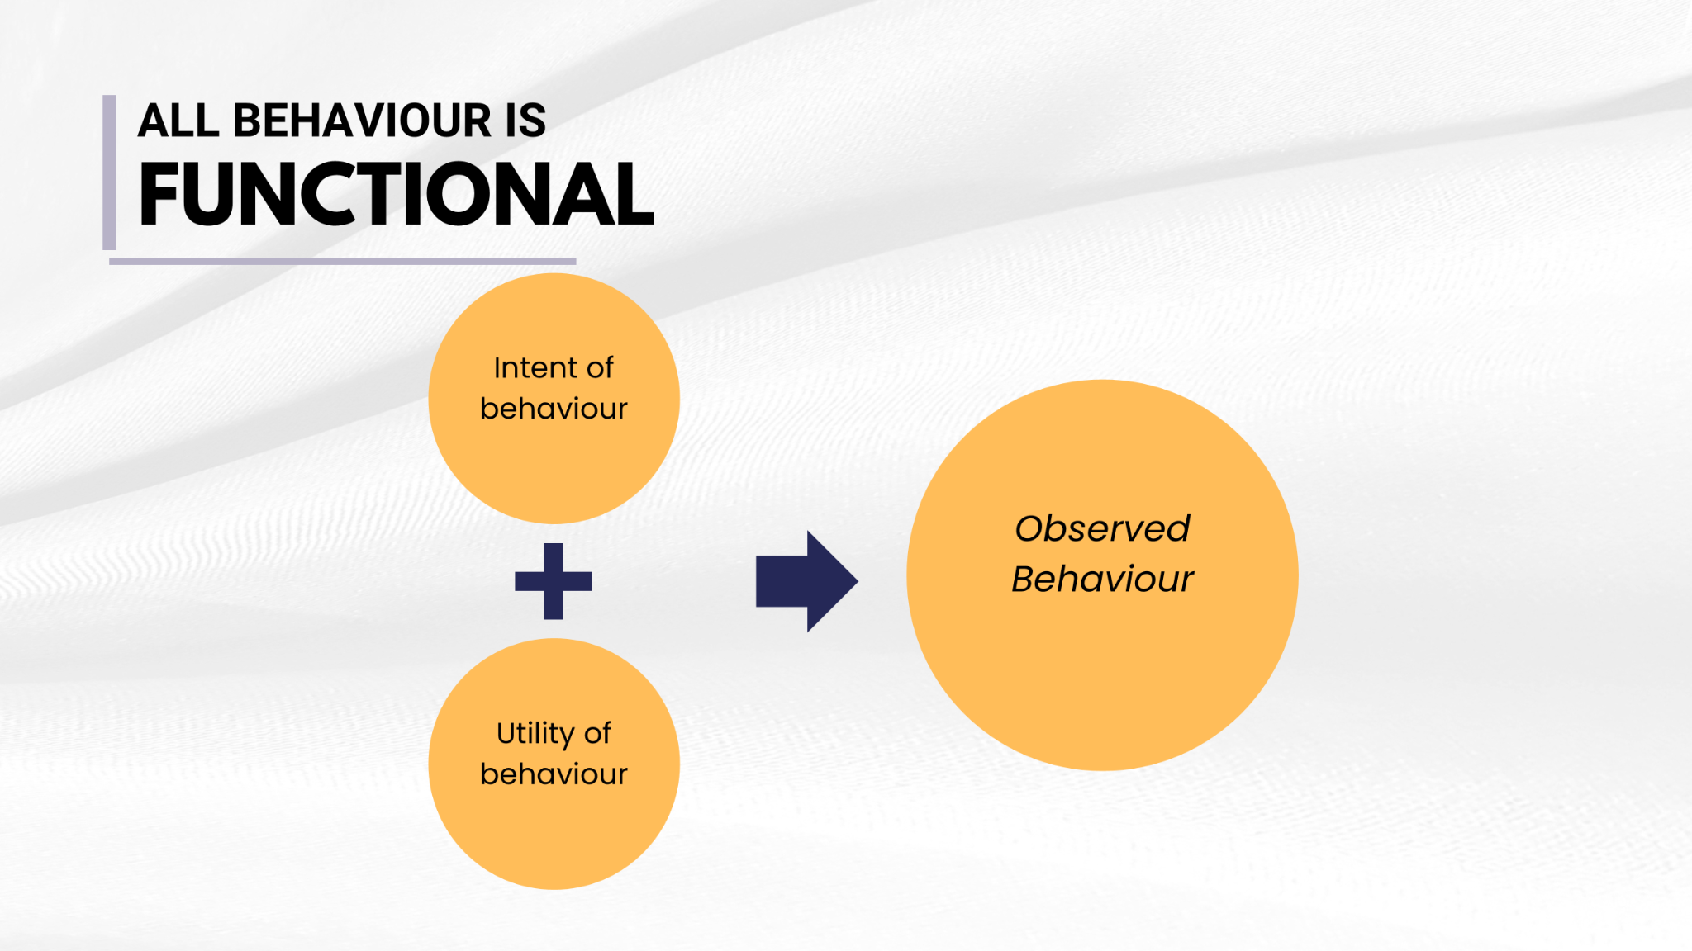

It may seem like they just can’t sit still but in reality they are overstimulated and overwhelmed
Provide opportunities to develop skills to better regulate emotions.
It may seem like a student is stealing when in reality they may have a lack of understanding of boundaries or ownership Provide opportunities to have ownership
Brain not Blame
It may seem like a student is deliberately lying, but they may be using storytelling to cover up memory problems.
Stay calm and ask more concrete questions to get to the “truth”
Notes:
It’s important that we understand that we as other people can only see the observed behaviour; what is missing (usually) are the underlying intentions around the behaviour, along with its usefulness.
We might not fully understand why someone is late to a counselling/WRAP appointment with us, or why a stranger yelled at us when we parked our car.
But we especially won’t be able to understand when we look at their behaviour and don’t consider what might be underlying it.

Slide 48
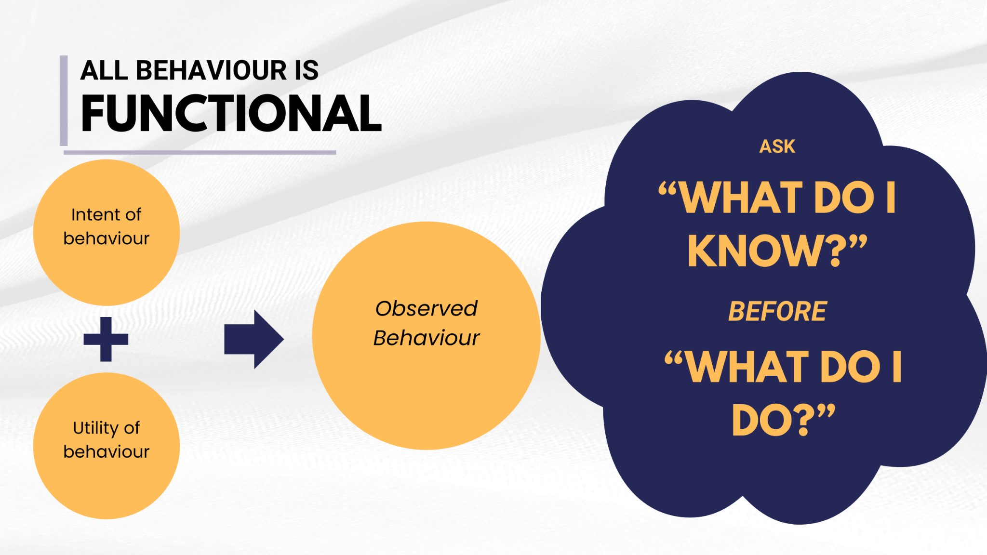
It may seem like they just can’t sit still but in reality they are overstimulated and overwhelmed
Provide opportunities to develop skills to better regulate emotions.
It may seem like a student is stealing when in reality they may have a lack of understanding of boundaries or ownership Provide opportunities to have ownership
Brain not Blame
It may seem like a student is deliberately lying, but they may be using storytelling to cover up memory problems.
Stay calm and ask more concrete questions to get to the “truth”
Notes:
And we certainly won’t be able to develop that understanding of the underlying causes of behaviour when we then jump right into thinking: What do I do? How do I solve this problem?
When we do that, we are likely to miss two crucial underlying pieces of information:
The underlying intention or the “why” behind the behaviour and
The function of the behaviour, or the need the behaviour is meeting.
Understanding the underlying causes of behaviour makes our lives easier. We can take a moment to pause before moving into action and first ask ourselves, “What do I know” about this person, this situation, this behaviour?
It gives us some space to understand the behaviour. It provides more information that will be super useful when it's time for us to begin considering solutions.

Slide 49

It may seem like they just can’t sit still but in reality they are overstimulated and overwhelmed
Provide opportunities to develop skills to better regulate emotions.
It may seem like a student is stealing when in reality they may have a lack of understanding of boundaries or ownership Provide opportunities to have ownership
Brain not Blame
It may seem like a student is deliberately lying, but they may be using storytelling to cover up memory problems.
Stay calm and ask more concrete questions to get to the “truth”
Notes:
By shifting our initial thinking from “what do I do” to “what do I know”, we are setting ourselves up to think about the situation from a mindset of curiosity and openness, which helps to inform our understanding and way forward, rather than jumping into judgment and action.
When we can think of ourselves as explorers or scientists who are curious about what we are seeing, we can approach situations with openness and understanding.

Slide 50

Brain
Understanding
Behaviour
NOT
As educators, we know, particularly for our students with complex needs, behavior can become their primary means of communication. It is important to remember all behaviour serves a purpose.
Blame
Notes:
In order to implement interventions effectively, we need to shift our mindset around behaviour. As educators, we know, particularly for our students with complex needs, behavior can become their primary means of communication. It is important to remember all behaviour serves a purpose.
All behaviour is goal-oriented, meaning that is functional and serves a purpose.
It may be difficult to determine the “reasons” behind the challenging behaviour
Instead of focusing on the resistive behaviour, explore what the goal is, the obstructions and how to use their strengths to achieve the goal
When trying to understand the behaviours, consider alternative explanations
We need to shift our thinking towards a brain not blame mindset.

Slide 51
A student with FASD isn’t “showing off”, they may be seeking acceptance or seeking attention
Provide positive attention
It may seem like they just can’t sit still but in reality they are overstimulated and overwhelmed
Provide opportunities to develop skills to better regulate emotions.
Brain not Blame
It may seem like a student is lazy or not trying. In reality they may be trying hard, tired of failing, or can’t get started.
Set more realistic expectations to help students achieve goals
Notes:
A student with FASD isn’t “showing off”, they may be seeking acceptance or seeking attention. We may be able to support them by providing positive attention
It may seem like they just can’t sit still but in reality they are overstimulated and overwhelmed. We can provide opportunities to develop skills to better regulate emotions.
It may seem like a student is lazy or not trying. In reality they may be trying hard, tired of failing, or can’t get started. We can set more realistic expectations to help students achieve goals.

Slide 52

The Shift
From seeing child as:
To understanding child as:
Bad
Lazy
Lies
Doesn’t Try
Mean
Doesn’t Care, Shut Down
Refuses to Sit Still
Fussy, Demanding
Resisting
Trying to Make Me Mad
Trying to Get Attention
Acting Younger
Thief
Inappropriate
Not Trying to Get to the Obvious
Frustrated, Defended, Challenged
Tries Hard
Confabulates/Fills In
Exhausted or Can’t Start; Tired of Always Failing
Defensive, Hurt, Abused
Can’t Show Feelings
Overstimulated
Oversensitive
Doesn’t Get It
Can’t Remember
Needing Contact, Support
Being Younger
Doesn’t Understand Ownership
May Not Understand Properties
Needing More Reteaching
Notes:
We need to shift how we see students with FASD from willful to identifying the behaviour you are seeing.

Slide 53

Personal and Professional Shift
Personal shift from:
To feelings of:
Hopelessness
Fear
Chaos, Confusion
Anger
Power Struggles
Frustration
Exhaustion
No Good Outcomes
Isolation
Hope
Understanding
Organization, Meaningfulness
Reframing Perceptions, Defusing
Working with, Rather than at
Trying Differently, Not Harder
Re-energized, New Options to Try
Seeing, Supporting Strengths
Networking, Collaboration
Notes:
Then we may also see a personal shift from feelings of:
Hopelessness to feelings of hope
Feelings of fear to feelings of understanding
Exhaustion to feelings energized and having new options to try
Using tools like:
Reframing perceptions, defusing anger
Working with rather than working at the student
Trying differently not trying harder
Seeing and supporting strengths
Networking and collaboration
And we will see a professional shift from traditional approaches with traditional interventions and consequences aimed at changing people to ourselves being able to recognize brain differences, prevent problems, develop effective strategies, and focus on changing environments.

Slide 54

“
…getting information from the FASD worker has allowed me to see signs in a lot of kids and given me tools in the toolbox for my daily practice with kids. Ignorance is bliss but when you know things, you can try them; if I don’t know them, I will just assume they are having a bad day.
- Teacher
”
54
http://www.kpdsb.on.ca/assets/uploads/FASD/FASDFinalReport.pdf
Notes:
http://www.kpdsb.on.ca/assets/uploads/FASD/FASDFinalReport.pdf

Slide 55

Leveraging Strengths
Supporting Students
Unique Needs and Strengths
Unique Environment
Notes:
As we mentioned above, each individual with FASD is unique and will have their own strengths and challenges. Students with FASD are consistently underestimated because they often struggle in areas where ability is traditionally measured, like reading, spelling, and math. Being in an environment where strengths are celebrated can transform the learning experience.
Educators should recognize and celebrate these strengths of students with FASD and provide opportunities for learners to use and build on their strengths.
Strengths Among Individuals with FASD is a report from the Canada FASD Research Network that highlights the unique personal, relational, and community strengths of individuals with fetal alcohol spectrum disorder (FASD), offering a strengths-based perspective to inform practice, policy, and support. The report can be accessed here: https://canfasd.ca/wp-content/uploads/2018/10/Strengths-Among-Individuals-with-FASD.pdf

Slide 56

Clearing the Clouds
By Melissa Dobson
https://www.youtube.com/watch?v=xOEiEjxlxnU
Notes:
Clearing the Clouds is a short film by Melissa Dobson, a caregiver who describes her experience of learning more about her child’s strengths and needs (4:02). https://www.youtube.com/watch?v=xOEiEjxlxnU

Slide 57





Personal Strengths
Caring with a strong sense of justice
Friendly and outgoing
Helpful and keen to please
Non-judgemental
Energetic
Notes:
For individuals with FASD, personal strengths may include:
Being helpful and keen to please​
Give them roles within the class which allow them to do this successfully​
Phrase tasks as a request, use suggestions or weighted choices, rather than phrasing it as a demand but ensure they have a clear understanding of their role and the task itself
Sometimes individuals with FASD can appear objectionable if they’re told to do something but will comply if asked for their cooperation instead​
Explain why the task is important rather than responding with “because I said so”
Being caring with a strong sense of justice​
They often want to help people who are upset or sad, especially if someone seems vulnerable​. Support them by:
Discussing socially appropriate ways to show care in different situations
Being non-judgemental​
They tend not to judge, reject, or bully those who do not fit the social norm​ and often choose friends who have complex needs of their own:
Support them in recognizing healthy friendships, strengthening them, and keeping them
Friendly and Outgoing​
They may be well known across the school community for their ability to speak to anyone and everyone​
Teach appropriate social skills, what information to share about ourselves, and what information to not​
Patient with and Interacts Well with Younger Children, the Elderly, and/or Animals​
Look for opportunities to work with younger children such as working with a school club or coaching a sports team​
Energetic​
They may be hands-on, concrete, active learners​. Support them by:
Provide movement-based learning tasks​
Ensure the task is simple, clearly explained, and finite
References:
Flannigan, K., Wrath, A., Ritter, C., McLachlan, K., Harding, K. D., Campbell, A., ... & Pei, J. (2021). Balancing the story of fetal alcohol spectrum disorder: A narrative review of the literature on strengths. Alcoholism: Clinical and experimental research, 45(12), 2448-2464. https://doi.org/10.1111/acer.14733
Kautz-Turnbull, C., Adams, T. R., & Petrenko, C. L. (2022). The strengths and positive influences of children with fetal alcohol spectrum disorders. American journal on intellectual and developmental disabilities, 127(5), 355-368. https://doi.org/10.1352/1944-7558-127.5.355

Slide 58





Learning Strengths
Hands on, concrete learner
Lateral thinkers with points of insight in certain areas
Athletic, sporty, creative, or musical
Persistent, determined, and hardworking
Excellent long term visual memories
Notes:
For individuals with FASD, learning strengths may include:
Hands-On, Concrete Learners​
They learn best when they can interact with actual object or items to help their learning​
Learners may need support to transfer learning from one context to another​
Lateral Thinkers with Points of Insight in Certain Areas​
Often have creative solutions or unusual insights​. Support them by:\
Encouraging them to think about and explain their thinking (metacognitive strategies)​
Praise their insights​
Athletic, Sporty, Creative, or Musical​
Build opportunities for the learner to share their skills and possibly teach others​
Encourage social skills, body movements, creative skills and organizational skills
Persistent, Determined, and Hard-Working​
Their determination to keep trying can be a positive attribute if channelled correctly. Support them by:
Ensuring that the task is of the right level and length to be completed​
Giving clear visual indications of time remaining​
Strong Long-Term Visual Memories​
People with FASD are often visual learners​. Support them by:
Breaking tasks into visual steps​
Allowing learners to record information in a way that suits their visual learning styles

Slide 59



Individualized Program Plans (IPPs)
Actively involve caregivers in the process
Actively involve students
(with FASD) in the process
59
Notes:
In Alberta, an IPP is a written commitment of intent by education teams to ensure appropriate planning for a student with identified learning needs, including students with FASD.
An IPP is also known as Individualized Education Plans (IEP), Instructional Support Plan (ISP), or Positive Behaviour Support Plan (BSP/PBSP).
They are working documents and records of student progress.
IPPs are really important because they provide the opportunity to assess students’ unique needs and their skill levels and will establish realistic goals for the student that can promote academic and behavioral functioning.
IPPs are working documents, meaning they are reviewed and updated regularly to reflect progress, changing needs, and new assessment information.
Effective IPPs are informed by comprehensive assessment data and observations across settings, not just a single test or report.
For students with FASD, assessment information is especially important to help education teams set realistic and achievable goals that reflect brain-based differences rather than age or grade-based expectations.

Slide 60

Additional IPP Resource
Proof Alliance developed an FASD-specific IPP (IEP) guide for families, caregivers, and educators.
The guide supports individualized, brain-based planning rather than one-size fits all accommodations.
The guide supports aligning goals, accommodations and strategies with how students with FASD learn and function.
This resource can be found here: https://www.proofalliance.org/wp-content/uploads/2021/11/Supporting-Students-with-FASD.pdf
Notes:
The Proof Alliance resource is designed to support more effective IPPs/IEP development for students with FASD.
It helps teams move beyond behavioural interpretations and instead focus on brain-based differences that affect learning, regulation, memory, and daily functioning.
The guide offers practical considerations for setting realistic goals, selecting meaningful accommodations, and promoting consistency across school and home.
It can be used collaboratively by educators and caregivers to create IPPs that are strength-based, preventative, and responsive to the student’s needs.

Slide 61

Additional IPP Resource
Article: FASD-Informed IEPs/IPPs by Healthy Minds Consulting
Focus on brain-based, FASD-informed planning.
Support realistic goals, environmental accommodations, and consistency across settings.
This resource can be found here: https://www.healthymindsconsulting.com/fasd-informed-ieps/
Notes:
This resource focuses on creating FASD-informed IPPs/IEPs that reflect how students with FASD learn and function, rather than relying on typical developmental expectations.
It reinforces the importance of viewing challenges as neurological, not motivational or behavioural, which aligns well with Alberta’s emphasis on individualized, strength-based planning.
The article highlights the need for realistic, achievable goals, recognizing that progress for students with FASD may be uneven and context-dependent.
A strong emphasis is placed on environmental accommodations, predictability, and adult responsibility for adjusting expectations and supports.
The resource also underscores the importance of consistency across home and school, collaboration with caregivers, and ongoing review of the IPP as a working document.

Slide 62

“
What is ‘appropriate’ for each student is subjective. [I] have had many conversations with educators arguing that my children will not be able to understand so much of the discussion [around IPPs], but they insist they take part and then we have an overwhelmed child/teenager
…
62
FASD Educator and Caregiver, Personal Communication, July 2021
Notes:
FASD Educator and Caregiver, Personal Communication, July 2021

Slide 63

With the caregiver, it would be so much more beneficial if the educator could go to the parents home or meet them outside of school to go over the IPP. We have many parents who get a lot of anxiety going into to sign the IPP and often they do not even remember it.
– Caregiver
”
63
FASD Educator and Caregiver, Personal Communication, July 2021
Notes:
FASD Educator and Caregiver, Personal Communication, July 2021

Slide 64

SECTION 4
Accommodations
TOPICS:
Instructional
Assessment
Environmental
Transition
64
Notes:
You can implement instructional, assessment, environmental and transition accommodations to support students with FASD to succeed in school. When considering accommodations, you can refer to the UDL guidelines to provide multiple opportunities for engagement, representations, and action and expression.

Slide 65
Instructional Accommodations
Assessment Accommodations
Environmental Accommodations
Possible Classroom Accommodations
Transition Accommodations
Notes:
Instructional
Assessment
Environmental
Transition

Slide 66

Instructional Accommodations
Notes:
We will talk about this more in a few slides, but instructional accommodations may include:
Give short, clear, instructions with key information
Give instructions in small steps rather than all at once
Provide think and response time – several minutes may be needed
Check that the student understood the instructions
Provide a breakdown of tasks with visual and tactile clues
Provide initial support on assignments
Allow extra time to finish assignments
Provide concrete and tactile manipulative that can be used to support learning
Use visual strategies like visual structuring
Provide opportunities for multisensory learning
Can you think of any other instructional accommodations that you could provide?

Slide 67

Assessment Accommodations
Notes:
Assessment accommodations may include:
Alternative methods of assessment, like demonstrations, projects, or verbal assessment instead of written tests
Allowing notes and or other resources to be used
Allowing students the option to use concrete and tactile manipulatives
Checking that students understand the purpose of and process for assessment
Allowing extra time to complete tests
Provide simple and non-stimulating notes
Allow regulation strategies and tools to be used during assessment time
Can you think of any other assessment accommodations that you could provide?

Slide 68







Environmental Accommodations
Visual
Tactile
Routine
Movement
Auditory
Boundaries
Calming Spaces
Notes:
Environmental accommodations will be reviewed further in Presentation 3, but these include:
Optimising/minimizing the visual environment
Maintaining a routine to minimize change
Providing auditory or tactile accommodations
Incorporating movement breaks into the schedule
Delineating spaces with visual boundaries
Providing calming spaces where individuals can go to regulate their emotions

Slide 69

“
[Training] has given me lots of ideas and strategies and how to make accommodations for the students and from that I've noticed some benefits, like the use of headphones to block out distractions when the student is doing independent work; [and] little things in the day-to-day routine that could throw a child off, like having a visual schedule so they know what is coming up and know what is expected of them.
– Teacher
”
69
http://www.kpdsb.on.ca/assets/uploads/FASD/FASDFinalReport.pdf
Notes:
http://www.kpdsb.on.ca/assets/uploads/FASD/FASDFinalReport.pdf

Slide 70





Transition Accommodations
01
Forewarn (or frontload)
02
Anticipate
03
State
04
Act
Notes:
Transitions are any events that result in changes to relationships, routines, expectations, or roles. Transitions occur naturally throughout our lifespan and can be small (like transitioning from one class to another) or big (like transitioning from high school into adulthood).
Transitions happen frequently at school. They may look like transitioning between activities, from classroom to classroom, or between subjects. Transition times are periods of change. Students with FASD often thrive on routine, so transitions may create opportunities for dysregulation to arise. Helping students build self-regulation strategies and providing them with sensory tools that they can turn to during these periods is important.
Transition accommodations will be reviewed further in Presentation 4, but a key step in supporting transitions is preparing students for transitions between activities, subjects, and classrooms by:
Forewarn (or Frontload) – Alerting students a few minutes before an activity is over
Anticipate – Restate the change, expect resistance, wait a few minutes
State - tell student exactly what action is required next
Act – explain the immediate action that is required
Transitions: Tips and Strategies is a resource from the Saskatchewan FASD Outreach Program that offers practical tips for supporting students with FASD through transitions in school and daily routines: https://www.fasdoutreach.ca/resources/all/t/transitions-tips-and-strategies

Slide 71
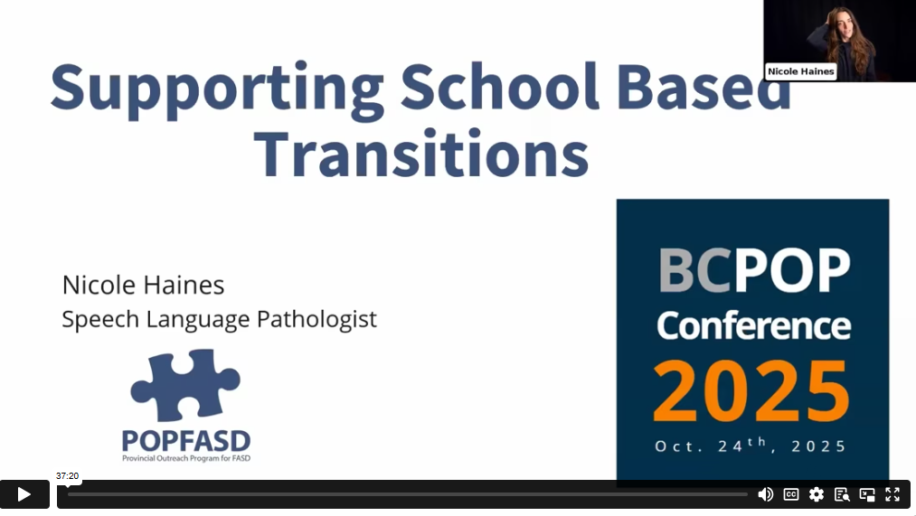
Supporting Transitions
by Nicole Hanes
Notes:
At the BCPOP conference, Nicole Hanes (SLP) presented on social, relational, and family supports, explored environmental accommodations, and considered the role of student agency and voice in the transition process. This video can be found here (37.17):
https://popcon.ca/talks/supporting-school-transitions-students-brain-based-differences

Slide 72

SECTION 5
Teaching Strategies
TOPICS:
All Subjects
Literacy
Math
Science
Art
72
Notes:
The following are various strategies that teachers can employ to improve learning for students with FASD. Strategies that are implemented should be developed through intentional practice, reflection, and assimilation and should be developed in consultation with the child’s support team.
There are lots of challenges and strategies reviewed in the next few slides. You do not need to state all the challenges and strategies as they appear. Feel free to pick and choose the ones that might be most applicable to your current audience (i.e. elementary vs high school teachers).

Slide 73






Gesture
Reduction
Rhyme
Rephrase
Visual Supports
Repeat
Simplify Instruction
Notes:
One of the most effective strategies is simplifying instructions to avoid cognitive overload. Often individuals with FASD need systematic and repeated instruction. Use strategies like:
Gesture
Point to the object your talking about or add in a gesture that symbolizes the function (i.e. drinking motion for a cup, opening a book to showcase textbook)
Rhyming
Simple rhyming phrases encourage memorization
Visual Supports
Use visual and verbal prompts, cues, aids, and demonstrations
If needed, start with physical guidance and gradually replace the physical guidance with gestures or picture cues, then eventually words
Show students pictures of what you want them to do
Use a highlighter to help students follow instructions by showing start and stop points
Demonstrate what you want them to do
Reduction
Reduce the amount of information in your instruction and break it into smaller pieces/more steps
Provide clear instructions that are simple and concrete.
Give instructions one step at a time
Rephrasing
State the direction or instruction in a different way (i.e. get ready for math = take out your math book)
Avoid using figures of speech, euphemisms, and sarcasm. Abstract language often is very difficult for students with FASD to understand
Repetition
Repeat the same instruction as needed
Give instructions in more than one way (i.e. visual or physical instructions that they can refer back to)

Slide 74





All Subjects
Differentiated Instruction
Belonging
Check Comprehension
Correction
Using Visuals
Notes:
Strategies that can be beneficial for all subjects include:
Differentiated Instruction
Fit the curriculum to the needs of the student
Adjust teaching methods, levels of support, and the resources
Link their specific developmental and academic levels to your expectations for them
Use multi-modal strategies (visual, auditory, tactile, kinesthetic).
For example, teach letters by having students draw, hear, speak, and create physical versions of their ABCs
Use hands on activities and concrete examples
Help students to recognize personal learning style and challenges
Plan learning activities based on strengths and interests
Plan learning activities based on strengths and interests
Building activities that they’re interested in and using creative teaching methods often helps keep students interested and on task
Help with the transfer of knowledge to other situations (generalizing)
Help students learn a skill by teaching it in the environment in which they are expected to perform the skill before having them apply it to other situations
Use sequential, repetitive teaching strategies which build on students’ prior knowledge base
Provide constant and close supervision as much as possible – they need to know someone is there to provide help as needed. Just being visible is often enough of a reminder to encourage students to stop and think about actions.
One-on-one or small group assistance
Use EAs and student peers to provide feedback where possible, but this should be done carefully and intentionally with informed student peers
Limit the number of questions you ask. Questions can often be abstract and difficult to answer.
Ensure a structured classroom and consistent routine
Belonging:
Adapt classroom activities to help students feel like they are meaningful contributors of the classroom and feel like they belong
Speak face-to-face with the student; use the student’s name
Patience and empathy are critical
Check Comprehension:
Slow the tempo and wait at least 10 seconds for students to process
Be concrete and specific. Non-compliance may mean the message was ambiguous.
Make sure students understand what to do and have them repeat it back in their own words, write it down, or ask the child to show you what needs to be done
Repeating something back does not always mean the student understands the task, even if they repeat it back in their own words. For some students, giving direction, cuing, and physical modelling are good options.
Help students to feel comfortable asking questions when they do not understand
Stop at key points to check in periodically with students to ensure that they understand the task
Correction
Model the rules, practice, teach, reteach, remind, model, practice
Create rules together
Rules/expectations should indicate what should be done rather than what shouldn’t be done
Instead of “don’t run” make the rule “walk”
Teaching the behaviour that we want is an excellent way to prevent incorrect actions in future
Use visuals, social stories, backwards chaining and cues to remind students of expected behaviours
Ensure they understand the rules (i.e. can they demonstrate the rule, do they know what it looks like or sound like?)
Avoid disciplining child for behaviours that are brain based (things they aren’t purposely doing wrong)
Positive, consistent, and immediate consequences to actions
Provide reminders of why consequences are there
Reinforce positive actions early by associating actions
Provide frequent feedback and evaluation
Helps give students a sense of accomplishment
Encourages you to have more contact with the student and build a better relationship
Using Visuals
Use lists for daily routine or daily work
Post information that you want students to remember on, or close to, their desk so that they can refer to it. This includes daily schedules, items that need to be taken home at the end of the day, etc.
Post visual reminders of routines or schedules up in the classroom
Use gestures and visual signals
Choose simple materials with illustrations
Use art to make abstract concepts more concrete.
For example, have students draw a picture to illustrate an abstract concept like “respect each other.” This will help them understand what this abstract concept means to them

Slide 75

“
I realized how skilled our daughter is at faking it: faking that she understands what is going on. If you go back and have a conversation with her, you find that what she says is completely skewed, how much she has learned to hide her lack of understanding.
– Caregiver
”
75
What Parents and Caregivers Need to Know – Manitoba
Notes:
What Parents and Caregivers Need to Know – Manitoba

Slide 76
F.A.R
4 Step Problem Solving
Sequencing Activities
Social Stories
Body Breaks
Specific Strategies
Notes:
FAR
FAR is a metacognitive strategy that supports increased self-regulation and reflection
Focus and plan - think with your brain and make a plan, look and listen carefully;
Act - do fun stuff and learn;
Reflect – ask what did you learn today?
4 Step Problem Solving
Use the 4-step problem solving technique to teach students with FASD how to reflect on behaviours. Ask:
Step one: Identify “What is the problem?”
Step two: Identify “What are my options?”
Step three: Choose 1 action
Step four: Ask the question “did it work”
Working through these simple steps with some visual cues for students with FASD might help them solve problems more independently
Sequencing Activities
Sequencing activities can help teach students with FASD to understand cause and effect.
For elementary students you can use pictures that can be taken apart mixed up and put back together in the right order
For high school students you can use the second step photo cards to help them think about what could happen next in pictures that show social situations
Social Stories
Social stories are powerful tools in teaching students what behavioural expectations are and how behaviour affects others. Social stories present the information you’re trying to teach in a first-person story format. Information or steps in a task should be broken down into simple sentences (i.e. sit at your chair; take out your math book). Little pictures or graphics might accompany the sentence to visually show the action that is required. Review the social story with the student before asking them to do a task.
Weebly.com. (n.d). FASD Toolkit. https://fasdtoolkit.weebly.com/social-stories.html
Allow for body breaks:
Physical movement can help people with FASD focus better. Build body breaks into your classroom schedule or your activities
Elementary - build in time for little physical activities like a dance break
High school - break into groups to add an element of movement to an activity

Slide 77

Literacy Challenges
Reading
Writing
Comprehension
Notes:
Common literacy challenges for students with FASD might look like:
Reading:
Learning sound/symbol associations
Reference resources that students need to use often have reading levels that are too advanced for students with a reading disability
May know sound of letter but not the name
Writing:
getting started, organizing thought and details in a sequential manner, knowing what detail to include, and putting them in written form
Difficulties with spelling, capitalization, and punctuation
Comprehension:
Understanding figurative language and some forms of humour
Identifying main ideas, making inferences, making predictions
By the intermediate grades, comprehension levels may plateau and students in secondary school frequently require adapted reading materials

Slide 78

Multimodal Learning
Speech, Language, Communication, and Social Skills
Comprehension
Literacy Strategies
Reading
Notes:
Multimodal Learning
Phonics as part of a literacy program
Picture walks
Looking at the photographs or illustrations in a story, to preview or introduce it prior to reading
Help student connect the visual images in the story to their own experiences and activate prior knowledge
Sets the purpose for reading and students can make predictions about what might happen in the story. As students make predictions, connections and set purpose, comprehension of the story is increased
Book walks – studying the front and back covers, table of contents, sample of pages, headings or bolded information, and illustrations in a text
Word wall
Experiential learning
Miscue review
Procedures that attempt to identify how reader process print by analyzing their oral reading errors
Focus on meaning
Building connections
Text-to-self
Text-to-text
Text-to-world
Start in strengths and progress to reading and writing in an integrated manner
Encoding and decoding assistance
Speech, Language, Communication, and Social Skills
Fewer and simpler words
Have student repeat instruction
Concrete social stories
Modeling
Role playing
Coaching
Dialoguing
Articulation support
Comprehension
Avoid using figures of speech, euphemisms, and sarcasm. Abstract language often is very difficult for students with FASD to understand
Reduce the amount of text and put few questions on a page
Where available, consult with a reading clinician
Stop at key points to check for comprehension
Recognize that students may not understand or may misunderstand complex language (i.e. negatives, passive verb construction)
Reading
Use a plain piece of paper to put under each line of reading material
Tape-record stories so students can listen and read along
Use a picture dictionary to aid in vocabulary development
Create key word and sight word cards for vocabulary building, phonetic strategies, etc.
Encourage students to develop a vocabulary card index
Enlarge font and spacing on academic worksheets
Use visual aids to accompany language messages

Slide 79

“
Be patient, very repetitive,
use many modalities. If it doesn’t work – try, try again. Create many varied experiences.
– Teacher
”
79
A Quick Guidebook for Schools – Lakeland Center – Heather MacFarlene
Notes:
A Quick Guidebook for Schools – Lakeland Center – Heather MacFarlene

Slide 80

Literacy for All Learners
by Dr. Shelby Pollitt
https://popcon.ca/talks/literacy-all-learners
Notes:
At the 2025 POPFASD CON Conference Dr. Shelby Pollitt presented “Literacy for All” and shared practical, evidence-based strategies to support literacy for students of all abilities. Link to video (55:41): https://popcon.ca/talks/literacy-all-learners
Other videos from the conference presentations related to literacy included:
Six Critical Actions to Promote Access for Text-to Speech Users with ARC-BC (52:30)
https://popcon.ca/talks/six-critical-actions-promot-access-tts-users-arc-bc
Re-Thinking Support: Connecting Language, Literacy, and Mental Health (51:43)
https://popcon.ca/talks/rethinking-support-connecting-language-literacy-mental-health
Supporting Language Comprehension for Students with Complex Needs
https://popcon.ca/talks/supporting-language-comprehension
Using Self-Regulated Strategy Development Support Writing for Students with Complex Needs:
https://popcon.ca/talks/using-self-regulated-strategy-development-srsd-support-writing-students-complex-needs

Slide 81

Math Challenges
What a number represents
Understanding math vocabulary
and symbols
Basic math skills
Memorising facts like multiplication tables
Confusion where to begin
Abstract concepts
Overwhelmed by information
Notes:
Challenges with math for people with FASD may look like:
No real understanding of what a number is and what it represents
Difficulty understanding math vocabulary
Confusion with multiple math terms for the same concept (addition, total, sum, all together, in all)
Confusion with math symbols, understanding and knowing the meaning of symbols
Difficulty with basic math skills
Difficulty memorising math facts
Unable to remember where to begin when working on a problem (left to right or right to left)
Challenges understanding abstract concepts like time and money
Before/After, Yesterday/Tomorrow, telling time and judging the passage of time
Names and values of coins, computing the value of a pile of change, knowing how much change to get back for a purchase, and judging the value of items
Overwhelmed by too much information on a page
Can you think of any other challenges?
Difficulty with number sequencing
They may be unable to quickly locate a page in a textbook
Inability to read, understand, determine the strategies needed to solve word problems
Confusion when to use a math operation or concept
Difficulty learning multiplication tables and other mathematical concepts

Slide 82

General
Basic Math Facts
Number Concepts
Spatial Direction and Organization
Problem Solving
Math Strategies
Computational Skills
Notes:
Allow extended time on quizzes or assignments
Be alert to the possibility of students freezing under the pressure of working fast in timed tests
Teach math at the student’s pace
Use consistent math vocabulary
Practice and more practice – overlearn
Students may need to practice math facts daily for short periods throughout the school year for the facts to come automatically
Make the math page user-friendly
Reduce the number of math problems on a page
Put all the problems of one kind on one page (i.e. only addition) and add different kinds of problems to the same page gradually
Keep a simple layout this reduces frustration, as well as visual distraction
Ensure manipulatives are readily available
Use visual and tactile strategies to help with retention of information
Basic Math Facts
Basic math facts can be hard for students to remember and recall
Use multiple strategies to remember math facts, like chanting, singing or drawing pictures
Have the student say the fact, write the fact, read the fact
Relate math facts to student’s life experience
Create a student store, post office or bank to practice basic computation
Concrete representations (including time and money). Focus on practical, functional math, such as flyers and other print materials from retail outlets are useful
Use cooking to practice fractions and measurement
Use a multi-sensory approach; this gives meaning to the rule and helps with remembering the rule
Use concrete objects/manipulatives to introduce basic math facts like unfix cubes, Cuisenaire Rods, Base 10, and blocks
Allow students to use tools like a calculator or a number line
Use computer program to practice math facts
Number Concepts
Students may be able to count, but the numerical concepts may not be understood. An important goal for the FASD student is to develop number concepts, including the concept of greater than or lesser than:
Use concrete materials when possible; making the connection between the manipulative and the number symbol
Use art projects to create numbers that students can see and feel – decorate with glitter, noodles, yarn, etc.
Use manipulatives: Unfix cubes, Cuisenaire Rods, Base 10, and blocks
Use a number line, fingers, or anything that works for the student
Use a vertical number line instead of a horizontal one. For students, increasing numbers mean going up - left to right might be too abstract.
Spatial Direction and Organization
Recognize that a student may be confused trying to understand left to right.
Use a highlighter to help the student know where to begin on a problem
Teach visual and verbal cues to remember where to start
Use graph paper to help with spatial organization (i.e use graph paper to keep columns and figures straight)
Use a column addition, double-digit multiplication, subtraction with regrouping, and long division
Problem Solving
Problem solving can be challenging for people with FASD because it requires making the abstract concrete. Strategies can include:
Include the student’s name in the word problem so they can relate it to their experience
Highlight key words in the problem
Helping students visualize the problem (i.e. draw a picture)
Use concrete objects, multi-sensory method, and group work
Provide cues and guide student to the conclusion/answer
When problem solving is leading to frustration, try putting it aside and try again later. It may be useful to revisit the information about the student’s strengths and challenges understand any barriers that may be impacting the student.
Computational Skills
Use regrouping
Processing Cards and checklists for sequencing

Slide 83
Example
6
5
Counting Up
Vertical Number Line
4
3
2
1
0
0
-1
-2
Counting Down
-3
-4
-5
-6
Notes:
Use a vertical number line instead of a horizontal one. For students with FASD, increasing numbers means numbers that are “going up”. Left to right orientation can be too abstract for students.

Slide 84

Science Challenges
Using Science Vocabulary
Recording, Interpreting, Discussing Observations
Mental Problem-Solving
Deduction and Inference
Manipulate Scientific Equipment
Understanding Oral Instructions
Conduct Experiments
Notes:
In science subjects, challenges may look like difficulty with:
Using/understanding science vocabulary
Demonstrating abilities in recording, interpreting, and discussing observations
Moving from computations with concrete materials to mental problem-solving
Problem-solving with an emphasis on deduction and inference
Using the fine-motor skills necessary to independently manipulate scientific equipment
High school: slide preparations, staining, adjusting mirrors, focusing, and orienting the image in the visual field
Understanding oral instructions/directions concerning what to look for
Conducting experiments

Slide 85

Reintroduce Information in New Contexts
Use Concrete Materials
Provide of Key Scientific
Concepts in Advance
Adapt the Pace
Science Strategies
Alternate Texts
Computer Programs
Notes:
Try to build on understanding by reintroducing information in new contexts with new sub-issues
Using concrete materials as examples of scientific ideas (i.e. models) may not only heighten motivation but also help concept formation
Use cooking and other food related activities to augment science curriculum outcomes
Foster personal involvement through the study of areas of science that directly affect the student, such as eating, the nervous system
Provide students in advance with organizers of key scientific concepts
Adapt the pace of activities
Use alternate texts at an appropriate reading level for the student
Use computer programs that provide opportunities for scientific practice and recording results
Be alert to the possibility of students freezing under the pressure of working fast in timed situations. Consider not assigning timed tasks. Assistance may be required with experiments where procedures are time limited (e.g. working with plaster that hardens quickly).
Secondary Students
By high school, part of the science curriculum can be too abstract and complex for some students with FASD. Some students might need an IPP that emphasizes practical/applied science at a very functional level
Find access points that still use the foundational knowledge of current class
Address potentially difficulties in the lab (i.e. difficulty reading lab manuals, and special adaptations for laboratory equipment) before students begin to tackle learning the science curriculum
Arrange for specialized adapted laboratory equipment, such as lower tables and specialized microscopes
Develop, post and/or provide material safety data sheets as well as safety checklists for use of any equipment

Slide 86

“
Children need hands-on, tactile learning. So, if you’re trying to explain the word ‘ball’, you’re not just going to use the word or picture, you're going to get a ball, you’ve got to feel the ball, you’ve got to bounce the ball, you’ve got to explore the whole concept of that.
– Parent
”
86
https://www.von.ca/sites/default/files/files/_fasdtool_fullproof_final_1.pdf
Notes:
https://www.von.ca/sites/default/files/files/_fasdtool_fullproof_final_1.pdf

Slide 87

Arts Challenges
Drama, Music, Visual Arts
Using Fine Arts Vocabulary
Sustaining Interest
Improvising
Space Issues
Gross and Fine Motor Skills
Remembering Lyrics or Notes
Sensory Stimulation
Notes:
Students with FASD may experience the following challenges related to learning arts:
Using/understanding fine arts vocabulary
Sustaining interest until the completion of a project
Improvising with materials, props, costumes, music, and voice
Space issues in music class, where they are expected to sit or stand in groups without clearly defined areas of personal space
Children with FASD may have significant delays in gross and fine motor skill development which can influence their acquisition of skills
Instruments can be challenging in their use and the noise they produce
Remembering lyrics or notes for songs may be frustrating
Sensory stimulation
Music activities may be too noisy and over-stimulating for some
Some visual arts media may not be as successful as others due to sensory issues

Slide 88
Art Opportunities
Music
Perceive, explore, communicate, and reflect on thoughts, feelings, images, and ideas
Transform images, ideas, and feelings into gesture and movement
Develop self-expression, co-operation skills, and appreciation of their own and others’ abilities
Enhance sensory integration and gross motor activities
Dance
Understand and appreciate the differences between people
Appropriate outlet for personal and social development
Exploring and examining situations, experiences, and roles
Make choices, resolve conflicts, and take responsibility for one’s own actions in a safe and supportive environment
Drama
Create and experience the power of the visual image
Using scissors, creating collages, and colouring strengthen fine motor skills
Paper mache, using clay or plasticene can be very calming
Visual Arts
Notes:
Individuals with FASD are often very creative and artistic. Art often gives students with FASD another language they can communicate with and classmates can establish a sense of community and find commonalities with each other. Other opportunities include:
Music
Music can help students with FASD to perceive, explore, communicate, and reflect on thoughts, feelings, images, and ideas
Dance
Dance provides students with the opportunities to transform images, ideas, and feelings into gesture and movement
Dance education provides opportunities to develop their self-expression, co-operation skills, and appreciation of their own and others’ abilities
Dance can be used to enhance sensory integration and gross motor activities
Drama
Drama education provides students with opportunities for creative expression and to understand and appreciate the differences between people
Drama can be an appropriate outlet and important area for personal and social development
Role-plays, skits, and short plays are powerful instructional techniques for both exploring and examining situations, experiences, and roles
Used to make choices, resolve conflicts, and encourage recognizing responsibility for one’s own actions in a safe and supportive environment
Visual Art
Visual arts provide opportunities to create and experience the power of the visual image
Students with FASD may produce remarkable self-portraits and descriptive designs
Cutting with scissors, creating collages, and colouring strengthen fine motor skills
Paper mache, using clay or plasticene can address various sensory needs and be very calming for some students

Slide 89

Group Learning
Social Skills and Etiquette
Multi-Sensory Experiences
Label and Teach Concepts
Writing Words or Pictures for Songs
Art Strategies
Notes:
Here are some strategies that may work to teach art skills:
Provide students with co-operative and other forms of group learning
Teach the difference between appropriate and inappropriate social and interpersonal behaviours, communication skills, and work behaviours
Use multi-sensory experiences in activities
Provide direct teaching on social skills and etiquette for performance and audience (i.e. music and drama)
Foster personal involvement though the areas of fine arts that directly affect the student
Use consultants and support teachers for problem-solving and to assist in developing strategies for fine arts instruction
Use art to label and teach concepts like emotion
Provide written words or pictures for songs and notes

Slide 90

SECTION 5
Educator
Self Care and Wellness
TOPICS:
Self-Care and Wellness
Compassion Fatigue
90

Slide 91

Self-Care
and Wellness
Key areas of consideration:
Meaning and Caring Burnout
Compassion Fatigue
Vicarious Trauma
Ambiguous Endings
Professional Uncertainty
You cannot take care of others until you take care of yourself
Notes:
Working with students with FASD can be challenging but very rewarding. Teachers with a strong understanding of FASD report less burnout and compassion fatigue.
However, it is important to recognize the signs of burnout.
Five areas for consideration:
Meaning and caring burnout
Compassion fatigue
Vicarious trauma
Ambiguous endings
Professional uncertainty
Remember: you cannot take care of others until you take care of yourself. Develop the self-care skills and strategies you need to maintain personal, familial, emotional, and spiritual needs.
Seek support from a professional if needed.

Slide 92

Compassion Fatigue
May look like:
Losing confidence that you can make a difference
Changes to your feelings of being safe
Personal relationships are affected
Your world view changes, you question your decision to be a teacher
Feelings of dependency
Isolating yourself and feeling overwhelmed
Notes:
Know the signs of compassion fatigue:
You begin to lose confidence that you can make a difference
You experience changes to your feelings of being safe
Your intimate personal relationships are affected
Your world view changes, you question your decision to be a teacher, and your ability to make a difference
Your experience changes to a feeling of dependency
You begin isolating yourself and feel overwhelmed

Slide 93

SECTION 6
Examples
TOPICS:
MILE Program
93

Slide 94

General learning ability
MILE Program Strategies
Working Memory
Visual-Spatial Skills
Remediate underlying cognitive factors
Visuomotor/ Graphomotor Skills
Metacognition
Notes:
The Math Interactive Learning Experience (MILE) program is designed to address the academic and behavioural problems that children with FASD often experience. The program improved:
General learning ability​ by:
Slower pace of instruction​
Active learning​
Touch, talk, experiment​
Working Memory​ by:
Small pieces of info​
Rhymes/song​
Cues​
Repetition/practice​
Time for recall​
Visual-Spatial Skills​ by:
Tactile objects/manipulatives​
Guide visual attention​
Add structure to paper (graph paper; keeps columns in the right place)​
Vertical number line (as things get bigger they go up; left to right is abstract)​
Metacognition​ by:
“Great answer, how did you do that?”​
What strategy did you use?”​
“What do you think you need to do here?”​

Slide 95
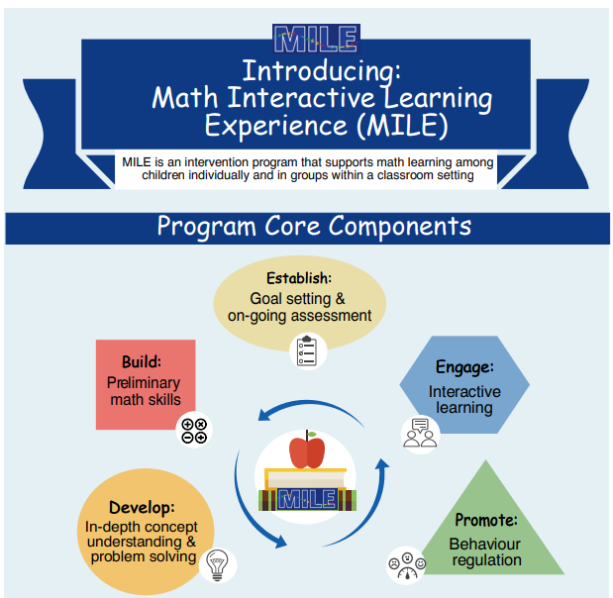
Math Interactive Learning Experience (MILE)
Notes:
Researchers and educational stakeholders have continued to evolve the MILE Program.
Additional information about the program based on the infographic presented here and in the next two slides includes:
MILE is an evidence-informed math intervention designed to support learners who struggle with traditional math instruction.
It focuses on how students think about math, not just whether they get the right answer.
The program integrates cognitive skill development, engagement, and behaviour regulation.
MILE can be used individually or in small groups within classroom settings.
Link to Infographic:
https://canfasd.ca/wp-content/uploads/2018/06/MILE-Infographic-3.0.pdf

Slide 96
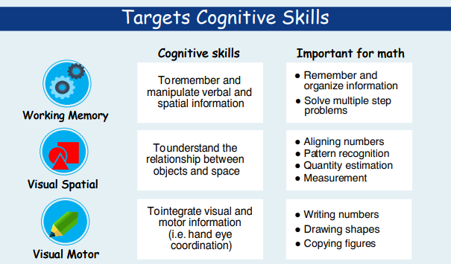
Notes:
MILE targets key cognitive skills that are essential for math learning, including working memory, visual spatial processing, and visual motor integration.
These skills are often areas of difference for students with FASD and other brain-based differences.
Strengthening these skills supports tasks such as multi-step problem solving, number alignment, and understanding quantity.
The focus is on building capacity rather than remediating deficits.

Slide 97
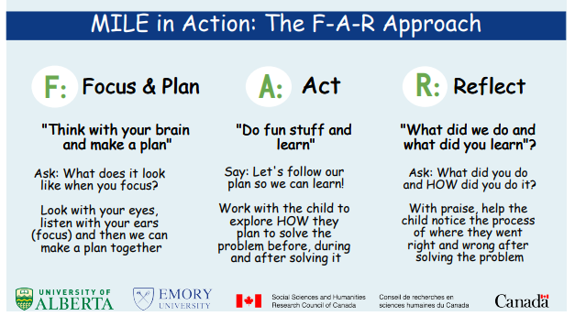
Notes:
The F-A-R approach teaches students to Focus and Plan, Act, and Reflect during math tasks.
It makes thinking and problem-solving processes explicit and concrete.
Adults guide students to notice how they approached the task, not just the outcome.
This supports metacognition, self-regulation, and confidence in learning.

Slide 98

Math Interactive Learning Experience
by Carmen Rasmussen
https://www.youtube.com/watch?v=2ZWjCch6JSM&t=3s
Notes:
A video about MILE can be found here: Carmen Rasmussen – The Math Interactive Learning Experience (MILE) Program
https://www.youtube.com/watch?v=2ZWjCch6JSM&t=3s

Slide 99

SECTION 7
Review
TOPICS:
FASD
Strategies
99

Slide 100

Foundations Review
FASD is a lifelong and complex disability
Each person is unique and has different strengths and challenges
Protective factors can reduce the risk of adverse outcomes
Inclusivity requires knowledge of FASD, communication and collaboration, and a ‘no blame, no shame’ approach
School staff should be
FASD-informed
Intentional action, reflective thinking, and assimilation of ideas

Slide 101


Classroom Strategies Review
Simplify instruction where possible
Modified teaching strategies can help students succeed
There are strategies that can be used for specific subjects based on the unique challenges each subject presents
Accommodations may be necessary to help students with FASD reach their full potential
There are teaching strategies that can be used for all subjects

Slide 102

WRaP Blog
wrap2fasd.org
FASD Networks in Alberta
fasdalberta.ca
CanFASD
canfasd.ca

Slide 103

Break
Slide
Take a short break

